Slide 1
Patient Pre-Screening for Clinical Trials: A Piece of the Puzzle
Alicia Roy, B.A.
Research Health Science Specialist
Herta Chao, M.D. Ph.D.
Attending Physician
Associate Professor of Medical Oncology
VA Connecticut Healthcare System
Yale Comprehensive Cancer Center

Slide 2
Learning Objectives
Describe the purpose and design of implementing a Pre-Screen Protocol for Clinical Trials
Describe how pre-screening can enhance the quality of care for patients
Discuss how pre-screening can improve a research program’s operational efficiencies

Slide 3
Life as a Cancer Doc at a VA clinic without Patient Pre-Screening Protocol
It is almost 8 am and you are getting ready to start a full clinic with precepting 4 first year fellows in addition to your own clinic; “Shall I get coffee or shall I review the lists for possible study patients?” => COFFEE!
It is 10.30 am Mr. Smith comes for f/u. The scans ordered by a previous fellow show progression of lung cancer. You think of a clinical trial that is open at your VA but cannot remember all the eligibility criteria. Mr. Smith and his family are anxious to get started on new treatment. You have no time to review the protocol since you have orders to review and sign, 2 fellows and your 10 am patient waiting for you => you give Mr. Smith info about standard of care Tx and plan to review the protocol later…
It is 7 pm you are thinking about checking the protocol but still have 8 notes to write and your spouse is checking whether you plan to attend dinner => “Doesn’t Mr. Smith have psoriasis or something like that? He would probably not qualify for the clinical trial…”

Slide 4
VA Connecticut Cancer Center Pre-Screening Protocol (PSP) – Why to consider it and how does it work?
Trial Diversification
Patient Recruitment
& Retention
Multi- Disciplinary
Patient Awareness & Education
Good
Clinical Practice
Regulatory
Patient Identification
Quality
Assurance
Communication with Providers
Data standards
& security
Clinical
Trial
Selection
Notes:
Pre-screening potential patients for a clinical trial is common practice at most research sites.
Saves time by quickly identifying subjects who may qualify prior to having them signed the study specific informed consent.
However, at the VA we should be getting approval for this process if this process will be done by anyone other than the patients provider.
Understanding Your Research Program/Clinic/Trials:
Patients Needs
Providers time, interest and engagement
Smart Clinical Trial Selection
Staffing time and Effort
Facility Needs (e.g., Cost savings due to drug provided)
Clear plan of how to identify patients for trial and optimal timing of when patients should be identified
Understanding inclusion/exclusion criteria and ability to identify similarities (selecting the right variables)
Identifying the needs of your Research Program
What resources do you have available?
How large of a program do you currently have?
Evaluating & Identifying Areas of Improvement – patient identification and tracking for trials
Anticipating growth of your program/clinical trials portfolio
After evaluating our program, we identified a number of issues. For example:
* missed patients due to strict timeline for enrollment
* rushed efforts to enroll patients
* studies that required patients that were not known to the clinic
* pressure on attendings to identify potential patients and to remember I/E criteria for active trials
* basic tracking systems in place and duplicated efforts
Therefore, we saw that we had a need for a PSP

Slide 5
Purpose of the PSP
Establish a standardized pre-screening process and infrastructure that will facilitate the recruitment of prospective cancer research participants for all trials within the VA CT Cancer Center and Yale Cancer Center/School of Medicine.
Reduce the overall screen failure rates by conducting pre-screening for all trials simultaneously.
Increase operational efficiencies.
Increase Veteran awareness and participation in cutting edge studies.
Pre-screening process is clearly outlined, approved and audited by IRB; no “secret” screening of charts.
Notes:
Reduced the overall screen failure rates by excluding patients before trial screening takes place (e.g., performance status, comorbidities, etc.)
Increased operational efficiencies:
reduce time for patients
reduce staffing resources – allows non-medical team to assist with pre-screening potential patients
Reduce cost
organized tracking and reporting:
Easy retrieval of information when you need it
Quick updates
Form of communication between research team
Increase patient awareness – timing is everything. Introduce trials to patients sooner give them other treatment opportunities-- ‘cutting edge’ studies.
No longer crossing that ‘gray area’

Slide 6
PSP for Cancer Trials
No informed consent needed for PSP
Many Cancer trials share common screening methods and eligibility criteria
Standardized limited chart review; only pertinence information needed to determine eligibility will be captured
PSP would allow to build a platform to identify potential study participants early and follow them efficiently
Notes:
Since this is a medical chart review, no informed consent is need since the information collected will not be used for anything except to identify potential patients and for tracking and reporting purposes.

Slide 7
PSP for Cancer Trials
New patients identified through consults, tumor boards, cancer tracking system
Providers are alerted BEFORE a potential study patient is seen in clinic
PSP permits use of invitation letters, e.g., smoking cessation study; patients can reply with opt-in or opt-out postcards
Data will be collected and managed using REDCap™ (Research Electronic Data Capture), hosted by the VA Information Resource Center (VIREC)
Notes:
Track pre-screening efforts – what resources are more beneficial when looking for targeted population.
Takes the pressure off of attendings; second pair of eyes to catch potential patients
For patients not known to our clinic, we have other avenues of alerting them to research (e.g., their primary care providers, invitation letter); no cold calling occurs

Slide 8
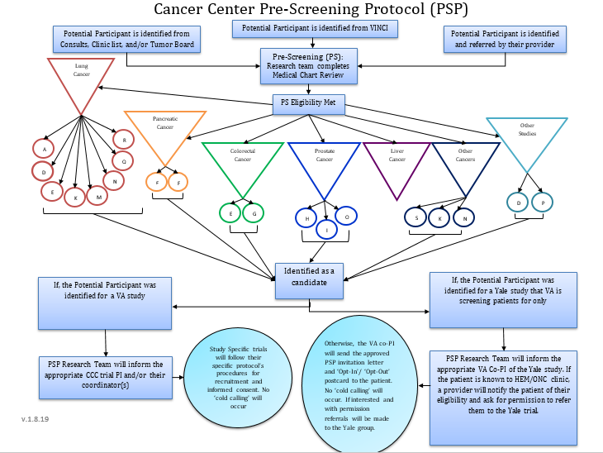
Notes:
Pre-Screening is broken down into two types:
Partial Pre-Screen
Full Pre-Screen
Will discuss the differences shortly
This protocol allows non-medical staff to assist with pre-screening potential patients for clinical trial, will discuss patients with PI or other attendings.
Allows us access to a number of different ways to reach these patients
Assist with studies outside the VA – collaboration with Yale

Slide 9
VACT Cancer Center Research Program
 | 2013 | 2014 | 2015 | 2016 | 2017* | 2018 | 2019
# of patients enrolled | 19 | 22 | 58 | 66 | 159 | 238 | 42
# of new trials | 3 | 1 | 4 | 2 | 9 | 1 | 4∞
# new sub-studies | 0 | 0 | 2 | 2 | 4 | 1 | 1
Total # of active trials | 6 | 6 | 12 | 16 | 25 | 26 | 24
* Pre-Screening Protocol Opened
∞ Pending Studies (6 clinical trials in the pipeline)
Notes:
The Pre-Screening Protocol Opened in the first Quarter of 2017.

Slide 10
VACT Cancer Center PSP Report
 | 2017 | 2018 | 2019
# New Pre-Screened | 2509 | 2034 | 416
# Potential Patients Identified | 482 | 614 | 186
# met basic I/E criteria before ICF + trial screening procedures (e.g. CT) | 236* | 432* | 88*
# enrolled | 159 | 238 | 42
# not interested | 38 | 81 | 30
# enrolled + Screen Failure | 6 | 6 | 0
* Some patients are still being followed
Notes:
Using a system like REDCap™ - ability to run reports to extract #s for reporting purposes.
# enrolled + Screen Failure: Due to insufficient tissue/low specimen quality; study I/E Screening Criteria (e.g. lab values, CT scan results--mets)

Slide 11
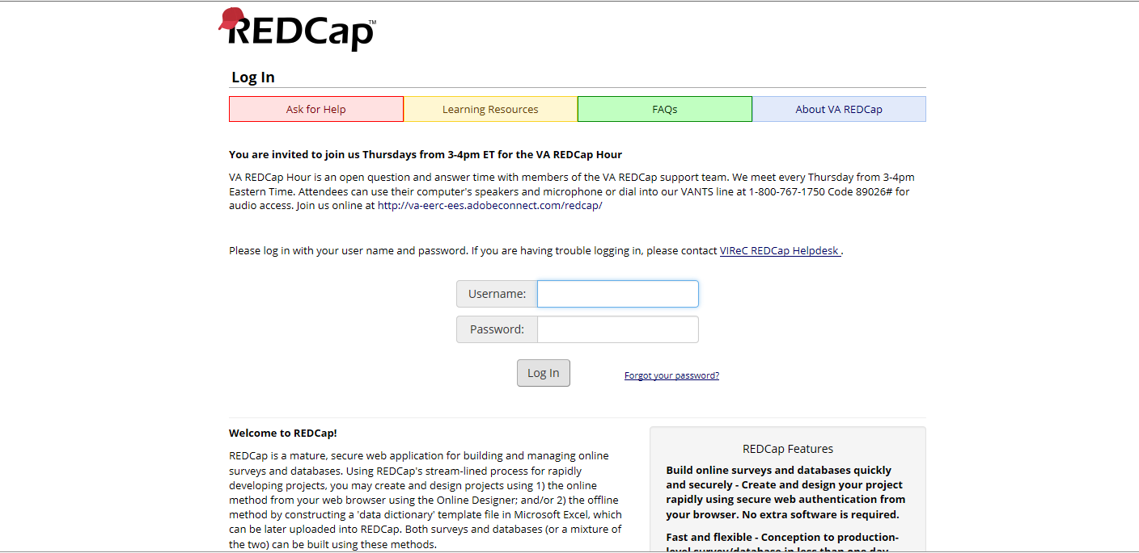
Using REDCap™
(Research Electronic Data Capture), hosted by the VA Information Resource Center (VIREC)
https://vhacdwweb05.vha.med.va.gov/redcap_v8.4.5/DataExport/index.php?pid=5887&report_id=12350
Notes:
Website can be access with the link.
Will need to request access for any individual utilizing the PSP. Can only be accessed on the VA server.
Great tool to use to discuss potential patients, have all the information easily accessible and able to update in real time.

Slide 12
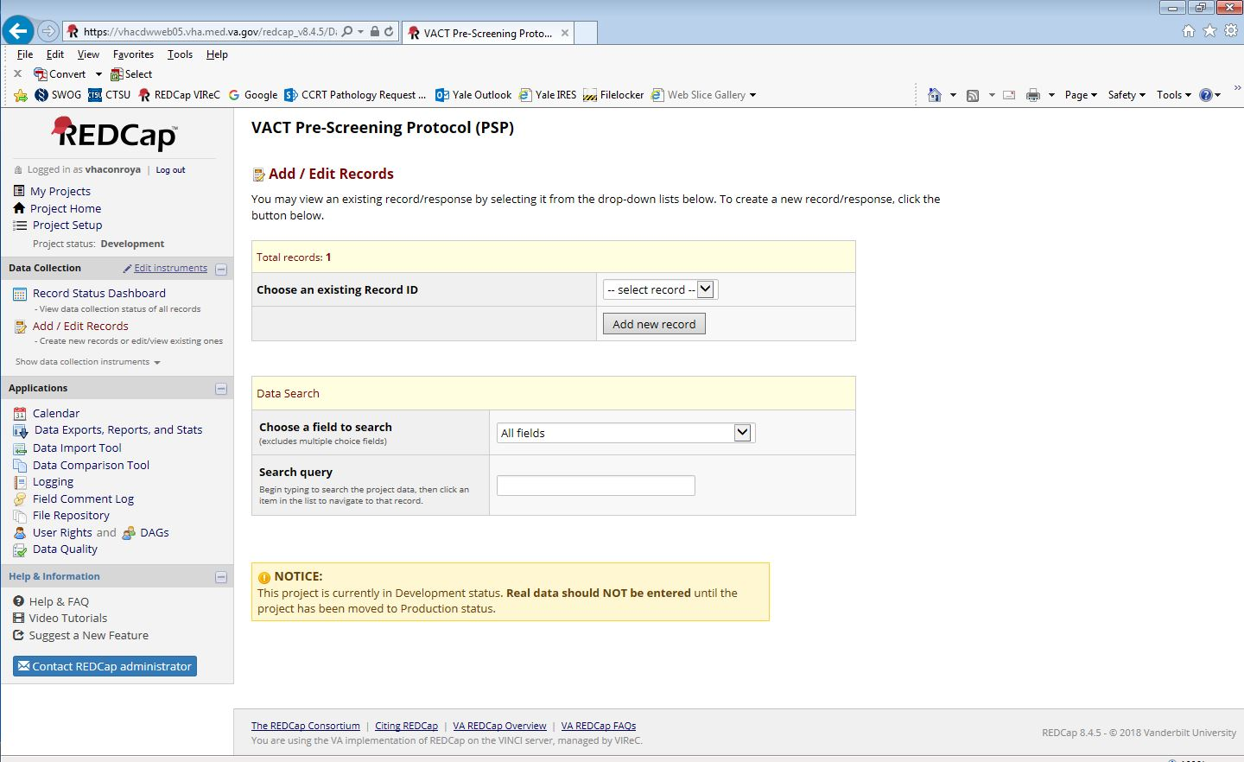

Slide 13
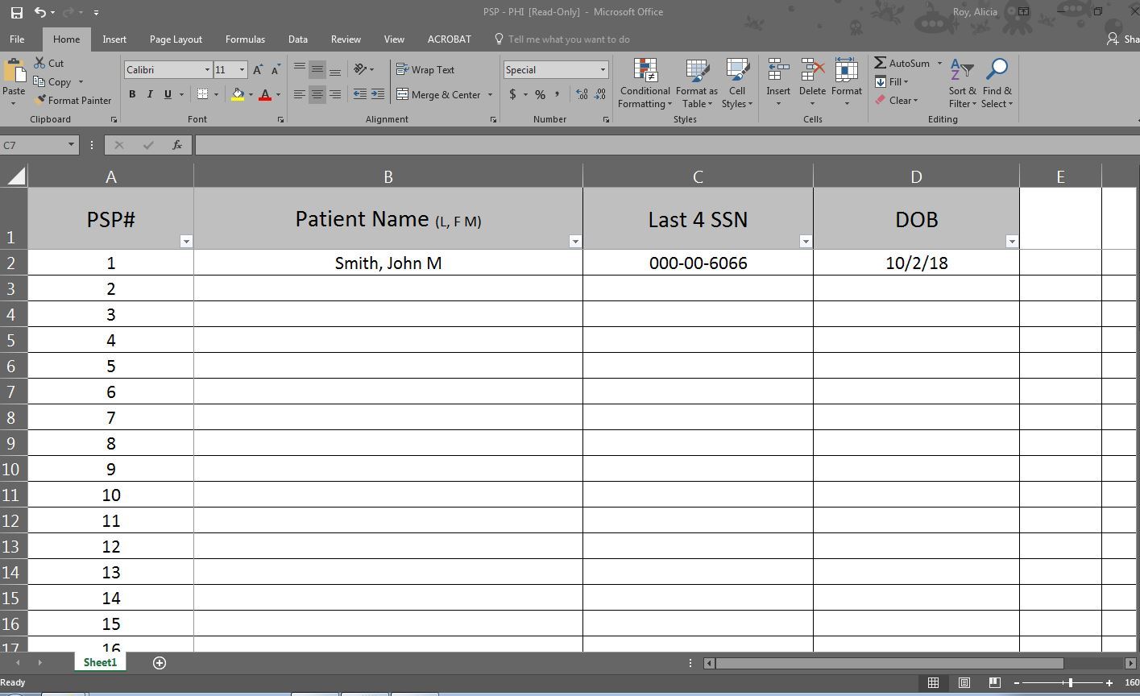
Notes:
The downside to REDCap is that we are not suppose to store patient names. Will have to work with your local ISO. Here is an option that you can use.

Slide 14
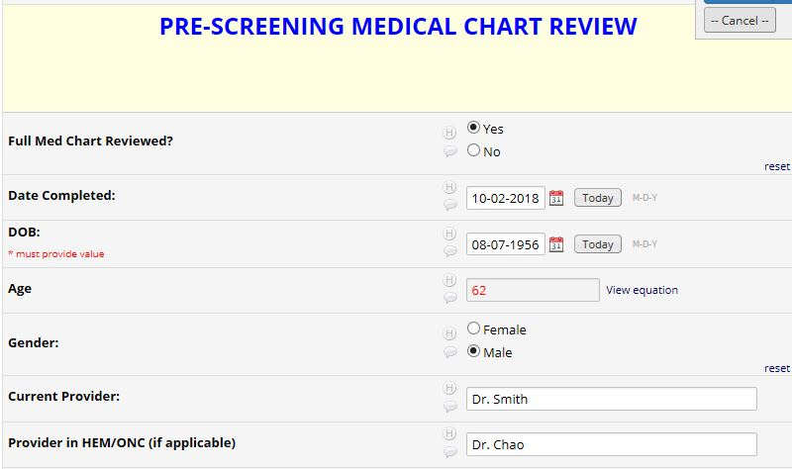
Pre-Screening Medical Chart Review
Partial Pre-Screen:
Demographics
Where Patient was Identified
Disease
History of Smoking
Eligibility
Example: ‘no available trial for disease type’
Full Pre-Screen:
Same as Partial Pre-Screen, in addition:
Disease histology and characteristics
Diagnosis information (Stage, date dx, gene mutation if known)
Performance Status
Prior and current Treatment
Medical History (prior or concurrent malignancies, major health concerns)
Eligibility:
Record for example: Screen Out, Eligible and Following, Not enough information to determine eligibility
Tracking/Updates

Slide 15
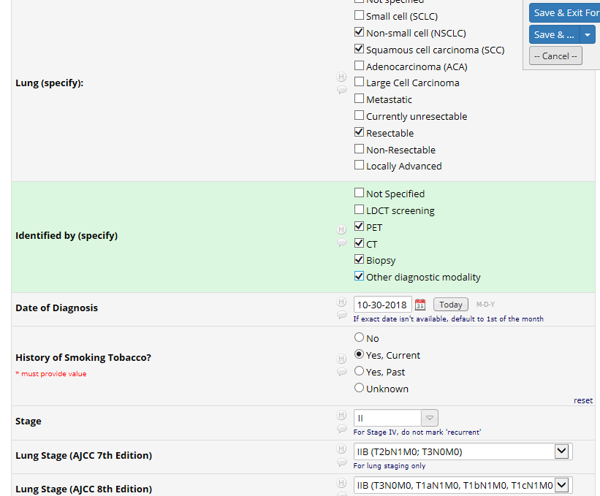
Notes:
Example of a patient we are potentially screening for a trial.
Can manipulate the fields to be check box, drop down, etc. Very user friendly.
Can using branching logic to hide fields, to only appear when a certain field is selected.

Slide 16
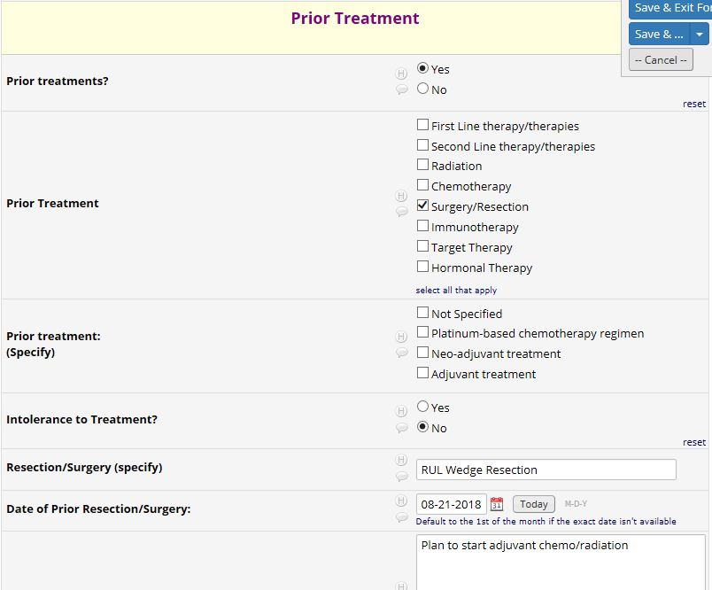
Notes:
Another example of capturing prior and current treatment

Slide 17
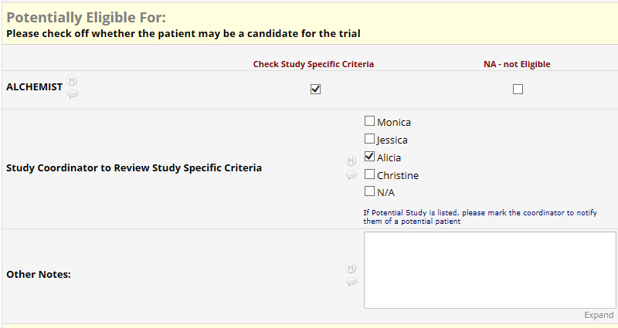
Alicia check for ALCHEMIST
Notes:
Based on the information, it auto-populated that this patient may be a candidate for ALCHEMIST. Ability to mark the coordinator and leave notes

Slide 18
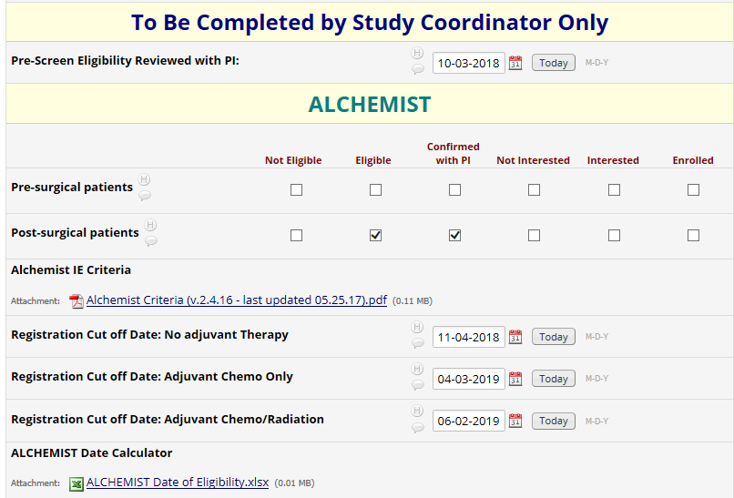
Important Dates to Track
Notes:
One place stop… you can attach documents and create important fields that keep things organized and easily accessible. Worth adding the extras and to think about ways to track additional information for reporting purposes.

Slide 19
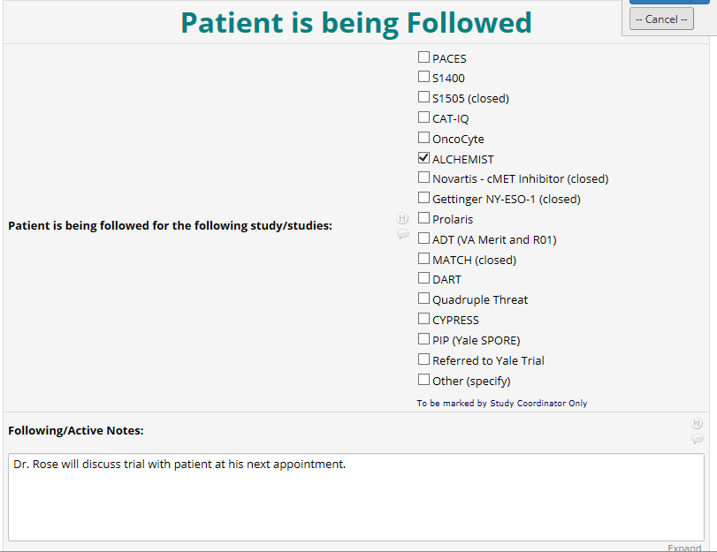
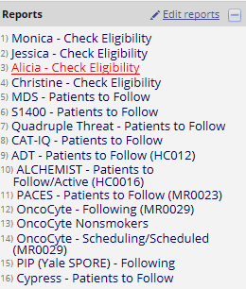
Notes:
Top of the page, we generated a noticeable note so that any coordinator updating the form will know the most up-to-date information. In addition, creating reports to auto-populate based on coordinator and/or study.

Slide 20
Take Away
PSP can be translated to any research discipline
Can be customized based on a research programs needs and goals
Med Chart Pre-Screen – waiver of written informed consent (WIC) and waiver of authorization (WoA)
Telephone Pre-Screening – WWIC
In-Person Pre-Screening – will need informed consent
A BIG commitment but a Good Investment
REDCap™ is user friendly and offers a number of resources/training and is APPROVED to use at the VA
Notes:
PSP does take a lot of time upfront. However, if you take the time to carefully plan and setup your database, you will find that the pros outweigh the cons. As your program grows, more trials and staff are involved, having the PSP streamlines the process and ensures a more efficient program. We recommend starting off small and pilot your first database. You will quickly pick up what works and what doesn’t and adjust as necessary. Using a electronic database such as REDCap™ allows for a more user friendly interface and offers a large number of features that programs like Access and Excel do not offer. In addition, multiple users can utilize the program at once, therefore, simultaneously screen patients.

Slide 21
Clinical Trials are good clinical care but need to be part of an Infrastructure
Research Care Coordination
Service Agreements
Multidisciplinary Tumor Boards
Clinical Trials
Patients
Interest
Eligibility
Education
Comorbidity
Notes:
21

Slide 22
Life as a Cancer Doc at a VA clinic with Patient Pre-Screening Protocol
It is almost 8 am and while sipping coffee you review the PSP email sent by your wonderful research coordinator about patients coming to clinic today that could be eligible for studies enrolling at your institution.
It is 10.30 am Mr. Smith comes for f/u. The scans ordered by a previous fellow show progression of lung cancer – your cancer care coordinator made you aware. He is eligible for a study according to PSP and the consent form is in your folder so you provide the info to Mr. Smith and his family.
It is 7 pm – you still have to write 8 notes but you feel pretty good because Mr. Smith and his family heard about cancer immunotherapy on TV and are actually excited that he could possibly participate in clinical trial for lung cancer immunotherapy…

Slide 23
Questions or Comments?

Slide 24
Thank you!
Contact Information:
Herta.chao@va.gov
Alicia.roy@va.gov

