Slide 1
Lung-MAP Webinar - Instructions to Attendees
Welcome to the Lung-MAP Webinar!
We appreciate your patience as we give everyone time to join before we begin.
Please mute your line if you are not speaking.
We will have 3 Q & A sessions throughout the webinar, in which you will have time to “raise your hand” in WebEx to ask a question or place your question in the chat box.
We will begin shortly!

Slide 2
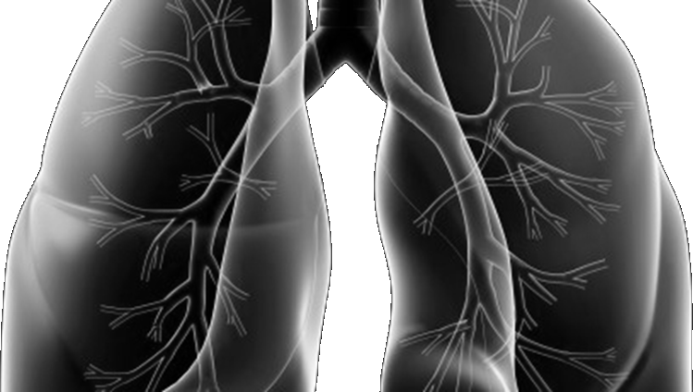
Lung-MAP New & Improved!
Lung-MAP Training Webinar:
New LUNGMAP Screening Protocol & S1900A Sub-Study
November 30, 2018

Slide 3
Welcome & Introduction
Mariah Norman
Lung-MAP Project Manager & Protocol Coordinator

Slide 4
Agenda
Lung-MAP Impact, Current Overview & Status
New Study Structure & CIRB Mandate
How Patients Will be Affected
Q & A on Study Structure, CIRB Mandate, & Effect on Patients
LUNGMAP Screening Protocol
S1900A Sub-Study
Q & A on LUNGMAP Screening Protocol & S1900A Sub-Study
Accrual Enhancement Efforts
General Q & A
There will be Q&A sessions during the presentation, but please feel free to place questions in the chat box for everyone.

Slide 5
Lung-MAP Impact, Current Overview, & Status
Vassiliki Papadimitrakopoulou, MD
Roy Herbst, md, phd
Study Chairs, Medical Oncology

Slide 6
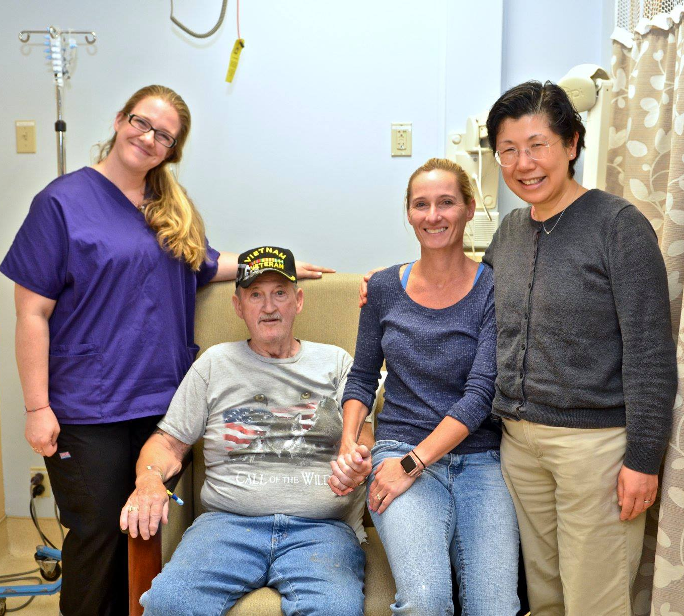
Lung-MAP Impact
I continue to be so grateful for everyone involved. Even after 48 visits for my opdivo infusion!
~ Annie B.
Over 15 clinical trials following Lung-MAP blueprint
FDA now has “master protocol” guidance and most pharma companies have launched a “master protocol”
Over 1,800 registered patients at more than 650 sites
Over 50 publications and abstracts
Almost 1,900 specimens in a public bank
300 genes identified with a genetic alteration
Most importantly, we are grateful Lung-MAP has helped many patients and we want to amplify our success so far by opening the trial to more patients!
Living!
I am more confident than I have been in a long time. Lung-MAP gave me my life back. ~ Clifford C.

Slide 7
Current Lung-MAP Overview & Status
The S1400 screening protocol is still open and patients may be registered to S1400 until the new screening protocol is activated
1838 patients enrolled on S1400
1118 patients screened at progression and 720 patients pre-screened prior to progression
S1400F is open and accruing
Opened 10/2/17
46 patients registered (24 acquired 22 primary resistance)
S1400K
Opened 2/5/18
28 patients registered as of 10/18/18
Temporarily closed to accrual on 10/18/18 to revise the protocol based on new safety information and while data matures for interim analysis
S1400GEN
93 patient surveys and 22 PI surveys
LUNGMAP screening protocol is CTEP/CIRB approved on hold, pending approval of S1900A
Accrual as of 11/29/18

Slide 8
Current Lung-MAP Schema
Actively Accruing
Screening Protocols
In Development
LUNGMAP
S1400
Temporarily Closed
Biomarker-Driven Sub-Studies
Non-Match Sub-Studies
Temporarily
Closed
Anticipated
Q1 2019
Anticipated
Q3 2019
Anticipated
Q3 2019
Open
Anticipated
Q1 2019
S1400K
C-MET +
S1900A
LOH/BRCA +
S1900B
RET Fusion +
S1900C
STK11/LKB1
S1400F
Checkpoint Refractory
S1800A
Checkpoint Refractory
*S1800A SOC Options
- Docetaxel
- Gemcitabine
- Pemetrexed
- Ramucirumab + Docetaxel
ABBV-399
Rucaparib
LOXO-292
Talazoparib + Avelumab
Durvalumab +
Tremelimumab
Pembrolizumab + Ramucirumab
v SOC *

Slide 9
New Study Structure & CIRB Mandate
Mariah Norman
Lung-MAP Project Manager & Protocol Coordinator

Slide 10
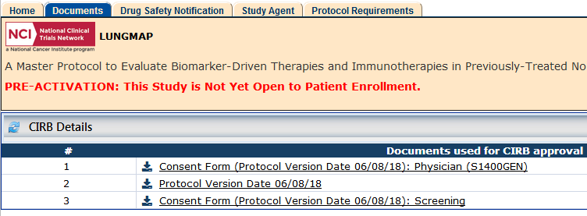
Good News!
LUNGMAP & S1900A are now available on CTSU via a pre-activation release!
To facilitate a seamless transition from S1400 to the LUNGMAP, we have released the LUNGMAP & S1900A protocol documents on CTSU for sites to review before activation
The new LUNGMAP screening protocol and S1900A sub-study are pending final approval
Activation of both LUNGMAP & S1900A are expected after the new year!
Notes:
-Located on CTSU Website > Protocols > Search for LUNGMAP or S1900A > Documents > Documents Used for CIRB Approval

Slide 11
New Study Structure
The Lung-MAP master protocol is expanding to adapt to the changes in the therapeutic landscape and study structure!
The new screening protocol is referred to as “LUNGMAP”
“Lung-MAP” refers to the master protocol as a whole, whereas “LUNGMAP” is the study ID for the new screening protocol
The S1400 screening protocol will close to accrual when the new LUNGMAP screening protocol activates
Patients enrolled to S1400 will be able to participate in all currently accruing and future sub-studies

Slide 12
New Study Structure
The Lung-MAP study is an umbrella master protocol which contains a screening protocol and clinical trial sub-studies under a single IND.
Sub-studies are included within the umbrella protocol and are independently conducted and analyzed, investigational treatment studies.
A revision to one sub-study will only include revisions to that sub-study. A revision to the LUNGMAP screening protocol will only include revisions to the screening protocol and not sub-studies.
Once LUNGMAP activates, the S1400 series will be retired.
New biomarker-driven sub-studies will be called “S1900X” and new non-match sub-studies will be called “S1800X.”

Slide 13
New Version Control Protocols
The structure of Lung-MAP has taught us many of the difficulties of having a single protocol document.
We thought that a single document would make it easier for sites to conduct the study.
Revisions were a large undertaking which affected the study as a whole
Sites had to open all sub-studies even if there was a small chance a patient would be assigned
Difficult for sites and IRBs to manage
Why are there multiple Version Control Protocols?

Slide 14
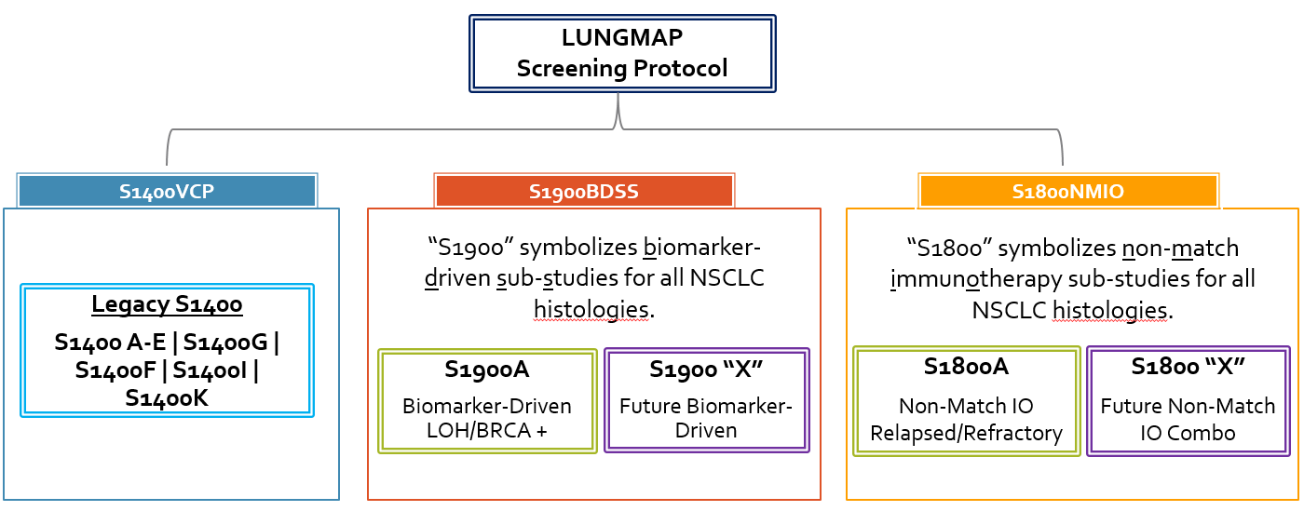
Sub-studies will be grouped under Version Control Protocols (VCP)
VCPs are overarching admin protocols to keep an up-to-date record of the current version of each sub-study
LUNGMAP will have 2 Version Control Protocols:
S1900BDSS: VCP for biomarker-driven sub-studies
S1800NMIO: VCP for non-match sub-studies

Slide 15
NCI CIRB Implementation at LUNGMAP Activation
Use of the CIRB will be required for all sites that open LUNGMAP and new sub-studies.
If Site is not a Member of the NCI CIRB:
Site Status Suspended - No registration of new patients to the sub-studies are allowed.
The site should continue to use the existing IRB of Record for patients registered prior to LUNGMAP. Treatment and follow-up data on previously enrolled patients will continue to be provided.
A site may register new patients to new sub-studies once it becomes a member of the NCI CIRB.
If Site is a Member of the NCI CIRB:
Continue to use the CIRB as the IRB of Record. Site may register new patients once study has been locally implemented.
Notes:
NIH Policy on Single Institutional Review Board (NCI CIRB) for US Sites Participating in the NCTN & NCORP Clinical Trials Networks
March 1, 2019

Slide 16
Opening LUNGMAP & New Sub-Studies
Sites will not be required to open the sub-studies of LUNGMAP until a patient has been assigned to a sub-study. Because sites will be using the CIRB, they will be able to more quickly process and activate the sub-study.
Processing of CIRB SSW approvals
Each Signatory Institution must submit a new Study-Specific Worksheet (SSW), for LUNGMAP, S1900A, and any new sub-study for the S1800 and S1900 series going forward.
Sites can choose to wait until a patient has been assigned to a sub-study before submitting the SSW, but may not participate in any sub-study without opening LUNGMAP.
-OR-
2. Sites can choose to complete the SSW application as soon as a new sub-study activates.
Show of hands

Slide 17
How will patients be affected?
Louise Highleyman
Lung-MAP data Coordinator

Slide 18
Patients Registered on S1400 - pg1
Patients registered to S1400 will remain in S1400 and will not need to be re-registered to the new LUNGMAP screening protocol.
The S1400 protocol, including the data submission schedule, should continue to be followed for all patients.

Slide 19
Patients Registered on S1400 - pg2
S1400, S1900, and S1800 series sub-studies are an option for S1400 patients. All S1400 patients who:
progress on pre-screening
need a sub-study reassignment
need a new sub-study assignment
May be assigned to sub-studies in the S1400, S1800, and S1900 series.
As for S1400, sub-study assignment depends on biomarker-profiling results and may depend on prior treatment and histology. Once assigned, the patient must meet the sub-study’s eligibility criteria.

Slide 20
Patients Registered on S1400 - pg3
For pre-screened patients, sub-study assignment will still occur upon submission of the S1400 Notice of Progression.
The S1400 Request for Sub-study Reassignment can continue to be submitted for patients who are not eligible for their most recently assigned sub-study.
The S1400 Request for New Sub-study Assignment can continue to be submitted for patients who progress on or after a sub-study.

Slide 21
Patients Registered on LUNGMAP - pg1
The sub-study assignment process on LUNGMAP is identical to S1400 in terms of:
Screening at progression vs. pre-screening prior to progression
Turnaround times
Form submission
Please refer to the LUNGMAP protocol for details.

Slide 22
Patients Registered on LUNGMAP - pg2
Sub-study eligibility may depend on histology. Legacy S1400 sub-studies were restricted to squamous histology.
LUNGMAP Patients with squamous cell carcinoma may be eligible for all legacy S1400 sub-studies and new S1800 and S1900 series sub-studies which allow squamous.
LUNGMAP Patients with mixed squamous or non-squamous NSCLC are not eligible for legacy S1400 sub-studies. These patients may be eligible S1800 and S1900 series sub-studies.
* Some future sub-studies may not allow mixed squamous or non-squamous NSCLC, or specify enrollment into histology-specific cohorts.

Slide 23
Q & A on Study Structure, CIRB Mandate, & Effect on Patients
Please
“raise your hand” in WebEx or place questions in the chat box.
All attendees

Slide 24
LUNGMAP Screening Protocol
Crystal Miwa
Clinical Trials Project Manager

Slide 25
LUNGMAP Screening Protocol
In addition to the new structure, LUNGMAP has been expanded to include:
All histologic types of non-small cell lung cancer (NSCLC)
Mixed squamous and non-squamous
Better serve the changing needs of patients and provide more options after lines of therapy have stopped working
Establish an immunotherapy combination platform for PD/L-1 resistance
These sub-studies will be grouped under the S1800 series and S1800 Non-Match Immunotherapy Version Control Protocol (S1800NMIO)
One consent form that combines screening and pre-screening
Collection of whole blood on a subset of patients for a ctDNA assay
To understand and exploit molecular signatures endemic to NSCLC and predict activity of targeted therapies in molecular subgroups

Slide 26
LUNGMAP - ctDNA
Aspirational Goal
Incorporate liquid biopsies in our comprehensive analysis
Objective: To evaluate circulating tumor DNA (ctDNA) and compare to the FMI Foundation tissue molecular profiling results in patients who submit a new biopsy for screening.

Slide 27
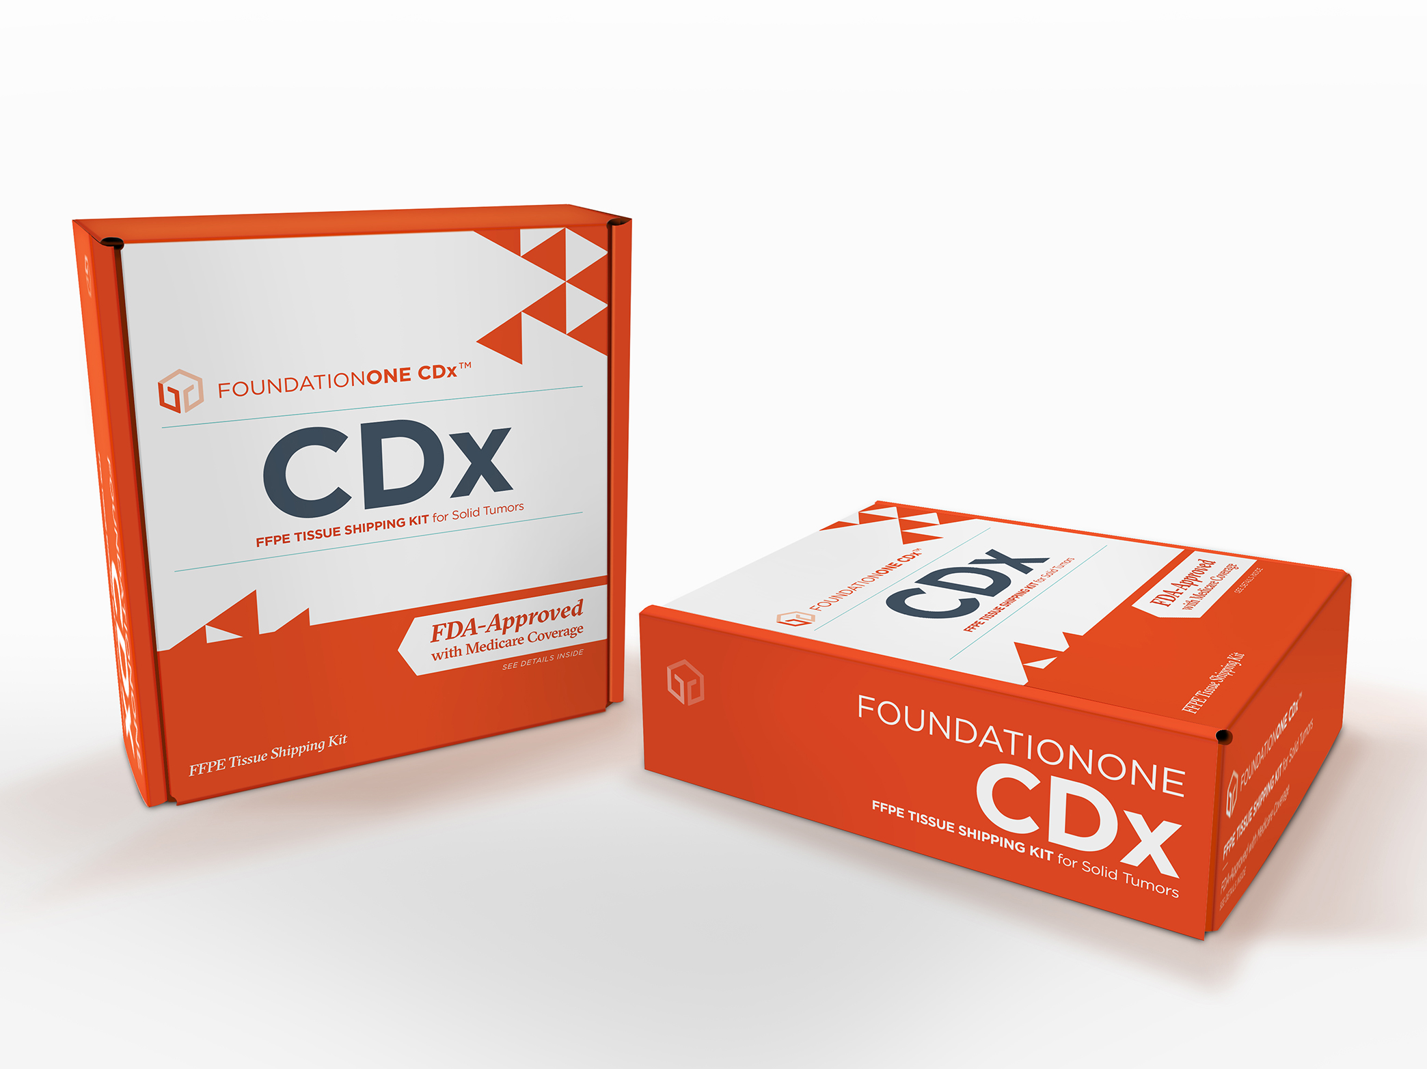
LUNGMAP – ctDNA Collection Details
Special tubes will be provided in kits
x 4 Roche Cell-Free DNA blood collection tubes (8.5ml)
Minimal in-lab processing required
Label tubes
Collect whole blood
Gently invert 10 times
Place in specimen shipping kits (provided)
Log into SWOG STS and include printout packing list
FedEX overnight (Fridays okay) at room temperature (DO NOT FREEZE)
Send same day or next day
Patients must be registered to Step 0 to obtain patient ID # for submission (Section 5.1)
Timepoint: Screening protocol
Within one week of tissue biopsy (+/- 7 Days) – Preferably same day
Please refer to the LUNGMAP protocol Section 15.3 for details

Slide 28
S1900A A PHASE II STUDY OF RUCAPARIB IN PATIENTS WITH GENOMIC LOH HIGH AND/OR DELETERIOUS BRCA1/2 MUTATION STAGE IV OR RECURRENT NON-SMALL CELL LUNG CANCER (LUNG-MAP SUB-STUDY)
Jonathan W. Riess, M.D.
Paul Wheatley-Price, M.D.
S1900A Study ChairS, Medical oncology

Slide 29
S1900A: Overview
Rucaparib is a potent small-molecule inhibitor of poly (ADP-ribose) polymerase (PARP) proteins (PARP-1, PARP-2 and PARP-3) that play an important role in repairing DNA damage and maintaining genomic stability.
The FDA recently approved rucaparib as maintenance treatment for ovarian, fallopian tube and primary peritoneal cancer following response to platinum-based chemotherapy.
The FDA also concurrently approved the complementary diagnostic test, FoundationFocusTM CDx BRCA LOH, for tumor samples to determine HRD status.
We seek to study rucaparib in recurrent/metastatic NSCLC harboring deleterious BRCA1/2 mutations and/or loss of heterozygosity (phenotypic biomarker for HRD).
Overall Objective: To evaluate the overall response rate (ORR) associated with rucaparib in metastatic NSCLC patients with genomic LOH high and/or deleterious BRCA1/2 mutations

Slide 30
S1900A: Schema
Deleterious BRCA1/2 mutation and/or LOH high by Foundation Medicine Assay
Cohort 1:
Squamous NSCLC
Treat with Rucaparib
continued till progression or intolerable toxicity
Sub-Study Assignment and Registration to S1900A
Lung-MAP Screening/ Prescreening Registration
Cohort 2:
Non-Squamous NSCLC
Accrual goal: 44 patients per cohort (88 total)
Activated: TBD (CIRB review – 10/4/18)
Goal: >10 responses per cohort
Go to: http://www.swogstat.org/accrual/lungmap.pdf for current status

Slide 31
S1900A: Objectives
Primary Objective
To evaluate the overall response rate (ORR) associated with rucaparib in patients with genomic LOH high and/or deleterious BRCA1/2 mutations within:
Cohort 1: Patients with squamous cell histology, including mixed histology with any squamous component.
Cohort 2: Patients with non-squamous histology.
Secondary Objectives
To evaluate investigator assessed progression-free survival (IA-PFS) and overall survival (OS) associated with rucaparib within each cohort.
To evaluate duration of response among responders within each cohort.
To evaluate the frequency and severity of toxicities associated with rucaparib among all patients enrolled on the study (combining cohorts).

Slide 32
S1900A: Rucaparib Mechanism of Action
Rucaparib is a potent small-molecule inhibitor of poly (ADP-ribose) polymerase (PARP) proteins (PARP-1, PARP-2 and PARP-3) that play an important role in repairing DNA damage and maintaining genomic stability.

Slide 33
S1900A: Rucaparib Administration
Route: Rucaparib is to be administered orally
Dose: 600 mg PO bid with at least 8 oz. water (with or without food)
Cycle duration: 21 days
Supportive care: Patients should use common precautions when going outside, such as applying sunscreen and/or covering exposed skin with clothing and wearing a hat and sunglasses, as photosensitivity has been observed.
Disease assessment: Every 6 weeks ± 7 days
Prohibited Because rucaparib is a strong BCRP inhibitor, concomitant use of drugs that medications: are BCRP substrates (e.g., rosuvastatin) are not allowed during the treatment study.
(https://www.fda.gov/Drugs/DevelopmentApprovalProcess/DevelopmentResources/DrugInteractionsLabeling/ucm093664.htm#table5-2)

Slide 34
S1900A: Biomarker
FoundationFocusTM CDx BRCA LOH, for tumor samples to determine HRD status.
FDA approved complementary diagnostic for rucaparib maintenance in ovarian cancer
Deleterious BRCA1/2 mutations – activity in breast, ovarian, prostate and pancreatic cancer
LOH High – OS benefit to platinum based chemotherapy in Squamous NSCLC
Activity of rucaparib (improved PFS) BRCA-WT, LOH high ovarian, fallopian tube, primary peritoneal carcinoma.
Foundation Medicine - Lung MAP Assay – Genome Wide LOH. (21% cutpoint for NSCLC).
LOH as phenotypic marker for HRD.
Estimated Prevalence by Histologic Lung Cancer Subtype
Histology | BRCA1/2 | LOH HIGH
Squamous | 5.8% | 16%
Adeno- carcinoma | 2% | 9%

Slide 35
S1900A: Substudy Specific Eligibility Criteria
Deleterious BRCA1/2 mutations and/or LOH high score determined by Foundation Medicine Assay.
Patients must not have a ≥ Grade 3 hypercholesterolaemia (defined by NCI CTCAE v5) within 28 days prior to sub-study registration. Peripheral neuropathy Grade 1 or less.
Patient must be able to take oral medications.
Patients must not have had prior treatment with any PARP inhibitor, including rucaparib, talazoparib, veliparib, olaparib, or niraparib

Slide 36
S1900A: Ready to Launch
Questions?
Please contact
Dr. Jonathan W. Riess and
Dr. Paul Wheatley-Price at
S1900AMedicalQuery@swog.org

Slide 37
Q & A on LUNGMAP Screening & S1900A Sub-Study
Please
“raise your hand” in WebEx or place questions in the chat box.
All attendees

Slide 38
Lung-MAP Accrual Enhancement Efforts
Stacey Adam, PhD
Amrin Chowdhury, MS
FNIH

Slide 39
Patient & Investigator Handouts
Update to patient handout and investigator handout
Patient handout to be located on CTSU under LUNGMAP abstract page and on www.Lung-MAP.org
Investigator handout will be provided in email with patients’ biomarker testing results

Slide 40
Accrual Enhancement Efforts
New look and update to www.Lung-MAP.org
Press release
Advocacy outreach call
New Lung-MAP email distribution list for communication direct to sites
Subscribe/Unsubscribe emails from SWOG@ohsu.edu
New Twitter strategy

Slide 41
General Q & A Session
Please
“raise your hand” in WebEx or place questions in the chat box.
All attendees

Slide 42
Contact Us
Site Coordinators Committee
LUNGMAPSCC@crab.org
Protocol & Regulatory Questions
mnorman@swog.org
Eligibility & Data Submission Questions
LUNGMAPQuestion@crab.org
General Medical Questions
LUNGMAP@swog.org
S1900A Medical Questions
S1900AMedicalQuery@swog.org
Funding Questions
Funding@swog.org

Slide 43
Acknowledgements
Thank you to our dedicated team for all your input and support!
Patients and Sites
Lung-MAP Site Coordinators Committee
Patient Advocates
Accrual Enhancement Committee
Trial Oversight Committee
Study Chairs
Statistical Team
Pharmaceutical Collaborators
Data Coordinators
Applications Development Team
Quality Assurance Team
Funding & Contracts Team
CTEP, CIRB, CTSU
Foundation for the National Institutes of Health
Friends of Cancer Research
CCS Associates Inc.

Slide 44
Summary & Adjourn
Thank you for joining us!
The slides and recording of the webinar will be available on the SWOG & CTSU websites

