Slide 1
S1400 (BRC6) Revisions #11-17 Training Slides
A Biomarker-Driven Master Protocol for Previously Treated Squamous Cell Lung Cancer. (LUNG-MAP)
Version date May 2018

Slide 2
Revisions #11-17
Schema
Revision Summary of Changes
Study Design/Goals
Objectives
Eligibility overview
Study Chairs

Slide 3
Current Studies included in Lung-MAP at Revision 17
Current Sub-Studies:
S1400G (BRC6G): Single arm Phase II Design – activated February 2017 (CCTG 9/20/17)
S1400I (BRC6I): Randomized Phase III Design – activated December 2015 (CCTG 4/15/16) (closed to accrual 4/23/18)
S1400F (BRC6F): Single arm Phase II Design – activated October 2017 (CCTG 2/27/18)
S1400K (BRC6K): Single arm Phase II Design – activated February 2018 (CCTG activation pending)
Current Ancillary Studies:
S1400I PRO: part of S1400I
S1400GEN: part of S1400 Screening Study (US sites only)

Slide 4
Schema at Revision 17
Biomarker Driven
Sub-Studies
Non-match
Sub-Studies
* Closed to Accrual 4/23/18
S1400G
HRRD
S1400K
C-MET
S1400I
Checkpoint
Naive
S1400F
Checkpoint
Inhibitor
Talazoparib
ABBV-399
MEDI4736
plus Tremelimumab
Nivolumab/
Ipilimumab
Nivolumab
Biomarker-driven sub-studies will progress to Phase III if study meets endpoint and Phase III is
feasible at which point the standard of care arm will be determined.

Slide 5
Revision 11 (S1400F & S1400VCP) Summary of Changes
US Version Date: 9/22/17 US Release Date: 11/3/17 CCTG: N/A
Administrative edits to Section 14 of S1400F Protocol
Inserted the missing risks table for tremelimumab in S1400F Consent
Rollout of S1400VCP (Version Control Protocol)
Administrative Protocol to keep track of changes in study documents
Allows independent revision of each sub-study
Lists version dates of each sub-study
VCP is updated with every revision

Slide 6
Revision 12 (S1400, S1400K, S1400GEN) Summary of Changes
US Version Date: 1/8/18 US Release Date: 2/5/18 CCTG Release Date: 5/15/18
Administrative edits to S1400 (BRC6) Protocol and Consent
Section 5 Eligibility: c-MET testing, S1400GEN for US sites and English speaking patients
Section 7 Follow-up Period: Until sub-study registration or death
Section 13 Registration Timing: Tissue submission lengthened to 5 calendar days and planned treatment lengthened to 10 calendar days
Section 18 On Site Monitoring: Reduced to sites w/ patients registered to sub-study. Made some exceptions for sites meeting certain requirements.
New Ancillary Survey Study S1400GEN: Survey to evaluate patient attitudes about the return of somatic mutation findings. (not applicable to CCTG sites)
New Sub-Study S1400K (BRC6K): Biomarker-driven sub-study for patients who have c-MET positive squamous cell lung cancer.

Slide 7
Revision 13 (S1400VCP)
Revision 13 is no longer relevant as Revision 14 was approved prior to Revision 13.
Revision 13 was never released to sites.

Slide 8
Revision 15 (S1400I/BRC6I) Summary of Changes
US Version Date: 2/5/18 US Release Date: 4/1/18
CCTG Release Date: Pending. Revision 15 & 16 to be combined.
Section | Change
Throughout | SWOG & CTSU links have been updated due to website changes.
5 - Eligibility | Canadian sites – allow for collection of lipase only.
7 – Follow-Up Period | Patients who enroll on a new sub-study following progression must continue follow-up on this sub-study, in addition to follow-up on the new sub-study.
9 - Calendar | EQ-5D Questionnaire should be completed within 14 days prior to registration. Frequency of Brain CT/MRI scans reduced to 12 weeks (for patients w/ brain mets at baseline).
13 – Registration Timing | Planned treatment lengthened to 10 calendar days.

Slide 9
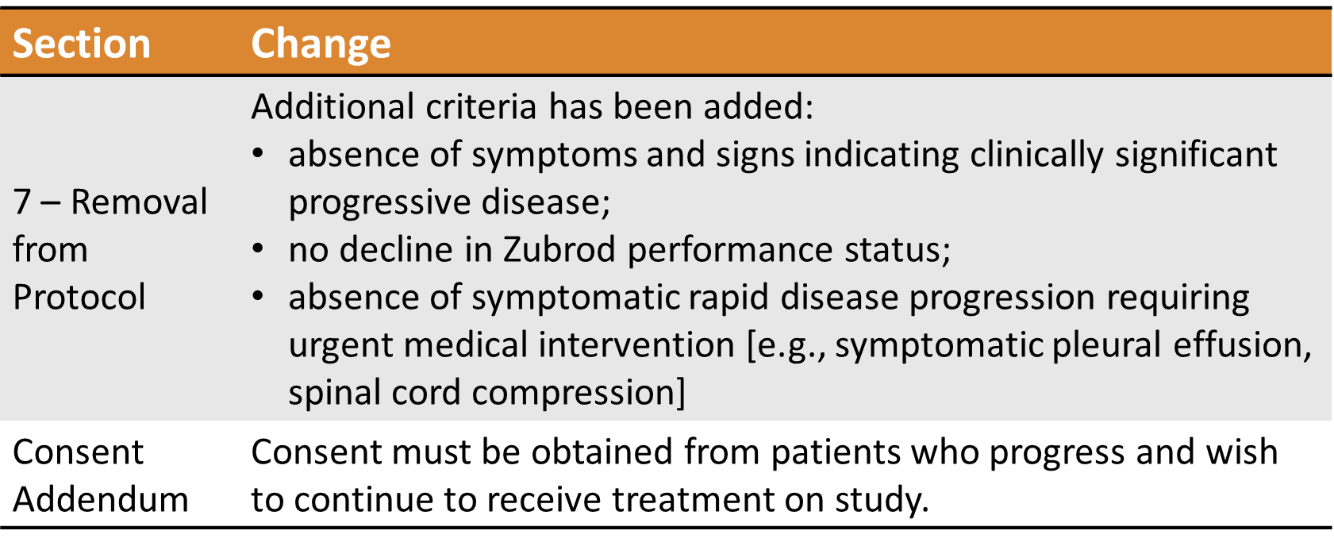
Revision 16 (S1400F/BRC6F) Summary of Changes
US Version Date: 2/21/18 US Release Date: 5/1/18
CCTG Release Date: Pending. Revision 15 & 16 to be combined.
Response to FDA comments to ensure patients continuing treatment beyond radiologic disease progression are not exposed to unreasonable risks.

Slide 10
Revision 14/17 (S1400A) Summary of Changes
Revisions 14 & 17 are not applicable to CCTG sites.
Revision 14 – US Version Date: 11/21/17 US Release Date: 2/5/18
Revision 17 – US Version Date : 2/21/18 US Release Date: 5/1/18
Section | Change
9 – Calendar Arm 3 | TSH/Free T3/T4 laboratory footnote has been modified to clarify that the laboratory tests, if clinically indicated, should be repeated every 4 weeks during treatment, then every 8 weeks prior to progression, or more often as clinically indicated.
Section | Change
9 – Calendar Arm 1 & 3 | TSH/Free T3/T4 laboratory footnote has been modified to clarify that the laboratory tests, if clinically indicated, should be repeated every 4 weeks during treatment, then every 8 weeks prior to progression, or more often as clinically indicated.
 | Justification: To reduce burden on patient if they are asymptomatic or off treatment.

Slide 11
S1400GEN Study Objectives
Primary Objective:
Evaluate patient attitudes and preferences about return of somatic mutation findings suggestive of germline mutations in the S1400 master protocol trial.
Secondary Objectives:
Evaluate S1400 study physician attitudes and preferences about return of somatic mutation findings suggestive of a germline mutation.
Evaluate S1400 patients’ and study physicians’ knowledge of cancer genomics.
Evaluate S1400 patients’ and study physicians’ knowledge of the design of the S1400 master protocol trial.
To explore whether physician and patient knowledge of cancer genomics, attitudes, and preferences about return of genomic profiling findings are correlated.
Not applicable to CCTG sites

Slide 12
S1400G Study Objectives
Primary Objective:
To evaluate overall response rate (ORR) with talazoparib in Homologous Recombination Repair Deficiency (HRRD) MDVN-positive patients
Secondary Objectives:
To evaluate investigator-assessed progression-free survival (IA-PFS) and overall survival (OS) associated with therapy in HRRD MDVN-positive patients
To evaluate ORR, IA-PFS, and OS in HRRD FMI-positive patients
To evaluate ORR in HRRD MDVN-negative/HRRD FMI-positive patients
To evaluate frequency and severity of toxicities associated with talazoparib in HRRD FMI-positive patients

Slide 13
S1400K Study Objectives
Primary Objective:
To evaluate the ORR (confirmed and unconfirmed, complete and partial) with ABBV-399 (Process II) in patients with c-Met-positive lung squamous cell carcinoma.
Secondary Objectives:
To evaluate investigator-assessed PFS and OS with ABBV-399 in immunotherapy-exposed and relapsed patients with c-Met positive squamous cell tumors.
To evaluate the ORR with ABBV-399 in immunotherapy-exposed and relapsed patients with c-Met positive squamous cell tumors.
To evaluate IA-PFS, and OS in all patients with c-Met positive lung squamous cell carcinoma .
To evaluate the duration of response (DoR) with ABBV-399.
To evaluate the frequency and severity of toxicities associated with ABBV-399.

Slide 14
S1400F Study Objectives
Primary Objective:
To evaluate response rate among patients treated with MEDI4736 (durvalumab) plus tremelimumab
Secondary Objectives:
To evaluate duration of response with the investigational therapy
To evaluate OS with the investigational therapy
To evaluate IA-PFS (both RECIST and irRC) with the investigational therapy
To evaluate frequency and severity of toxicities with the investigational therapy

Slide 15
S1400 Screening/Pre-screening Eligibility Overview
Patients must have Stage IV or recurrent squamous cell lung cancer
Patients are eligible for the S1400 Screening/Pre-Screening registration:
upon progression on prior therapy (Screen at progression), or
prior to progression on current treatment for Stage IV disease (Pre-Screen prior to progression)
Patients must have measurable disease
Patients must have a performance status of 0-1
Patients must have an adequate tissue specimen for biomarker profiling
The local pathologist must sign off on the S1400 Local Pathology Review Form prior to enrollment certifying the tissue requirements have been met

Slide 16
S1400 Sub-Study Chairs
S1400GEN
Scott Ramsey, MD, PhD
Joshua A. Roth, PhD, MHA
S1400G – Talazoparib
Taofeek K. Owonikoko, MD, PhD, MSCR
NCTN: ECOG-ACRIN
Lauren A. Byers, MD
NCTN: SWOG
S1400K – ABBV-399
Saiama N. Waqar, MBBS, MSCI
NCTN: NRG
Susanne M. Arnold, MD
NCTN: SWOG
S1400I – Nivolumab plus Ipilimumab
Scott N. Gettinger, MD
NCTN: SWOG
Lyudmila A. Bazhenova, MD
NCTN: ALLIANCE
S1400F – MEDI4736 Plus Tremelimumab
Natasha Leighl, MD
NCTN: CCTG
Naiyer Rizvi, MD
NCTN: SWOG

Slide 17
Questions?
Eligibility/Data Submissions (SWOG Data Coordinators): S1400Question@crab.org
Protocol/Regulatory (SWOG Operations): cmiwa@swog.org and mnorman@swog.org
Funding (SWOG Group Chair’s Office): funding@swog.org
Rave Data Entry Guidelines: Chapter 16e of ORP Manual or as a link on the protocol abstract page
CCTG Site, Drug Supply/Distribution, and Ethics/Consent: nmagoski@ctg.queensu.ca
S1400 Treatment-related/Medical: S1400MedicalQuery@swog.org
S1400F: S1400FMedicalQuery@swog.org
S1400G: S1400GMedicalQuery@swog.org
S1400I: S1400IMedicalQuery@swog.org
S1400K: S1400KMedicalQuery@swog.org
Thank you for your support with the Lung-MAP Trial!

