Slide 1
PRIME Trial Kickoff Training
S1602 - A randomized Trial to Evaluate the Influence of BCG Strain Differences and T-Cell Priming with Intradermal BCG Before Intravesical Therapy for BCG Naïve High-Grade Non-Muscle Invasive Bladder Cancer
Robert S. Svatek MD/MSCI

Slide 2
Agenda
Background
Study Overview
Statistical Overview
Registration
PPD testing
Data and Sample submission
Patient Reported Outcomes
Imaging
Quality Control/Study Monitoring
Informed Consent
Acknowledgements

Slide 3
Background (T-cell Priming)
In preliminary studies, “priming” with intradermal BCG improved the response to intravesical BCG
This is a simple and inexpensive approach that could have impact in improving response to BCG
Thus, we will test the ability of T-cell priming to boost response to BCG therapy.

Slide 4
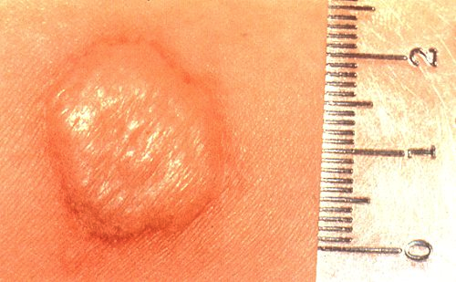
Pre-existing BCG-specific immunity improves anti-tumor response in patients
Patients with high-risk bladder tumor
Surgery
BCG therapy
Clinical outcome?
PPD test
100
+
+
+
+
90
+
+
80
+
+
+
70
+
60
50
Recurrence-free survival (%)
+
+
+
40
+
30
20
+
Censored
10
PPD + (n=23)
PPD - (n=32)
*
0
0
10
20
30
40
50
60
Time until recurrence (months)
Biot, et al. Sci Transl Medicine

Slide 5
Comments from Bladder Cancer Opinion Leaders…
“we have to do this [the BCG immunization] before the intravesical administration and that makes immunologic sense.” -Harry Herr
giving BCG prior to intravesical therapy “should get more bang for our buck…It will need to be tested in a clinical trial, of course, but I think this [work] provides a very strong basis for doing such a trial.” -Mike O’Donnell
Williams, R. TB Vax for Bladder Cancer. The Scientist, 2012.

Slide 6
Background (comparing BCG strains)
The only FDA approved strain of BCG is TICE (Merck)
Manufacturing shortages have resulted in treatment delays and lack of availability of TICE BCG
Thus, having another BCG strain available in the U.S. is a priority.

Slide 7
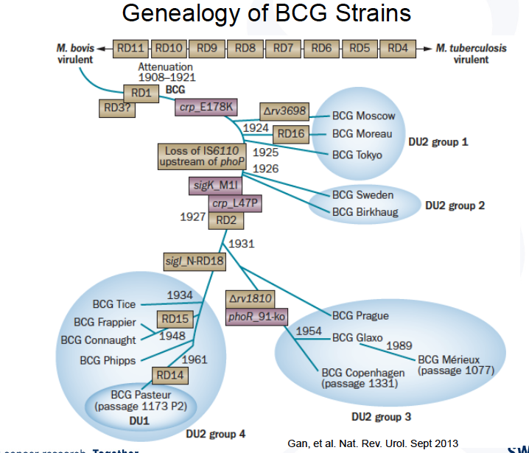
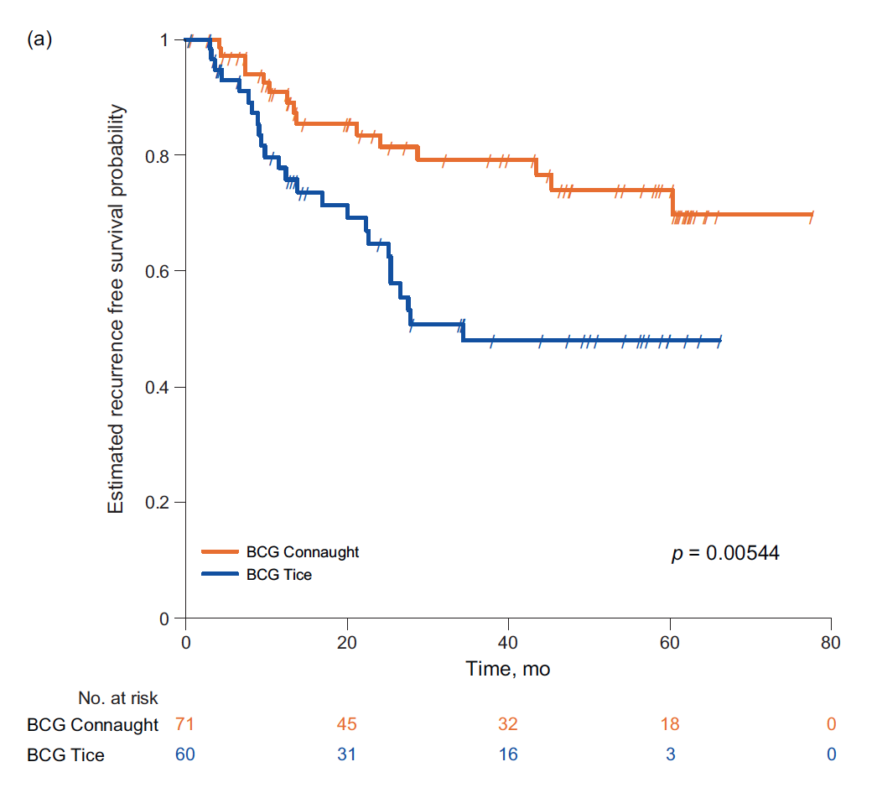
Rationale for Strain evaluation: Differences in genotype/phenotype between BCG substrains could influence antitumor efficacy.
Recurrence-free survival (%)
BCG Connaught (n=71)
BCG Tice (n=60)
Rentsch, et al. European Urology 2015

Slide 8
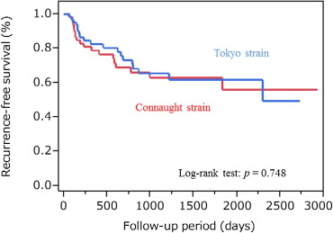
A Prospective Comparative Study of Intravesical Bacillus Calmette-Guérin Therapy with the Tokyo or Connaught Strain for Nonmuscle Invasive Bladder Cancer
Atsushi Sengiku, , Masaaki Ito, Yu Miyazaki, Harutake Sawazaki, Takeshi Takahashi, Keiji Ogura

Slide 9
BCG shortages
In 2014, identified 91 (87%) patients who experienced a divergence from the standard of care and planned treatment.
28 patients never received indicated BCG
40 experienced delayed or missed doses
14 had incomplete therapy
9 received an alternative regimen
37.5 % recurrence rate at first cystoscopy
“We hope this [BCG shortage] serves as a wake-up call not only to patients and providers but also to the pharmaceutical industry and the FDA, who may need to consider a change in policies and incentives to ensure patients are not negatively impacted by drug shortages in the future.”
Parker, McKiernan, 2015

Slide 10
PRIME (S1602) Trial Schema
Intravesical BCG
TICE (50 mg/dose)
CIS, HG TA, or HG T1 bladder cancer
Randomize
Intravesical BCG
(Tokyo strain 80 mg/dose)
Prime: intradermal BCG
(Tokyo strain 100 µl at 0.5 mg /ml)
+
Intravesical BCG
(Tokyo strain 80 mg/dose)

Slide 11
Primary Objectives
To test that Tokyo-172 BCG is non-inferior to Tice BCG
2. To test that Priming (intradermal BCG) followed by intravesical BCG is superior to intravesical BCG alone
Primary Study End-Point:
Time to high grade recurrence (TTHGR)

Slide 12
Eligibility
Non-muscle invasive bladder cancer (Ta, T1, CIS)
High-grade
BCG-naïve
Negative PPD test

Slide 13
Statistics and Accrual
Accrual period: 3 years Follow-up: 5 years
Randomization 1:1:1 Total patients = 969 (n=323 per arm)
Objective #1 (Strain comparison):
Non-inferiority margin (HR) = 1.34, α=0.025, Power = 84%
68% vs. 75% one-year FFS estimate in Tokyo vs. Tice
Patients (N=308 patients per arm)
Objective # 2 (Priming):
83% power to detect a HR= 1.40, one-sided α=0.025
75% vs. 81% one-year FFS estimate in no priming vs. priming

Slide 14
Registration Overview
No Screening step
PPD test must be completed within 90 days prior to registration

Slide 15
PPD Testing Please visit this YouTube video on how to place PPD test… https://www.youtube.com/watch?v=fJDQyQVXOrM

Slide 16
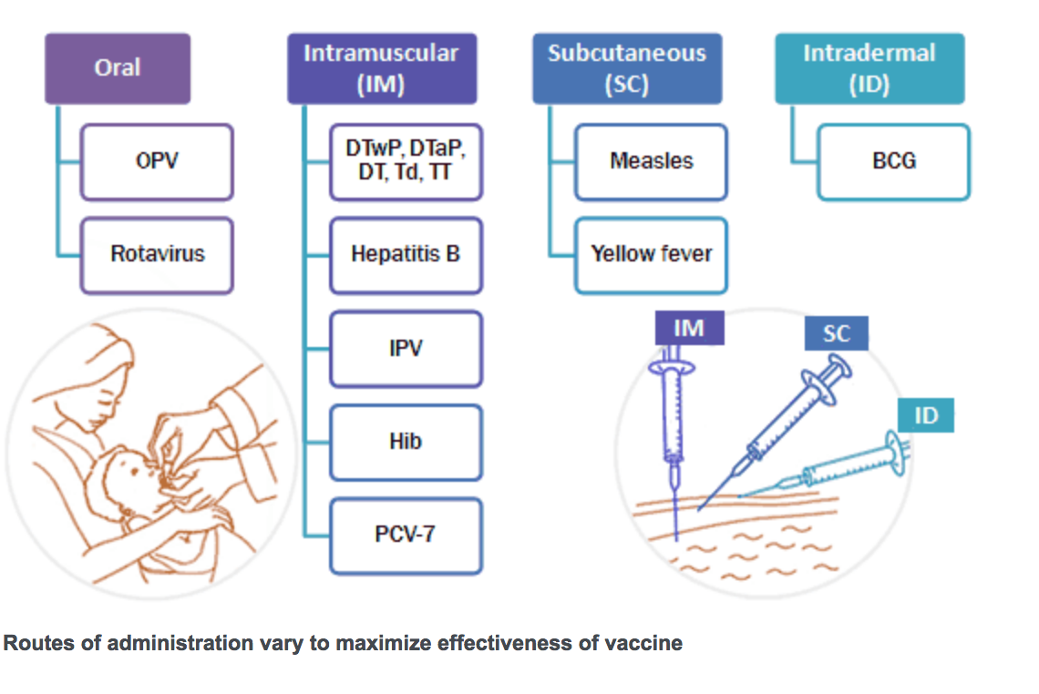
Both BCG and PPD are administered Intradermal (ID)

Slide 17
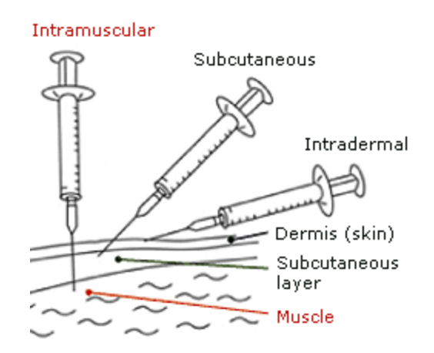
Both BCG and PPD are administered Intradermal (ID)

Slide 18
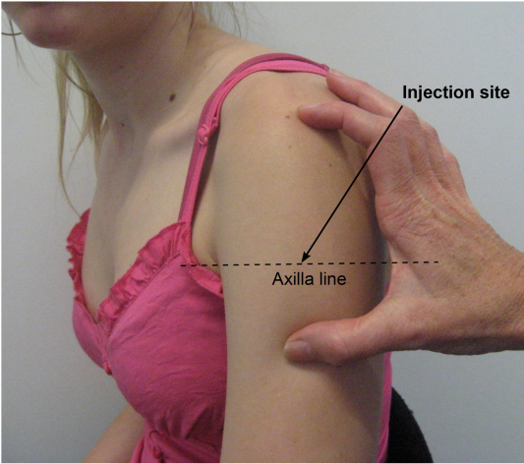
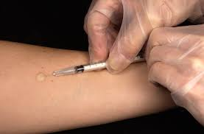
Intradermal Tokyo BCG placement
PPD placement
Intradermal PPD placement is on volar aspect of the forearm
Intradermal Tokyo BCG placement is halfway down the outer aspect of the upper arm at the level of the axilla line. Do not vaccinate at the shoulder.

Slide 19
Tokyo BCG vial

Slide 26
Data and sample submission
Section 14 of the protocol contains instructions for data submission
Section 15 of the protocol contains special instructions for sample submission (blood, urine, slides), and QOL administration
Notes:
The data and sample submission are well detailed within the protocol with section 14 of the protocol containing instructions for data submission and section 15 containing instruction for sample submission. – this includes instructions for PD-L1 testing, tissue banking, PK/ADA sampling, QOL administration and image submission to IROC.

Slide 27
Patient Reported Outcomes (PROs)
PROs directly measure effect of a treatment on quality of life as directly reported from the patient
Treatment-related toxicities may impact PROs
The goal is to compare quality of life between study arms

Slide 28
Patient-Reported Outcome (PRO)
Objectives
Primary Objective:
To compare patient-reported urinary function and bother before, during and after intravesical treatment across S1602 treatment arms to test the null hypothesis that patient-reported urinary function/bother scores do not differ significantly by tested agents/study groups at 6 months
Secondary Objectives:
To examine whether patient-reported urinary function/bother are transiently but negatively affected by intravesical BCG-based treatment across time points with recovery to baseline scores
To compare symptoms and general QOL between comparison arms of S1602

Slide 29
Methodology
Instruments focus on urinary function, bother, symptoms as well as general QOL
When? Baseline, 6-wk, 3-mo, 6-mo, and 12-mo times that correspond to study visits
Trained (view training module) research staff will administer PRO forms to patients
Administered and collected on-site in paper-pencil format with follow-up collection for incomplete or missed forms
Instruments scored and compared across S1602 treatment groups

Slide 30
Survey Instruments
Bladder Cancer Index (BCI): 36 items in bowel, sexual and urinary domains. Psychometrically developed & evaluated with good validity/reliability.
EORTC QLQC-30: 30 cancer-specific item in 5 functional domains (physical, role, cognition, emotional and social), 3 symptom scales (fatigue, pain and nausea/vomiting) and a global health and QOL scale.
AUASS: 7 question urinary symptom scale and QoL x 1
Instrument | Description | No. of Questions
 |  | Baseline | 6 wk | 3 mo | 6 mo | 12 mo
BCI | Urinary, bowel, sexual domains QoL | 36 | 36 | 14 (urinary) | 36 | 36
QLQ-30 | Global QoL | 30 | - | - | 30 | -
AUASS | Urinary symptoms | 8 | 8 | - | 8 | -
 | Total: | 74 | 44 | 14 | 74 | 36

Slide 31
Quality Assurance
Mandatory training of key site personnel prior to first patient registration
Additionally mandatory centralized training to be provided if major changes to the protocol occur, or common problem areas are identified during monitoring and audits
Oversight through routine auditing and monitoring using a risk-based approach to monitoring.
Notes:
Quality Assurance will require mandatory training of key site personnel prior to the first person registration.
In addition mandatory centralized training will be done if major changes to the protocol occur or common problems occur during monitoring and/ or audits.
There will be oversite through routine auditing and monitoring using a risk based approach to monitoring as is common for SWOG studies.

Slide 32
Quality Assurance
SWOG monitor dedicated to S1602
Routine monthly communication between monitor and site staff to assess potential problem areas, provide feedback, identify staff turnover, etc.
Centralized electronic monitoring
On site monitoring

Slide 33
Informed Consent
Patients are required to complete informed consent discussion and sign consent for
Study procedures which include urine collection
Patients may opt-in to have their tissues banked for future research
Notes:
The informed consent process is straight forward with all patients required to complete informed consent discussion and sign consent with study procedures which include PD-L1 staining.
Patients may opt-in to have their tissues banked for future research. We are hopeful most patients will agree to this.

Slide 34
Acknowledgements
SWOG Leadership
Ian Thompson, MD
Seth Lerner, MD
Christopher Ryan, MD
Statistics
Cathy Tangen, DrPH
Melissa Plets, MS
Joseph Unger, PhD
Michael Wu, PhD
Patient Advocacy
Rick Bangs
Quality of Life Studies
Scott Gilbert
Translational Medicine
Josh Meeks
The Hope Foundation
SWOG Group Chair’s Office
Casey Dawson
Edith Van Putten
Nathan Eriksen
SWOG Operations Office
Dana Sparks, MAT
Nicki Trevino
Japanese BCG Laboratories (JBL)
Naoki Nakada
Tamio Hoshina
JBL’s U.S. Liaisons
Tim Ratliff
Christine Richardson
Study Chairs/Participants
Ajjai Alva, MD
Michael Woods, MD
Peter Black, MD

