Slide 1
S1605: Phase 2 trial of Atezolizumab in BCG-unresponsive non-muscle invasive bladder cancer.
SC: Peter Black, UBC
Parminder Singh, Mayo Clinic
Notes:
MPDL3280A = atezolizumab = PD-L1 inhivi
tory monoclonal antibody

Slide 2
S1605 Agenda
1. Introduction
2. Protocol Overview:
Study Objectives
Inclusion/Exclusion Criteria
Enrollment Goals
Visit Schedule
Study Procedures
3. Translational Medicine
& Bio-Banking
4. Monitoring & Auditing
5. Investigator
Responsibilities
6. Patient Perspective
7. Questions and
Answers

Slide 3
Introduction
Black & Singh

Slide 4
S1605 SWOG Study Team
Principal Investigators
Peter Black, M.D. (Urology)
University of British Columbia
Phone: 604/875-4301
E-mail: pblack@mail.ubc.ca
Parminder Singh, M.D. (Medical Oncology)
Mayo Clinic Arizona
Phone: 480/342-4800
Email: Singh.Parminder@mayo.edu
Seth Lerner, M.D. (Urology)
Scott Department of Urology
Baylor College of Medicine
Phone: 713/798-6841
E-mail: slerner@bcm.edu
Notes:
Add Scott Lucia - Pathology

Slide 5
S1605 SWOG Study Team
Protocol Coordinator
Nicki Trevino
SWOG Operations Office
ntrevino@swog.org
Biostatisticians
Cathy Tangen, Dr.P.H. (Biostatistics)
Michael Wu, Ph.D. (Translational Studies)
Melissa Plets, M.S.
SWOG Statistical Center
Fred Hutchinson Cancer Research Center
E-mail: ctangen@fredhutch.org
E-mail: mcwu@fredhutch.org
E-mail: mplets@fredhutch.org
Notes:
Add Scott Lucia - Pathology

Slide 6
S1605 SWOG Study Team
Translational Study Chair
David McConkey, Ph.D.
Greenberg Bladder Cancer Institute
Brady Urological Institute at Johns Hopkins
Email: djmcconkey@jhmi.edu
Patient Advocate
Rick Bangs
E-mail: chezrick@comcast.net
Pathologist
Scott Lucia, M.D.
University of Colorado
Scott.Lucia@ucdenver.edu
Notes:
Add Scott Lucia - Pathology

Slide 7
S1605 – Intergroup Participation
Alliance
Michael Woods, MD
University of North Carolina
ECOG-ACRIN
Trinity Bivalacqua, MD, PhD
Brady Urological Institute at Johns Hopkins
CCTG
Wassim Kassouf, MD
McGill University

Slide 8
Study Objectives
P Black

Slide 9
S1605
Phase 2 trial of Atezolizumab in BCG-unresponsive non-muscle invasive bladder cancer.

Slide 10
“BCG unresponsive” high risk NMIBC
Recurrent/persistent high grade urothelial carcinoma after completion of at least induction and one cycle maintenance BCG (“5+2”) for high grade Ta/T1/Tis
  Never achieved CR or recurred within 6 months of last BCG dose
  Also T1HG recurrence/persistence after induction
Unfit for or “refusing” radical cystectomy
Lerner et al. Bladder Cancer 1:29,2015)

Slide 11
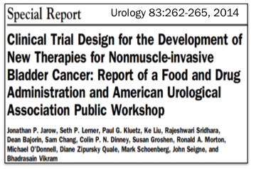

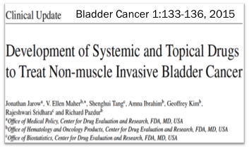
Consensus definition of BCG-unresponsive patient cohort and outline of trial design for FDA registration pathway

Slide 12
Current standard therapy in BCG unresponsive NMIBC
there are no established 2nd line intravesical therapies (Valrubicin FDA approved but ineffective)
standard is radical cystectomy
  some patients not eligible
  some patients will decline
  many patients will experience complications
  most patients will experience negative impact on quality of life

Slide 13
Urgent unmet clinical need
novel therapies to preserve bladder

Slide 14

Draft FDA Guidance – November 2016

Slide 15
Clinical Trial Design – FDA Guidance
Randomizing patients with BCG-unresponsive disease to a minimally effective drug as a concurrent control raises ethical concerns.
Because effective drugs are not available and the alternative treatment is cystectomy, single-arm trials of patients with BCG unresponsive CIS disease with or without papillary disease are appropriate.
Primary endpoint should be complete response in patients with CIS

Slide 16
What is Atezolizumab?
monoclonal antibody
targets and blocks the immune checkpoint PD-L1
  thereby unleashes anti-tumor immune response
administered by intravenous infusion

Slide 17
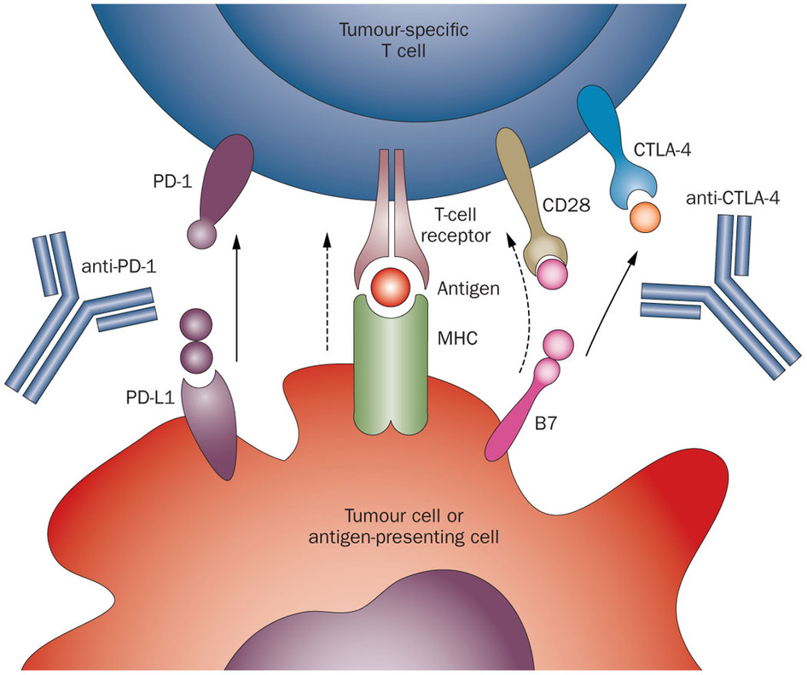
Drake et al., Nature Reviews Clinical Oncology 11, 24–37 (2014)
Notes:
Checkpoint inhibitors are now so familiar to you all that I think we can bypass the usual primer on tumor immunology. Let me just point out that I will be talking almost exclusively about PD1, PDL1 and CTLA4 inhibitors.

Slide 18
Checkpoint Blockade in Bladder Cancer
Atezolizumab (2016) and nivolumab (2017) are FDA approved for 2nd line therapy after platinum-chemo
  Atezolizumab also for 1st line platinum-ineligible
Pembrolizumab superior to 2nd line chemo in phase III trial¹
Durvalumab and avelumab show similar efficacy in early phase trials
First-line trials underway
IO moving to earlier disease states
¹ Bellmunt et al, NEJM 2017

Slide 19
Rationale for checkpoint blockade in
BCG-unresponsive NMIBC
High risk NMIBC responds to immunotherapy
PDL1 is expressed in NMIBC¹
Efficacious in syngeneic mouse models of BC²
Encouraging results in metastatic disease^{3,4}
Hypothesis: checkpoint molecules facilitate immune evasion in BCG-unresponsive NMIBC and this can be overcome with checkpoint inhibitors
¹ Inman et al, Cancer 2007
² Mangsbo et al, J Immunother 2010
³ Powles et al, Nature 2015
⁴ Rosenberg, Lancet 2016

Slide 20
Study Scheme
Atezolizumab
Atezolizumab
Atezolizumab
maintenance q3wks for
9 cycles
Atezolizumab
Atezolizumab
Atezolizumab
Atezolizumab
Atezolizumab
Atezolizumab
Atezolizumab
BCG unresponsive
Ta/T1/Tis (TURBT)
cysto cytology
cysto cytology biopsy
surveillance
for 18 mo.
q 3 weeks
13 weeks*
q 3 weeks
CR @
25 weeks*
(=6 months post TURBT)
EFS @ 18
months*
registration within
60 days of TURBT
start therapy within
5 days of registration
* time is relative to registration

Slide 21
Co-Primary Endpoints
Complete response (CR) in patients with CIS
  negative cytology, cystoscopy, biopsy at 6 months
Event-free survival (EFS) at 18 months for overall study cohort (Ta/T1/CIS)
    histologically proven high grade urothelial carcinoma of bladder, urethra or upper tract; or
    muscle invasive bladder cancer; or
    metastasis; or
    death due to any cause
Notes:
Event: Histologically proven first appearance of high-grade bladder cancer (≥ Ta, including CIS), persistent CIS at Week 25, muscle-invasive bladder cancer, clinical evidence of metastatic disease, high grade upper tract urothelial carcinoma, high grade urothelial carcinoma of the prostatic urethra, or death due to any cause.

Slide 22
Secondary Endpoints
Durability of response in CIS patients achieving CR
EFS in Ta/T1 subset (no CIS)
Progression-free survival (PFS)
  Progression to MIBC, cystectomy or metastasis
Cystectomy-free survival
Cancer specific survival (CSS)
Overall survival (OS)
Notes:
Also TM endpoints

Slide 23
Inclusion & Exclusion Criteria
P Black

Slide 24
Eligibility Criteria - Disease
patients must fulfill definition of BCG-unresponsive
  high grade Ta/Tis
    after at least induction and maintenance (“5+2”) or 2nd induction BCG
    within 6 months of last dose BCG
  high grade T1
    after at least induction BCG
  high grade Ta/Tis/T1
    recurrence within 6 months of last dose BCG in patients who were NED at 6 month time point

Slide 25
Eligibility Criteria - Disease
histologically proven, recurrent, NMIBC within 60 days prior to registration meeting criteria for BCG-unresponsive
  tissue must be available for central pathology review
mixed urothelial carcinoma with a glandular and/or squamous component will be eligible
presence of other histologic variants, pure adenocarcinoma, or pure squamous cell ca, will make a patient ineligible

Slide 26
Eligibility Criteria - Disease
all visible tumor (but not CIS) must be completely resected within 60 days prior to registration
cystoscopy confirming no visible papillary tumor within 21 days prior to registration
cytology within 21 days prior to registration
  cytology for CIS patients not expected to be negative
  if the cytology for patients with only Ta/T1 disease is positive for malignant cells, patient must have had a biopsy of the prostatic urethra within previous 6 mo.

Slide 27
Eligibility Criteria - Disease
T1: must undergo re-TURBT within 60 days prior to registration, and must have uninvolved muscularis propria in the pathologic specimen from either the first or the second TURBT
  Tissue from the re-resection must be submitted
  First TURBT may have taken place more than 60 days prior to registration
Patients must not have had urothelial carcinoma in the prostate or upper urinary tract within the previous 24 months, or muscle invasive urothelial carcinoma of the bladder at any time.
Notes:
many other criteria related to prior/concurrent therapies and lab/clinical criteria

Slide 28
Eligibility Criteria - Disease
Patients must have a CT or MRI of the abdomen and pelvis to rule out upper tract malignancy and intra-abdominal metastases within 90 days prior to registration.
Patients must be deemed unfit for radical cystectomy by the treating physician, or the patient must refuse radical cystectomy (RC)
  RC is considered standard of care for these patients.
  Reason not to undergo RC must be documented.
Notes:
many other criteria related to prior/concurrent therapies and lab/clinical criteria

Slide 29
Eligibility Criteria – Prior Therapy
All adverse events associated with any prior surgery and intravesical therapy must have resolved to Grade ≤ 2 prior to registration.
Patients must not have had systemic chemotherapy or immunotherapy. Prior intravesical interferon therapy is allowed.
Patients must not be planning to receive concomitant other biologic therapy, radiation therapy, intravesical chemotherapy, surgery, or other therapy while on this protocol.
Patients must not have received any prior radiation to the bladder for bladder cancer. Radiation for prostate/cervix cancer ok.
Notes:
including, but not limited to interferon alfa-2b, high dose IL-2, PEG-IFN, anti-PD- 1, anti-PD-L1, intra-tumoral, or vaccine therapies prior to registration. Patients must not have received or be planning to receive any of the prohibited therapies listed in Section 7.3 during protocol treatment.

Slide 30
Eligibility Criteria – Prior Therapy
Patients must not have received treatment with systemic immunosuppressive medications (e.g. prednisone, cyclophosphamide, azathioprine, methotrexate, thalidomide, and anti- TNF agents) within 2 weeks prior to Cycle 1, Day 1.
Exceptions:
  Patients may have received acute, low dose, systemic immunosuppressant medications (e.g., a one-time dose of dexamethasone for nausea);
  The use of inhaled corticosteroids and mineralocorticoids (e.g., fludrocortisone) for patients with orthostatic hypotension or adrenocortical insufficiency is allowed.

Slide 31
Eligibility Criteria – Lab/Clinical
adequate bone marrow and liver function
eGFR ≥ 30 ml/min
Zubrod Performance Status ≤2
no active infection within 14 days
  no severe infection within 28 days
no autoimmune disease requiring systemic
therapy in last 2 years
no prior malignancy within 5 years (exceptions)
Notes:
severe infection: including but not limited to hospitalization for complications of infection, bacteremia, or severe pneumonia.
No other prior malignancy is allowed except for the following: adequately treated basal cell or squamous cell skin cancer, in situ cervical cancer, adequately treated Stage I or II cancer from which the patient is currently in complete remission, or any other cancer from which the patient has been disease free for five years.

Slide 32
Enrollment Goals
M Plets

Slide 33
Enrollment goals
Sample size:
  135 eligible patients + additional 10% to account for ineligibility = 148 total
  Target accrual rate: 4 patients/month
    ~ 3 years to fully accrue
  Maximum follow-up: 5 years
Stratification Factor
CIS component: | 70 eligible patients
T1/Ta only: | 65 eligible patients
Notes:
The total sample size for this trial is 135 eligible patients, but we will accrue a total of 148 patients to account for approximately 10% ineligible patients. We have one stratification factor and that is CIS component at study entry vs T1/Ta only. Of those 135 eligible patients, we will be capping accrual of the T1/Ta only subset to 65 eligible patients to ensure that we accrue 70 eligible CIS patients.
We anticipate that we will accrue an average of 4 patients per month, resulting in approx 3 years of accrual. All patients will be followed for a maximum of 5 years.

Slide 34
Enrollment goals
Hierarchical / Step-down approach
    Co-primary objective #1: Complete Response at 25 weeks in CIS
      H₀: 30% H_{A}: 50%
    Type I error rate (one-sided) of 0.05
    Statistical power of 0.96
    Co-primary objective #2: Event-free survival at 18 months
      H₀: 20% H_{A}: 30%
    Type I error rate (one-sided) of 0.05
    Statistical power of 0.93
Notes:
As Dr. Black mentioned, we have 2 co-primary objectives in this study: CR at 25 weeks for CIS patients and EFS at 18 months for Ta/T1/CIS patients.
An interesting feature about this study design is the hierarchical or step-down approach for these objectives. Meaning we will evaluate the CR at 25 weeks for CIS patients first (which is the endpoint that the FDA is most interested in). Then, only if those results are statistically significant will we evaluate EFS at 18 months.
I brought this up again because it is important that you understand how critical it is for us to get the data needed to evaluate this CR endpoint. Since those patients with out a biopsy at 25 weeks will be considered non-responders, missing assessments/data for this timepoint potentially makes it that much harder to have the opportunity to assess the 2nd co-primary objective. I will go into more detail about disease assessment schedule, including this week 25 biopsy, in a few minutes.

Slide 35
Futility Analysis in CIS cohort
Co-primary endpoint: Complete Response in CIS
Evaluate first 25 CIS patients for CR at 25 weeks
  trial will continue to accrue while interim evaluation underway
7 (28%) or more CRs out of 25 would be considered favorable and study will continue to accrue to a total of n=70
Notes:
We have one futility interim analysis built into the study for each of these co-primary objectives.
For the first co-primary objective, CR at 25 weeks in CIS pats, we will evaluate the first 25 CIS patients – note that the trial will continue to accrue during the time of this interim evaluation. If 7 or more CRs occur, we would continue to accrue to the full n=70 CIS patients.

Slide 36
Futility Analysis in Ta/T1/CIS
Co-primary endpoint: Event free survival at 18 months in Ta/T1/CIS
Conducted at the end of accrual
  If the upper bound of the 99% EFS CI is lower than 30%, consider reporting results early due to futility
Will not consider reporting early due to efficacy
Final analysis will be conducted when all patients have been followed for 18 months.
Notes:
The futility interim analysis for the 2nd co-primary objective, EFS at 18 months, will occur at the end of accrual. Since the endpoint occurs at 18 months and accrual is expected to be steady but modest, an interim analysis of EFS prior to this point would not be informative.
We will construct a 99% CI around the 18 mo EFS KM estimate and if that CI is lower than 30% we will consider it unlikely that we will meet our threshold and will consider reporting results early due to futility
Please note that we will NOT be reporting results early due to efficacy because we want to ensure we have convincing evidence at the end of the trial.
The final analysis will be conducted when all patients have been followed for 18 months.

Slide 37
Visit Schedule
Treatment and disease assessment
M Plets
Notes:
For this study, disease assessment is independent of treatment schedule – meaning that disease assessments are at fixed timepoints relative to registration. If a patient has a dose delay or hold, disease assessment schedule will remain at those fixed timepoints specified in the protocol.
To emphasize this, and to potentially make the scheduling a little easier to understand, we created 2 separate study calendars – one for the treatment schedule and one for the disease assessment schedule

Slide 38
Study Calendar
9.1 TREATMENT AND SPECIMEN SUBMISSION
Notes:
Section 9.1 in the protocol is the treatment schedule calendar. A treatment cycle is 21 days and drug is administered on day 1 of each cycle. Dr. Singh will be talking more about dosing and administration here shortly.
You will see specimen collection here, as well as in the separate disease assessment calendar. I will come back to these a little later.
I want to point out here that in the absence of treatment delays or holds, cycles 5, 9, 13 and 17 will coincide with disease assessments

Slide 39
Study Calendar
9.2 DISEASE ASSESSMENT
REQUIRED
(pts w/ CIS)
Notes:
Section 9.2 in the protocol is the calendar for disease assessment.
While the patient is receiving atezolizumab, disease assessment is to be conducted every 12 weeks and this 12 week schedule continues after completion of protocol therapy up to week 109 (about 2 years) after registration. Then disease assessment is to occur every 24 weeks for the duration of follow-up (5 years).
At each disease assessment, all patients will undergo cystoscopy and urine cytology. If either the cystoscopy looks suspicious or there are malignant cells present in the urine cytology, the patient will then undergo a biopsy. If the biopsy determines that the patient has had a HG recurrence, they discontinue protocol treatment. If the biopsy is negative or determines the patient has had a LG recurrence, the patient should continue protocol therapy. Dr. Singh will be talking more about the disease assessment process in detail in a few minutes.
There is one exception and that is what I really want to focus on here. There is a mandatory week 25 biopsy for patients with a CIS component at study entry. It is imperative that this procedure happens as this endpoint is one of the co-primary objectives of this study- but more than that (as I mentioned before), this aim will be tested first and only if it is statistically significant will the EFS objective be evaluated.
Because this procedure is so important, the SDMC will be taking some additional steps to help remind sites in enough time to ensure their patient is scheduled for this biopsy. I will touch on that again in more detail in a little bit.

Slide 40
Study Calendar
9.2 DISEASE ASSESSMENT
Co-primary endpoint: EFS @ 18 months in Ta/T1/CIS
CT or MRI imaging of the abdomen and pelvis 18 months after registration (if patient has not had HG recurrence)
  Images must be locally read and interpreted by radiologist
Must be submitted electronically via AG Mednet
Notes:
Another important procedure is this 18 month CT or MRI scan for all patients who have not had a HG recurrence. This procedure will be critical in evaluating our second co-primary objective, EFS at 18 months.
These images must be locally read and interpreted by radiologist
Because this is an FDA study, we are also collecting these scans. Scans must be submitted electronically via the AG Mednet system. The detailed instructions for accessing AG Mednet and submitting the images are in section 15.2 of the protocol.
Note: this is also a regularly scheduled disease assessment timepoint – cystoscopy, urine cytology and a “for-cause” biopsy will also be performed at this timepoint. We will also be expecting the cytology report and path report (if biopsy performed) to be uploaded as source docs in RAVE, just like all other disease assessment timepoints.

Slide 41
Allowable windows
Mandatory 25 week biopsy (CIS pts. only)
Within 7 days after start of week 25
CT or MRI @ 18 months (All pts. without HG recurrence)
+/- 28 days
All other scheduled disease assessments
+/- 7 days
Notes:
The allowable window for that mandatory week 25 biopsy for CIS patients is up to 7 days after the start of week 25. Note that this is not a +/- . It is up to 7 days AFTER the start of week 25.
The allowable window for the 18 month CT/MRI is +/- 28 days
The allowable window for all other scheduled disease assessments is +/- 7 days.

Slide 42
Follow-up Schedule
Off Treatment: PRIOR to HG Recurrence
  Every 12 weeks for the first 2 years, then every 24 weeks for years 3-5 until HG recurrence or death
Off Treatment: AFTER HG Recurrence
  Follow-up forms are required every 6 months for the first 2 years, then annually for Years 3-5
**Toxicity Assessment**
  Follow-up (off treatment) safety assessments are required at
  30 days and 90 days after the last dose of atezolizumab.
  ALL TOXICITIES for first 30 days, then only ≥ Grade 3 thereafter
Notes:
What happens when a patient discontinues or completes protocol treatment with atezolizumab?
We break it down into 2 scenarios:
the first being Off treatment PRIOR to HG recurrence. This could mean that the patient completed the full 17 cycles of treatment and is now in follow- up, or that the patient went off of protocol treatment early due to a reason other than HG recurrence.
In this scenario, the patient is to be followed every 12 weeks for the first 2 years, then every 24 weeks thereafter until HG recurrence or death. In this case, when we say “followed” we mean continued disease assessments on this schedule. Meaning you will be submitting BOTH the follow-up form and the disease assessment form in RAVE.
The 2nd scenario is Off treatment AFTER HG recurrence
Here, we expect follow-up every 6 months for the first 2 years, then annually thereafter. In this case, only the follow-up form is to be submitted, not the disease assessment form. However, there are some events such as cystectomy and Muscle invasive disease that we are interested in collecting on that Follow-up form for our secondary study objectives.
I also wanted to point out toxicity assessment during follow-up because it is a little different than SWOG standard. Usually, SWOG only requires >= Grade 3 toxicities to be reported. However, the FDA requires that ALL toxicities, even Grade 1’s, be reported for the first 30 days following the last dose of study drug, then >= Grade 3 thereafter.

Slide 43
Visit Schedule
Specimen Submission
M Plets
Notes:
I wanted to touch on specimen submission because this study has some Required specimens for central review and some requested specimens for translational medicine projects. I want to highlight the difference.

Slide 44
Specimen Submission
REQUIRED | REQUESTED
Three (3) H&E slides
  Baseline
  All subsequent onstudy biopsies
One (1) urine cytology slide (CIS patients only)
  Week 13
  Week 25
FFPE tissue from TURBT
  Baseline
  All subsequent onstudy biopsies
Whole blood
  Baseline
  Day 1 of cycles 5, 9, 17
Urine
  Baseline
  Day 1 of cycles 5, 9, 17
  At 18 months
Notes:
The required specimens will undergo central review to determine eligibility and confirm diagnosis. These include 3 H&E stained slides to be collected at baseline and all subsequent onstudy biopsies (all patients). And 1 urine cytology slide (CIS patients only) at the week 13 and week 25 disease assessments. I also want to note that we will also be expecting the associated path reports and cytology reports to be uploaded as source docs in RAVE.
The requested specimens are those which are not required, but are required to be offered to the patient and if they consent, we will be expecting all of these to be submitted. These specimens include:
FFPE tissue from TURBT at baseline and all subsequent onstudy biopsies.
Whole blood collected at baseline and day 1 of cycles 1, 5, 9, and 17
And urine collected prior to start of treatment, on day 1 of cycles 5, 9, and 17 and at 18 months (when you will also be doing that mandatory CT/MRI).
Dr. David McConkey will be talking more about the TM projects associated with these specimens in detail in a few minutes

Slide 45
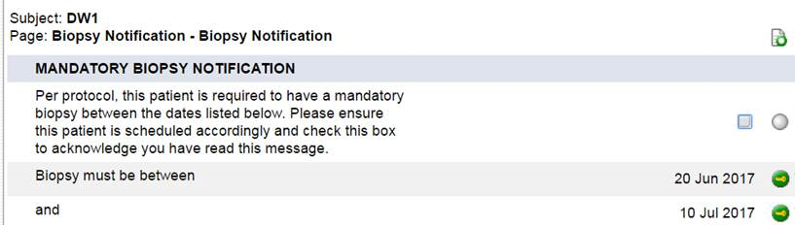
Helpful tools
RAVE notification:
Statistics and Data Management Center reports
  Reminders sent via email ~ 1 month before patient is due for 25 week mandatory biopsy
Notes:
We recognize that this is not exactly a vanilla SWOG study and I just want to point out a couple of helpful tools we created including:
We have created a “Biopsy Notification” form in the baseline folder in RAVE that will only roll out for CIS patients. This notification will contain the dates for the allowable window for the mandatory biopsy as well as a check box notifying us that you have read the notification. This box will need to be checked or it will show up as “overdue data” in RAVE.
The SDMC (aka me) has created an automatic report that will run weekly that tells me which CIS patients will be due for their mandatory 25 week biopsy in about 5 weeks. I will then manually send a reminder email to the treating investigator and the head CRA at that site. This email will include the patient’s SWOG id, reg date, and the allowable time window for their 25 week biopsy (relative to their regdt). This email is only intended to be a reminder, so please do your best to track the scheduling for each patient. Additionally, the contact information I have available at the SDMC may not necessarily be the people in charge of scheduling the patient, so please bare with me and forward my reminder email to the appropriate party. I am also open to any suggestions from you that may make these reminder emails more beneficial to you (i.e. if there are additional fields that may be helpful).

Slide 46
Helpful tools
Disease assessment flow chart (section 7.3 of protocol)
Resources
  Statistics and Data Management Center (SDMC)
    guquestion@crab.org, (206)652-2267
  Study Chairs – emails on title page of protocol
Notes:
We have also inserted a very comprehensive disease assessment flow chart in sect 7.3 of the protocol which walks you through what procedures are expected at those week 13 and week 25 disease assessment timepoints for CIS patients. Dr. Singh will be talking more about this flow chart in a minute.
And lastly, you can always contact our data coordinators at the SDMC via email or phone, as well as our Study Chairs, Dr. Black and Dr. Singh. We are here to help.

Slide 47
Treatment Plan and Monitoring
P Singh

Slide 48
Prohibited Medications
Anti-cancer systemic chemotherapy or biological therapy.
Immunotherapy not specified in this protocol.
Any non-study anti-cancer agent (investigational or non-investigational).
Investigational agents other than atezolizumab.
Radiation therapy
Live vaccines
  Seasonal influenza vaccines for injection are generally killed virus vaccines and are allowed; however, intranasal influenza vaccines (e.g. Flu-Mist®) are live attenuated vaccines, and are not allowed
Glucocorticoids for any purpose other than to modulate symptoms from an event of suspected immunologic etiology.
  The use of physiologic doses of corticosteroids (defined as 10 mg prednisone) is acceptable, however site investigators should consult with the Study Chair for any dose higher than 10 mg prednisone.

Slide 49
Treatment Plan
Atezolizumab is administered at standard dose -1200mg IV every 3 weeks
No premedication required but can be used after 2nd cycle at the discretion of physician
No PK/PD labs
First infusion is 60 min
If tolerated subsequent infusion can be reduced to 30 min
Vitals to be monitored every 30 min during infusion

Slide 50
Treatment Plan
Infusion can be restarted for grade 2 IRR side effects after treatment
Treatment will be abandoned completely if Grade 3 or higher IRR
CBC, CMP prior to every infusion and TSH every 2 infusion
Protocol does not mandate history and physical at every infusion
Notes:
infusion-related reactions

Slide 51
Adverse Events
CTCAE V4.0 for toxicity and serious adverse event reporting
no atezo dose reduction allowed
may suspend treatment up to 42 days due to AEs
standard medical management of AEs
Notes:
(NCI Common Terminology Criteria for Adverse Events)

Slide 52
Surveillance on treatment
Regular blood-work
Cytology + cystoscopy every 3 months up to 18 months
Mandatory biopsy at 6 months in all patients with CIS at baseline (exception: next slide)
Any positive cystoscopy or cytology will require biopsy and possibly imaging according to standard practice
CT-IVP or MRI prior to study entry and at 18 months

Slide 53
treat with atezolizumab
WEEK 13
cystoscopy –
cytology –
cystoscopy +
cytology +/–
cystoscopy +/–
cytology +
biopsy
biopsy -
biopsy +
treat with atezolizumab
off treatment
WEEK 25
cytology & cystoscopy
**mandatory biopsy**
cytology & cystoscopy
for cause biopsy only
Positive cystoscopy is defined as suspicious for malignancy
Positive cytology is defined as positive for malignant cells
Disease assessment schedule is independent of treatment schedule. Disease assessment must occur at weeks 13 & 25 (± 7 days) regardless of treatment delays.

Slide 54
Imaging
All participants will undergo CT or MRI imaging of the abdomen and pelvis 18 months after registration if they have not had a high-grade recurrence
Images must be locally read and interpreted by radiologist
Imaging exams must then be submitted via AG Mednet for quality control and image banking

Slide 55
Quality Assurance Auditing and Monitoring
Audits are conducted according to FDA regulations and NCI guidelines for Auditing Clinical Trials for the National Clinical Trials Network (NCTN) Program, NCI Community Oncology Research Program (NCORP) and Research Bases
Additional on-site monitoring mandated by study
The major objective of the audit process is to verify study data that could affect the interpretation of primary study endpoints

Slide 56
Translational Medicine and Biobanking
D McConkey

Slide 57
Mandatory specimen submission for central pathology review
3 H&E slides from each TURBT/biopsy:
  prior to study registration (including both specimens if patient had re-TURBT)
  at time of mandatory re-biopsy in patients with CIS at baseline
  from all subsequent TURBT/biopsy for suspected recurrence
Urine cytology (1 slide) at week 13 and
week 25 in all patients with CIS at baseline
Failure to submit will make patient ineligible!

Slide 58
Translational Medicine Plan
To identify markers that predict response to atezolizumab in BCG-unresponsive non-muscle invasive bladder cancer. We will test the hypothesis that the following markers predict response:
  Expression of PD-L1 and CD8 by IHC
  Expression of immune expression signatures by RNA-sequencing (including molecular subtyping)
  Neoantigen burden by whole exome sequencing
Tissue, urine and blood banking

Slide 59
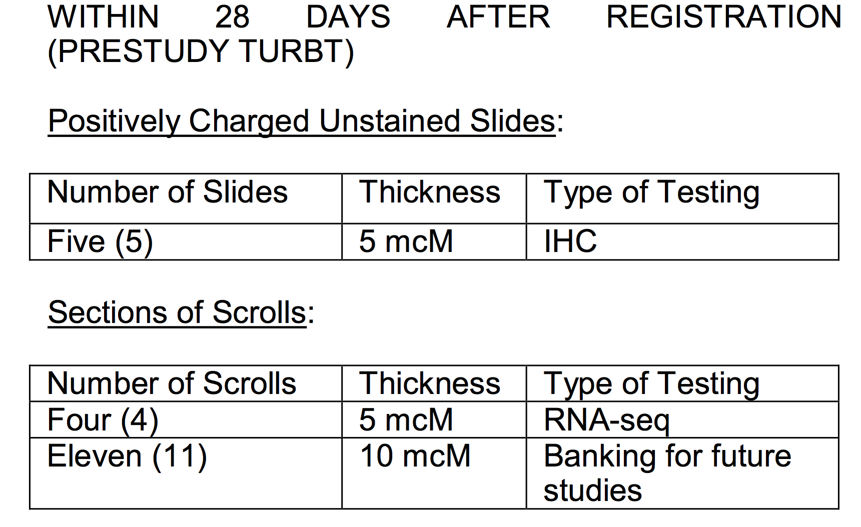
Tissue requirements for TM
all translational studies on tissue require FFPE tissue sections on slides or as scrolls
Notes:
11 slides for banking includes 5 for WES

Slide 60
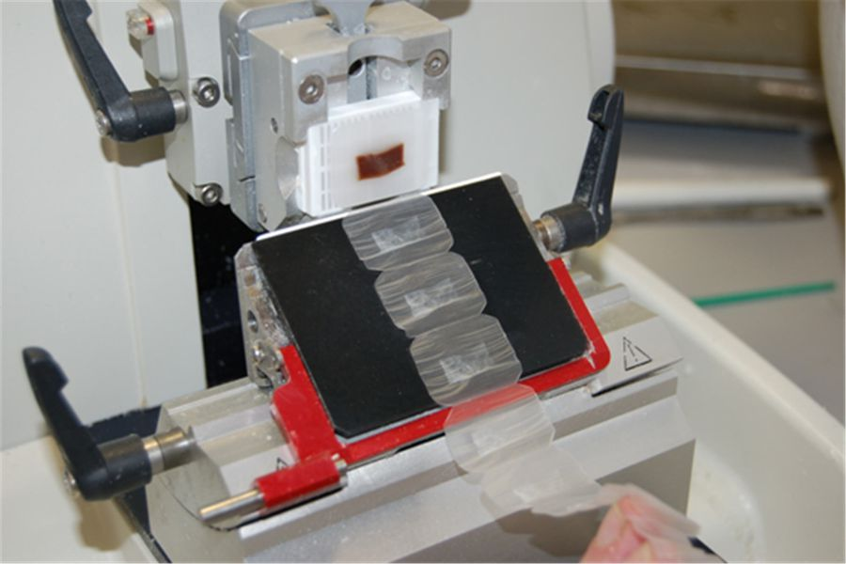
What is a scroll?

Slide 61
Immunohistochemistry
Genentech will sponsor IHC for PD-L1 and CD8 in a CLIA-certified third party laboratory
Validated assays from prior trials will be used
  FDA-approved Ventana PD-L1 (SP142 or SP263)
  CD8+ lymphocyte density in specified regions of tissue
Notes:
CD8
Image analysis will be used to determine the number of CD8+ cells in specified regions of the tissue, including: i) tumor, ii) invasive front (the boundary between malignant and nonmalignant tissue), and iii) normal tissue. CD8+ lymphocyte density will be calculated in each region using an algorithm described in Cuka et al. (PIP: An Open Source Framework for Multithreaded Image Analysis of Whole Slide Images. Laboratory Investigation; 94:398A-A, 2014).
PDL1
Genentech researchers or delegate pathologists will score the PD-L1 staining intensity using their established scoring system, rating both tumor cells and immune cells as IHC 0, 1, 2, or 3 if < 1%, ≥ 1% but < 5%, ≥ 5% but < 10%, or ≥ 10% of cells are PD-L1 positive, respectively.

Slide 62
RNA sequencing
FFPE sections
Genentech will sponsor RNAseq in a CLIA-certified third party laboratory
Molecular subtyping according to TCGA clusters
Raw data available to SWOG investigators for analysis

Slide 63
Mutation Rate
Not yet included in CTEP submission
  will require amendment
Plan whole exome sequencing from FFPE sections
Analysis of mutational load as a surrogate for neoantigen burden
Able to make microsatellite instability (MSI) calls as well
  surrogate for mismatch repair deficiency

Slide 64
Whole Blood for Banking
Current Protocol
Whole blood at registration
  5 ml in sodium heparin tube
  use for germline DNA to be compared to whole exome sequencing from tissue
Whole blood on day 1 of cycles 1, 5, 9,17
  1 ml in Smart Tube
Freeze blood without further processing at -80°C until shipment

Slide 65
Whole Blood for Banking
Upcoming amendment
Whole blood at registration
  5 ml in sodium citrate tube
  use for germline DNA to be compared to whole exome sequencing from tissue
Whole blood at registration and on day 1 of cycles 5, 9,17
  4 ml in sodium heparin tube
  Additional processing required

Slide 66
Peripheral immune cells
Blood collection in Na-heparin tubes (upcoming amendment)
mix 2 ml blood + 2.8 ml PROT1 buffer
10 min at room temperature
ok to have in fridge up to 8 hrs
storage at -80°C
CyTOF to assess for PD-L1+ immune cells and other potentially relevant immune cell subpopulations

Slide 67
Urine for Banking
Urine collected:
  prior to start of atezolizumab
  on day 1 of cycles 5, 9 and 17
  at 18 months
≈30 mL of urine mid-stream in a sterile urine cup
Aliquot collected urine into 15 cc conical tubes, centrifuge 10 minutes at 1,000 g (4ºC), and freeze (-80 ºC) until shipment

Slide 68
cfDNA in urine
experimental assay to assess panel of genomic alterations in cell-free DNA in urine
  will need CTEP amendment
for detection of tumor and recurrence
not specifically related to therapeutic agent

Slide 69
Monitoring & Auditing
E Lackey

Slide 70
S1605 Regulatory Review
Auditing
Monitoring
Investigator Responsibilities
  Evonne Lackey, BA, CCRP

Slide 71
SWOG Quality Assurance Program (SWOG Policy 19)
Program Purpose
Data reported on eCRFs accurately reflect source documents
Verify compliance with protocol and regulatory requirements
Adherence to NCI/SWOG policies and procedures
Provide educational support related to GCP, data collection and data management

Slide 72
Quality Assurance Audit Process
Standard SWOG Audit Process
  10% of registrations over past 3 years (minimum of 3 cases)
  Randomly selected cases emphasizing
    Investigational studies
    Multi-modality
    Intergroup
    Cancer control
    High accrual studies
  Typical review is one full day (depends on number of subjects accrued)

Slide 73
Quality Assurance Audit Process
Assessment of communication between monitors, SDMC, site staff to assess potential problem areas, provide feedback, identify staff turnover, etc.
Safety monitoring through routine review of adverse event reports for accuracy and timeliness of SAE reporting

Slide 74
What’s Different for S1605
Mandatory training of key site personnel prior to 1st patient registration
Additional mandatory training if major protocol changes or common problem areas are identified during monitoring and audits
Oversight through routine on-site auditing and off-site centralized monitoring

Slide 75
QA/On-Site Monitoring Process for S1605
First site visit within 6 months of first patient registration
Subsequent visits dependent on accrual but no less than once every 2 years
Site visits combined with treatment audits or other registration trial site visits

Slide 76
Other Reasons for More Frequent On-Site Monitoring
  Inadequate initial on-site monitoring result
  Deficient or delinquent data submission
  Higher than expected SAE reporting or ineligible cases
  Excessive staff turnover

Slide 77
What to Expect at an On-site Monitoring Visit
Regulatory requirements
  IRB approvals
  Consent form content
  Investigational drug accountability
  Patient Case Review
  Consent Form
  Eligibility
  Treatment
  Response
  Toxicity Assessment
  Data Quality

Slide 78
Your Responsibility During an On-Site Monitoring Visit
Source documents ready for review
EMR password issued to auditor(s) if allowed per your institution SOPs
Scheduled time to visit pharmacy
Availability to answer questions
Availability for monitoring summary/exit interview

Slide 79
QA/Audit Program Resources on SWOG Website
Links to Guidelines:
SWOG Policy 19
SWOG QA Audit Guidelines
NCI-CTMB Guidelines for Monitoring Clinical Trials
Links to Regulatory Guidance:
Human Subjects Protection
SWOG Regulatory Guidance
IRB Implementation Dates
FDA Inspections (Trial Master File Document)

Slide 80
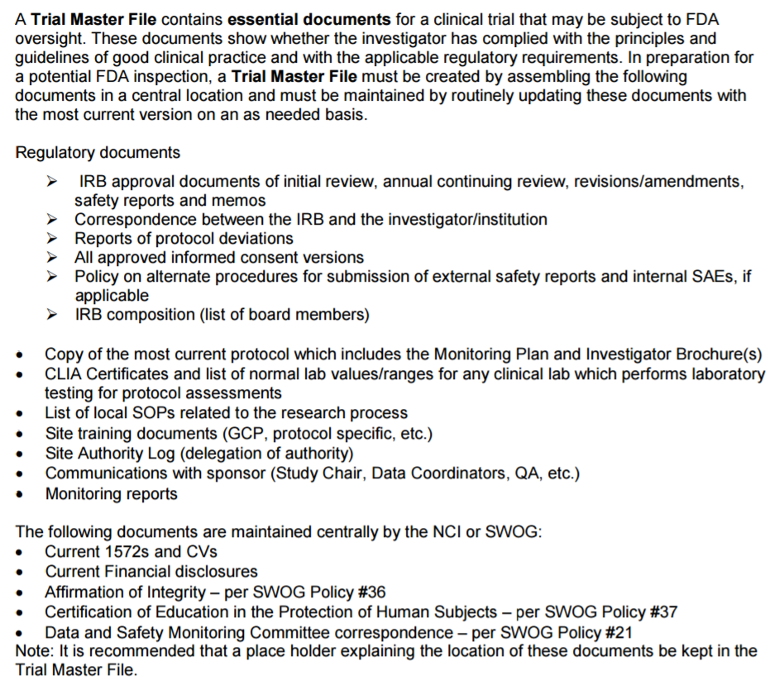

Slide 81
Who to Contact for Questions Related to
QA/On-Site Monitoring for S1605
Elaine Armstrong
  (210) 614-8808
  OR
  Email: QA@SWOG.ORG

Slide 82
SDMC Risk-based Monitoring for S1605
New for Registration Trials!
In addition to routine reviews and audits, the SDMC Central Monitors will be conducting Source Document Verification (SDV)

Slide 83
SDV Process for Centralized Monitoring
Head CRA notification via email for source document upload instructions into Rave
First two patients randomized at each site will be centrally monitored
SDV will include auditable elements* for the following:
  Eligibility
  Consent
  Activities for cycles 1 and 2
  Disease assessment at weeks 13 and 25
Data must be redacted and free of PHI
*see handout for auditable elements
Notes:
PHI – private health information

Slide 84
Centralized Monitoring at the
Statistics and Data Management Center (SDMC)
Routine review of submitted data
Remote verification of critical source documents (pathology, radiology and applicable lab reports)
Analysis of site characteristics and performance metrics to identify trial sites with poor performance or non-compliance through the SWOG IPR and other available reports
Review timeliness of SAE reporting
Review timeliness of data submission
Verification of specimen submission
* See Central Monitoring Handout for more details

Slide 85

Who to Contact for Questions Related to
Centrally Monitored Data for S1605
Dona Marrah, CCRP
Donam@crab.org

Slide 86
Investigator Responsibilities
E Lackey

Slide 87
Investigator Responsibilities – Who is an Investigator?
An individual who actually conducts a study (i.e. under whose immediate direction the test article is dispensed to a subject)
OR
In the event an investigation is conducted by a team of individuals, the investigator is the responsible leader of the team
[21 CFR 312.3]

Slide 88
Investigator Responsibilities - 1572
Personally oversee or conduct investigation
Follow protocol – modifications only after sponsor (SWOG) notification unless a patient is at risk
Ensure all persons supporting the study are informed of obligations
Inform patients that agents are being used for investigational purposes
Ensure informed consent (21 CFR Part 50)
Obtain initial and ongoing IRB approval (and comply with every thing that goes along with working with an IRB) (21 CFR Part 56)
Report adverse events (21 CFR 312.64)

Slide 89
Investigator Responsibilities - 1572
Maintain accurate records (21 CFR 312.62) and make them available for inspection in accordance with federal regulations
Read more about it…..
  Section 5 of ICH E6 (R2)
  There are differences between ICH E6 and US federal regulations (elements of consent, consent process, 3rd party access to records, subject responsibilities)
  These ICH E6 (R2) elements do not apply to S1605

Slide 90
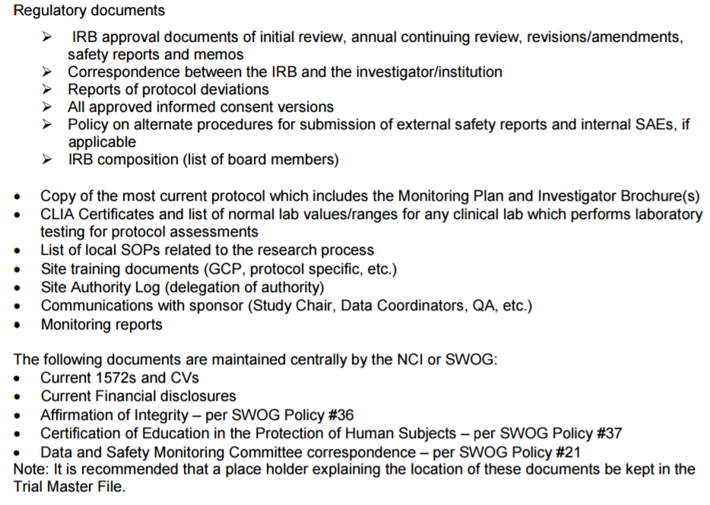
Trial Master File

Slide 91
Investigator Responsibilities
Follow the protocol/document protocol excursions
Schedule tests according to Study Parameter Calendar
Submit data according to protocol data submission schedule
Remain current on safety updates
Contact SWOG for questions

Slide 92
Investigator Responsibilities Summary
Investigator is responsible for personally conducting research
Research support staff must be trained and qualified to conduct research
Current and accurate documentation is essential to support FDA application effort
Quality data support patient contribution to clinical trials research

Slide 93
Thank You!
Contact Information
  Evonne Lackey
    Elackey@fredhutch.org

Slide 94
Patient Perspective
R Bangs

Slide 95

Potential Patient Concerns With S1605
Tumor remnants/CIS may remain
Side effects
10-30% success rate
Logistical burden
Financial toxicity
Selecting the right immunotherapy
Plan B if S1605 fails in the short or long run
  Clinical trial #2
Normal new treatment unknowns
Dosing right for bladder cancer

Slide 96
Questions & Answers
S1605 Panel

Slide 97
Frequently Asked
Questions

Slide 98
eligibility
FAQ

Slide 99
Is a patient eligible if (s)he finished induction BCG but could not tolerate any maintenance therapy?
only recurrent HG T1 disease is eligible after only induction BCG
all other patients must have at least 2 doses of maintenance BCG or a second induction
BCG intolerance is NOT an inclusion criterion

Slide 100
Patient has complete TURBT 5 weeks prior to registration by the same investigator – does (s)he need repeat cystoscopy within 3 weeks of registration?
Yes
“Patients must have had cystoscopy confirming no visible papillary tumor within 21 days prior to registration. (CIS disease is not expected to have been completely excised).”

Slide 101
Patient with prior history of muscle invasive bladder cancer treated with bladder preservation (max. TUR or RT) now has BCG unresponsive NMIBC. Eligible?
Ineligible for two reasons:
  prior MIBC
  prior RT to bladder for bladder cancer
  RT for prostate/cervix/colon is NOT a contraindication

Slide 102
Is a patient with HIV eligible?
HIV patient can be included if currently on HAART with CD4 count >250
Notes:
Patients with past or resolved hepatitis B infection (defined as having a negative hepatitis B surface antigen [HBsAg] test and a positive anti-HBc [antibody to hepatitis B core antigen] antibody test) are eligible..
Patients positive for hepatitis C virus (HCV) antibody are eligible only if polymerase chain reaction (PCR) is negative for HCV RNA.

Slide 103
Is a patient with hepatitis eligible?
Yes
Patients with past or resolved hepatitis B infection are eligible
  defined as having a negative hepatitis B surface antigen [HBsAg] test and a positive anti-HBc [antibody to hepatitis B core antigen] antibody test
Patients positive for hepatitis C virus (HCV) antibody are eligible only if polymerase chain reaction (PCR) is negative for HCV RNA.

Slide 104
Endpoints
FAQ

Slide 105
What if a patient has low grade recurrence?
the patient continues on protocol
only high grade recurrences are considered treatment failure

Slide 106
What if a patient with CIS has for-cause biopsy after 3 months and it is negative? Does (s)he require mandatory repeat biopsy at 6 months?
the patient continues on protocol
if normal cystoscopy and normal cytology at 6 months, then no biopsy required – patient considered CR
if abnormal cysto and/or cytology, then repeat evaluation as per usual clinical routine

Slide 107
What if a patient on follow-up has positive cytology but negative cystoscopy?
cytology is considered positive if malignant cells are identified
the study include guidelines for evaluation of positive cytology
  perform cystoscopy
      if visible lesion on cystoscopy, then proceed with bladder biopsy
      if no visible lesion on cystoscopy, then proceed with random bladder biopsies to include ≥4 sites in the bladder and biopsies of the prostatic urethra (encourage TUR at 5 and 7 o’clock);
        bilateral retrograde ureteropyelograms and bilateral upper tract washings for cytology should be performed at the same time;
        the retrograde studies can be replaced by CT-IVP if the treating physician prefers.

Slide 108
Does a patient meet criteria for recurrence if positive cytology with negative cystoscopy and imaging?
positive cytology must be assessed according to protocol
CR in CIS patient: cystoscopy, cytology and biopsy must all be negative
recurrence: must be histologically proven high grade disease (Ta/T1/CIS)

Slide 109
Patient develops new upper tract disease on follow-up can patient continue on protocol?
No
Since atezo is being administered sytemically, and upper tract or prostatic urothelial recurrence is considered treatment failure

Slide 110
treatment
FAQ

Slide 111
If infusion is delayed more than 3 doses can patient go back on the study?
Criteria for Removal from Protocol Treatment
  Recurrence of high-grade disease, muscle invasive disease, or high-grade upper tract involvement
  Persistent CIS disease at Week 13 or Week 25 biopsy
  Unacceptable toxicity
  Treatment delay > 42 consecutive days for any reason
    this is equivalent to two dose intervals (6 weeks)
  Completion of protocol treatment
  Pregnancy
  Patient withdraws for any reason
  At investigator discretion (detrimental to patient health or poor compliance)

Slide 112
specimens and translational medicine
FAQ

Slide 113
Does investigator have to wait for central review of pathology before determining that a patient has failed study treatment?
No: decisions regarding eligibility and attainment of study endpoints are made by treating physician “real time”
Imaging, pathology and cytology will be reviewed centrally at a later time
  to ensure patient eligibility (some patients will be deemed ineligible after central review)
  to compare endpoint assessment (final endpoint analysis will be based on local interpretation)
Notes:
submit three H&E slides from every TUR/biopsy plus pathology report
submit one cytology slide plus report for CIS patient at baseline, at 6 months, and if endpoint met

Slide 114
Can we send FFPE slides or is tissue block mandatory?
all translational studies on tissue are based on tissue sections provided on slides or as scrolls; no blocks required

Slide 115
s1605 logistics
FAQ

Slide 116
Are there any specific concerns around informed consent for this trial?
radical cystectomy is considered standard of care for these patients and they must be deemed unfit for, or they refuse cystectomy
requires careful discussion of potential toxicity of systemic PD-L1 inhibition
optional consent for biobanking

Slide 117
Will the CIS and Ta/T1 cohorts accrue separately? Can one close before the other?
enrollment will be capped in the Ta/T1 arm to ensure 70 patients with CIS are accrued
CIS arm will not be capped

Slide 118
Does surveillance of patients end at 18 month time point?
All patients will be followed for recurrence, progression, and survival for 5 years after registration.

Slide 119
Will you provide any additional promotional resources?
Webinar for study team
Video for patients
Patient brochure
Poster for office
Additional Investigator Meetings

Slide 120
Acknowledgements
SWOG Team
CTEP/NCI
Gretchen Getz
Dana Sparks
Casey Dawson
Nathan Eriksen
Karen Anderson
Mark Schofield
Evonne Lackey
Sean O’Bryan
Bhupinder Mann
Elad Sharon
Massimo Cardinali
Boris Freidlin
Genentech
Notes:
names listed in addition to investigators/team listed on slide 30

