Slide 1
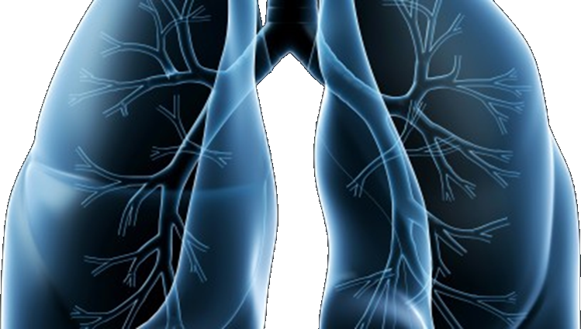
S1400 Revision #3 Training Slides
A Biomarker-Driven Master Protocol for Previously Treated Squamous Cell Lung Cancer. (LUNG-MAP)
This slide deck contains an overview of the study design, eligibility criteria, and updates to the design and eligibility for Revision #3 of S1400
Version date December 2015

Slide 2
S1400 Revision #3 version 11/18/2015 A Biomarker-Driven Master Protocol for Previously Treated Squamous Cell Lung Cancer. (LUNG-MAP)
Revision Summary of Changes
Schema
Study design/goals
Objectives
Eligibility Overview
Steps to implement revision
Study Chairs

Slide 3
Revision #3 Summary of Changes
S1400B, S1400C, S1400D modified to single arm (targeted therapy only)
Patients randomized to docetaxel will have the opportunity to re-register to the targeted therapy arm upon progression
NEW Sub-Study, S1400I: Immunotherapy non-match study
Combination of nivolumab (anti-PD-1) + ipilimumab (anti-CTLA-4) vs. nivolumab
Restrict to Performance Status 0-1 (from 0-2)
Pre-screening allowed during any line of treatment for Stage IV disease
Prior docetaxel exclusion removed

Slide 4
Schema at Revision #3
Biomarker Driven
Sub-Studies
Non-match
Sub-Study
S1400B
PI3K
S1400C
CCGA
S1400D
FGFR
S1400I
Checkpoint
Naive
Single Arm
Phase II
GDC-0032
Palbociclib
AZD4547
Randomized
Phase III
Nivolumab/
Ipilimumab
Nivolumab
GDC-0032
vs. TBD
Palbociclib
vs. TBD
AZD4547
vs. TBD
Biomarker-driven sub-studies will progress to Phase III if study meets endpoint and Phase III is feasible at which point the standard of care arm will be determined.

Slide 5
Study Design and Goals at Revision #3
Overall Study Goal:
Identify and quickly lead to approvals of immunotherapies as safe and effective regimens (monotherapy or combinations) based on matched predictive biomarker-targeted drug pairs
Study Design:
S1400B, S1400C, S1400D: Single arm Phase II Design
S1400I: Randomized Phase III Design

Slide 6
Study Objectives at Revision #3
Study Objectives for Phase II Biomarker-driven Sub-studies: S1400B, S1400C, S1400D
Primary Objective:
To estimate the response rate among patients treated with the investigational therapy
Secondary Objectives:
To evaluate investigator-assessed progression-free survival and overall survival with the investigational therapy
To evaluate duration of response with the investigational therapy
To evaluate frequency and severity of toxicities associated with investigational therapy

Slide 7
Study Objectives at Revision #3
Study Objectives for Phase III Non-Match Sub-study: S1400I
Primary Objective:
To compare overall survival in patients randomized to nivolumab plus ipilimumab vs. nivolumab
Secondary Objectives:
To compare investigator-assessed progression-free survival in patients randomized to nivolumab plus ipilimumab vs. nivolumab
To compare response rates among patients randomized to nivolumab plus ipilimumab vs. nivolumab
To evaluate frequency and severity of toxicities associated with nivolumab plus ipilimumab vs. nivolumab

Slide 8
S1400 Screening/Pre-screening Eligibility Overview
Patients must have Stage IV squamous cell lung cancer
Patients are eligible for the S1400 Screening/Pre-Screening registration:
upon progression on prior therapy (Screen at progression), or
prior to progression on current treatment for Stage IV disease (Pre-Screen prior to progression)
Patients must have measurable disease
Patients must have a performance status of 0-1
Patients must have an adequate tissue specimen for biomarker profiling
The local pathologist must sign off on the S1400 Local Pathology Review Form prior to enrollment certifying the tissue requirements have been met

Slide 9
Steps to Implement Revision #3
Revision #3 is considered a SHOW STOPPER amendment, therefore:
At each site, accrual will be suspended to S1400 and sub-studies until the following steps are completed:
Site has reviewed new training slides for S1400
Revision 3 Model Consent Forms are IRB approved by the site’s IRB of record, are implemented, and proof of that IRB approval is received by CTSU
Refer to Revision #3 Memo of Changes
with the release of the revision

Slide 10
S1400 Sub-Study Chairs Revision #3
S1400A–MEDI4736
Vassiliki A. Papadimitrakopoulou, MD
NCTN: SWOG
Hossein Borghaei, DO
NCTN: ECOG-ACRIN
S1400B–GDC-0032 (TASELISIB)
Jeffrey A. Engelman, MD, PhD
NCTN: ALLIANCE
Corey J. Langer, MD
NCTN: NRG
S1400C–PALBOCICLIB
Martin J. Edelman, MD
NCTN: NRG
Kathy S. Albain, MD
NCTN: SWOG
S1400D–AZD4547
Charu Aggarwal, MD, MPH
NCTN: ECOG-ACRIN
Primo N. Lara, Jr., MD
NCTN: SWOG
S1400I–Nivolumab plus Ipilimumab
Scott N. Gettinger, MD
NCTN: SWOG
Lyudmila A. Bazhenova, MD
NCTN: ALLIANCE

