Slide 1
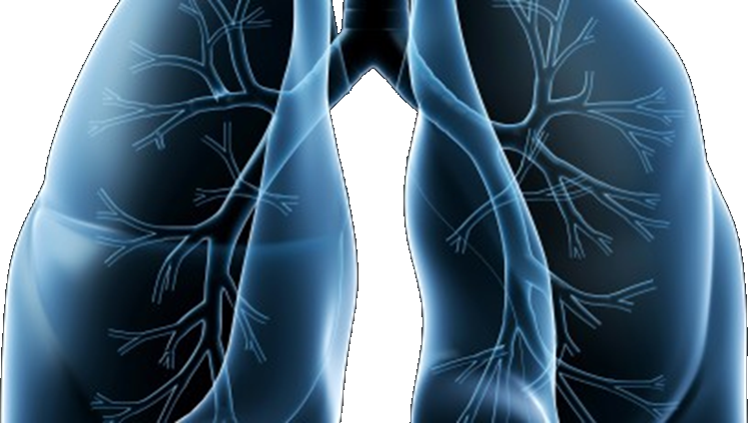
S1400 Revisions #4/5 Training Slides
A Biomarker-Driven Master Protocol for Previously Treated Squamous Cell Lung Cancer. (LUNG-MAP)
This slide deck contains an overview of the study design, eligibility criteria, and updates to the design and eligibility for Revisions #4/5 of S1400
Version date November 2016

Slide 2
S1400 Revision #4/5 version 3/3/16 and 7/19/16 A Biomarker-Driven Master Protocol for Previously Treated Squamous Cell Lung Cancer. (LUNG-MAP)
Revision Summary of Changes
Schema
Study design/goals
Objectives
Eligibility Overview
New sub-study registration
Study Chairs

Slide 3
Revision #4 and #5 Summary of Changes
Revision #4
Rapid Request for Amendment (RRA) for ipilimumab and for nivolumab
Revision #5
Request for Amendments (RAs) for MEDI4736, GDC-0032, Palbociclib, AZD4547
S1400I: Addition of Patient Reported Outcomes
The option of enrolling to a new sub-study following progression on another sub-study

Slide 4
Schema at Revision #5
Biomarker Driven
Sub-Studies
Non-match
Sub-Study
S1400B
PI3K
S1400C
CCGA
S1400D
FGFR
S1400I
Checkpoint
Naive
Single Arm
Phase II
GDC-0032
Palbociclib
AZD4547
Randomized
Phase III
Nivolumab/
Ipilimumab
Nivolumab
GDC-0032
vs. TBD
Palbociclib
vs. TBD
AZD4547
vs. TBD
Biomarker-driven sub-studies will progress to Phase III if study meets endpoint and Phase III is feasible at which point the standard of care arm will be determined.

Slide 5
Study Design and Goals at Revision #5
Overall Study Goal:
Identify and quickly lead to approvals of immunotherapies as safe and effective regimens (monotherapy or combinations) based on matched predictive biomarker-targeted drug pairs
Study Design:
S1400B, S1400C, S1400D: Single arm Phase II Design
S1400I: Randomized Phase III Design

Slide 6
Study Objectives at Revision #5
Study Objectives for Phase II Biomarker-driven Sub-studies: S1400B, S1400C, S1400D
Primary Objective:
To estimate the response rate among patients treated with the investigational therapy
Secondary Objectives:
To evaluate investigator-assessed progression-free survival and overall survival with the investigational therapy
To evaluate duration of response with the investigational therapy
To evaluate frequency and severity of toxicities associated with investigational therapy

Slide 7
Study Objectives at Revision #5
Study Objectives for Phase III Non-Match Sub-study: S1400I
Primary Objective:
To compare overall survival in patients randomized to nivolumab plus ipilimumab vs. nivolumab
Secondary Objectives:
To compare investigator-assessed progression-free survival in patients randomized to nivolumab plus ipilimumab vs. nivolumab
To compare response rates among patients randomized to nivolumab plus ipilimumab vs. nivolumab
To evaluate frequency and severity of toxicities associated with nivolumab plus ipilimumab vs. nivolumab

Slide 8
S1400 Screening/Pre-screening Eligibility Overview
Patients must have Stage IV squamous cell lung cancer
Patients are eligible for the S1400 Screening/Pre-Screening registration:
upon progression on prior therapy (Screen at progression), or
prior to progression on current treatment for Stage IV disease (Pre-Screen prior to progression)
Patients must have measurable disease
Patients must have a performance status of 0-1
Patients must have an adequate tissue specimen for biomarker profiling
The local pathologist must sign off on the S1400 Local Pathology Review Form prior to enrollment certifying the tissue requirements have been met

Slide 9
New Sub-study Registration Option (Added Revision #5 v.7/19/16)
Patients who progress on a Lung-MAP sub-study may register to another Lung-MAP sub-study, if eligible for one of the other studies
Progress on Lung-MAP sub-study
If Patient will not be registered to new sub-study for any reason
Note: Can change decision
Evaluate Common Eligibility Criteria
Submit the Request for New Sub-study Assignment
(See S1400 main Protocol Section 14)
Submit Notice of Intention Not to Register Form in Rave ®
Sub-study assignment
(received within 1 day following request submission)
Submit Request for Sub-study Reassignment Form in Rave®
If patient is assigned to sub-study and meets sub-study common eligibility criteria but does NOT meet study-specific eligibility criteria
Register to new Sub-study in OPEN
Follow-up per current Sub-study
Follow-up per new Sub-study

Slide 10
S1400 Sub-Study Chairs Revision #4/5
S1400A–MEDI4736
Vassiliki A. Papadimitrakopoulou, MD
NCTN: SWOG
Hossein Borghaei, DO
NCTN: ECOG-ACRIN
S1400B–GDC-0032 (TASELISIB)
Corey J. Langer, MD
NCTN: NRG
James Wade III, MD
NCTN: SWOG
S1400C–PALBOCICLIB
Martin J. Edelman, MD
NCTN: NRG
Kathy S. Albain, MD
NCTN: SWOG
S1400D–AZD4547
Charu Aggarwal, MD, MPH
NCTN: ECOG-ACRIN
Primo N. Lara, Jr., MD
NCTN: SWOG
S1400I–Nivolumab plus Ipilimumab
Scott N. Gettinger, MD
NCTN: SWOG
Lyudmila A. Bazhenova, MD
NCTN: ALLIANCE

