Slide 1
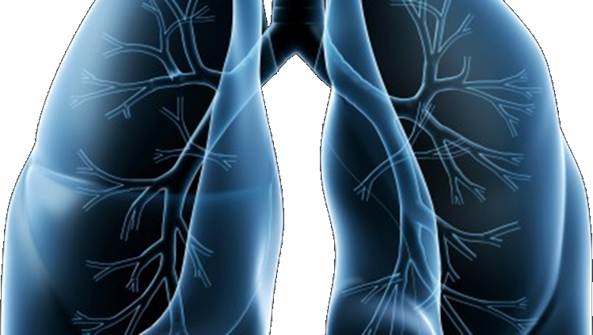
S1400 Revision #8 & 9/10 Training Slides
A Biomarker-Driven Master Protocol for Previously Treated Squamous Cell Lung Cancer. (LUNG-MAP)
This slide deck contains an overview of the study design, eligibility criteria, and updates to the design and eligibility for Revisions #8 & 9/10 of S1400
Version date September 2017

Slide 2
S1400 Revision #8 & 9/10 versions 3/14/2017, 9/1/2017 A Biomarker-Driven Master Protocol for Previously Treated Squamous Cell Lung Cancer (LUNG-MAP)
Revision Summary of Changes
Schema
Study design/goals
Objectives
Eligibility Overview
Study Chairs

Slide 3
Current Studies included in Lung-MAP at Revision #9/10
Current Sub-studies :
S1400G: Single arm Phase II Design – activated February 2017
S1400I: Randomized Phase III Design – activated December 2015
S1400F: Single arm Phase II Design – activated October 2017

Slide 4
Schema at Revision #9/10
Biomarker Driven
Sub-Studies
Non-match
Sub-Studies
S1400G
HRRD
S1400I
Checkpoint
Naive
S1400F
Checkpoint
Inhibitor
Talazoparib
MEDI4736
plus Tremelimumab
Nivolumab/
Ipilimumab
Nivolumab
Biomarker-driven sub-studies will progress to Phase III if study meets endpoint and Phase III is
feasible at which point the standard of care arm will be determined.

Slide 5
Revision #8 and #9/10 Summary of Changes
Revision #8
Request for Rapid Amendment (RRA) for talazoparib
Revision #9/10
New Sub-Study, S1400F: a non-match study with previously treated anti-PD-1/PD-L1 resistant disease
Eligibility criterion for patients screened at progression on prior treatment or pre-screened prior to progression has been opened to include checkpoint inhibitor therapy as a line of therapy
Request for Rapid Amendment (RRA) for MEDI4736 (durvalumab)
Administrative edits for S1400, S1400F, S1400G, S1400I

Slide 6
Study Objectives at Revision #9/10 – S1400G
Primary Objective:
To evaluate overall response rate (ORR) with talazoparib in Homologous Recombination Repair Deficiency (HRRD) MDVN-positive patients
Secondary Objectives:
To evaluate investigator-assessed progression-free survival (IA-PFS) and overall survival (OS) associated with therapy in HRRD MDVN-positive patients
To evaluate ORR, IA-PFS, and OS in HRRD FMI-positive patients
To evaluate ORR in HRRD MDVN-negative/HRRD FMI-positive patients
To evaluate frequency and severity of toxicities associated with talazoparib in HRRD FMI-positive patients

Slide 7
Study Objectives at Revision #9/10 – S1400I
Primary Objective:
To compare overall survival in patients randomized to nivolumab plus ipilimumab vs. nivolumab
Secondary Objectives:
To compare investigator-assessed progression-free survival in patients randomized to nivolumab plus ipilimumab vs. nivolumab
To compare response rates among patients randomized to nivolumab plus ipilimumab vs. nivolumab
To evaluate frequency and severity of toxicities associated with nivolumab plus ipilimumab vs. nivolumab

Slide 8
Study Objectives at Revision #9/10 – S1400F
Primary Objective:
To evaluate response rate among patients treated with MEDI4736 (durvalumab) plus tremelimumab
Secondary Objectives:
To evaluate duration of response with the investigational therapy
To evaluate OS with the investigational therapy
To evaluate IA-PFS (both RECIST and irRC) with the investigational therapy
To evaluate frequency and severity of toxicities with the investigational therapy

Slide 9
S1400 Screening/Pre-screening Eligibility Overview
Patients must have Stage IV or recurrent squamous cell lung cancer
Patients are eligible for the S1400 Screening/Pre-Screening registration:
upon progression on prior therapy (Screen at progression), or
prior to progression on current treatment for Stage IV disease (Pre-Screen prior to progression)
Patients must have measurable disease
Patients must have a performance status of 0-1
Patients must have an adequate tissue specimen for biomarker profiling
The local pathologist must sign off on the S1400 Local Pathology Review Form prior to enrollment certifying the tissue requirements have been met

Slide 10
S1400 Sub-Study Chairs Revision #9/10
S1400G–Talazoparib
Taofeek K. Owonikoko, MD, PhD, MSCR
NCTN: ECOG-ACRIN
Lauren A. Byers, MD
NCTN: SWOG
Contact: S1400G@swog.org
S1400I–Nivolumab plus Ipilimumab
Scott N. Gettinger, MD
NCTN: SWOG
Lyudmila A. Bazhenova, MD
NCTN: ALLIANCE
Contact: S1400I@swog.org
S1400F–MEDI4736 Plus Tremelimumab
Natasha Leighl, MD
NCTN: CCTG
Naiyer Rizvi, MD
NCTN: SWOG
Contact: S1400F@swog.org

