Slide 1
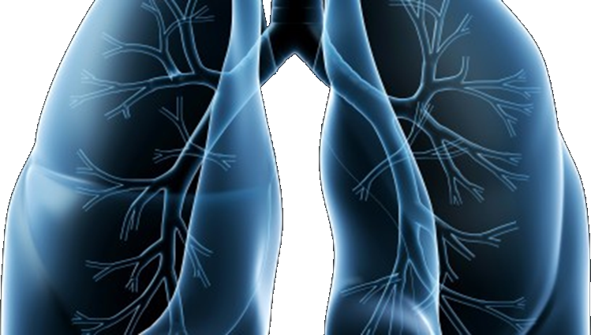
S1400 OVERVIEW / BACKGROUND
A Biomarker-Driven Master Protocol for Previously Treated Squamous Cell Lung Cancer (LUNG-MAP)
This slide deck provides an overview of the design and motivation for the Lung-MAP (S1400) trial
Version Date November 2016

Slide 2
S1400 Study Chairs
Vassiliki A. Papadimitrakopoulou, MD (Medical Oncology)
Roy S. Herbst, MD, PhD (Medical Oncology)
David R. Gandara, MD (Medical Oncology)
Fred R. Hirsch, MD, PhD (Translational Medicine)
Philip C. Mack, PhD (Translational Medicine)
Lawrence H. Schwartz, MD
(Imaging)
Statisticians
Mary W. Redman, PhD
James Moon, MS
Katherine Griffin, MS
Jieling Miao, MS
Cooperative Groups
Karen Kelly, MD (SWOG)
Everett Vokes, MD (Alliance)
Suresh Ramalingam, MD (ECOG/ACRIN)
Jeff Bradley, MD (NRG)
Natasha Leighl, MD (CCTG)

Slide 3
Generic Lung-MAP Design
Centralized Biomarker Profiling
Biomarker 1 Positive
Biomarker 2 Positive
…Biomarker n Positive
Not Biomarker 1-n Positive
Sub-study 1
Biomarker-driven
Sub-study 2
Biomarker-driven
…Sub-study n
Biomarker-driven
Non-match Sub-study
Evaluate: Investigational therapy 1
Evaluate: Investigational therapy 2
Evaluate: Investigational therapy n
Evaluate:
Non-Match Investigational therapy
All patients evaluated for full set of biomarkers. Sub-studies assigned based on biomarker results; patients with multiple biomarkers randomly assigned to sub-study based on the ratio of biomarkers’ prevalence.

Slide 4
Lung-MAP Design and Design Principles
Common biomarker profiling platform allows patients to be evaluated for participation in all active sub-studies
All eligible patients have access to at least one clinical trial within Lung-MAP
Trial infrastructure (platform) allows for the addition of new investigational therapies over time
Each investigational therapy is evaluated independent of other investigational therapies
Sub-studies are either:
Biomarker driven, or
Non-match for patients not positive for one of the sub-study biomarkers

Slide 5
Lung-MAP Design and Design Principles
Biomarker-driven sub-studies include a targeted therapy in a biomarker-defined population
Non-match studies include a therapy that may benefit patients irrespective of biomarker status
Standardized designs across sub-studies for consistency
Single arm Phase II design for targeted therapies to rapidly evaluate potential efficacy, may lead to a future Randomized Phase III trial
Randomized Phase III design for definitive evaluation on investigational therapies
Ultimate goal of each sub-study evaluation is to lead to regulatory approval of successful investigational therapies

Slide 6
Why is Lung-MAP in Squamous Cell Lung Cancer?
Screening for potential therapeutic targets is rapidly becoming a standard part of treatment of NSCLC
In 63% of lung squamous cell cancer (SCCA) we can now identify a possible therapeutic target
Lung SCCA remains an “orphan” group where substantial developments in targeted therapeutics have yet to be seen and all the targeted therapies so far approved in NSCLC, are largely ineffective. Subgroup selection (genotype or phenotype-driven) refined strategy is promising.
In 2015, two immunotherapy agents were approved by the FDA and Health Canada for the treatment of squamous lung cancer. Immunotherapy is a major component of the Lung-MAP trial.

Slide 7
Study Description and Objectives
Description:
Unique biomarker umbrella trial for patients who have received and progressed on one or more lines of prior therapy for lung SCCA
One of the first large-scale precision medicine trials launched in the NCTN
Includes biomarker-driven sub-studies and at least one study option for patients not eligible for biomarker-driven sub-studies
Offers patients both targeted and immunotherapy treatments; provides options to patients who have limited alternatives
Objective:
Identify and quickly lead to the approval of safe and effective regimens that match predictive biomarkers with targeted drugs

Slide 8
S1400 Master Protocol led by SWOG with a Unique Private-Public Partnership
SWOG
ECOG-ACRIN
NRG
CCTG
Alliance
S1400 Master Protocol

