Slide 1
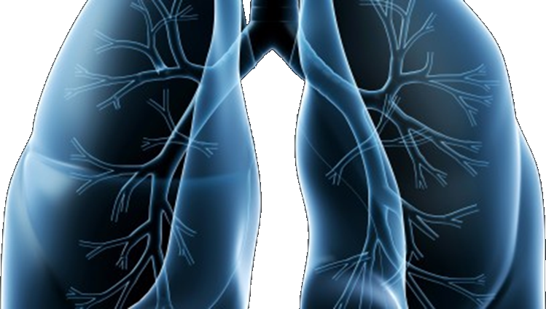
LUNG-MAP
S1400 Lung Master Protocol
SWOG Spring meeting
April 29, 2016

Slide 2
Welcome
SWOG
ECOG-ACRIN
NRG
NCIC-CTG
Alliance
S1400 Master Protocol
Karen Kelly, MD
swog lung cancer committee chair
David Gandara, md
Study Co-Chair, Medical Oncology

Slide 3
Study Updates
Vassiliki Papadimitrakopoulou, MD
Study Chair, Medical Oncology

Slide 4
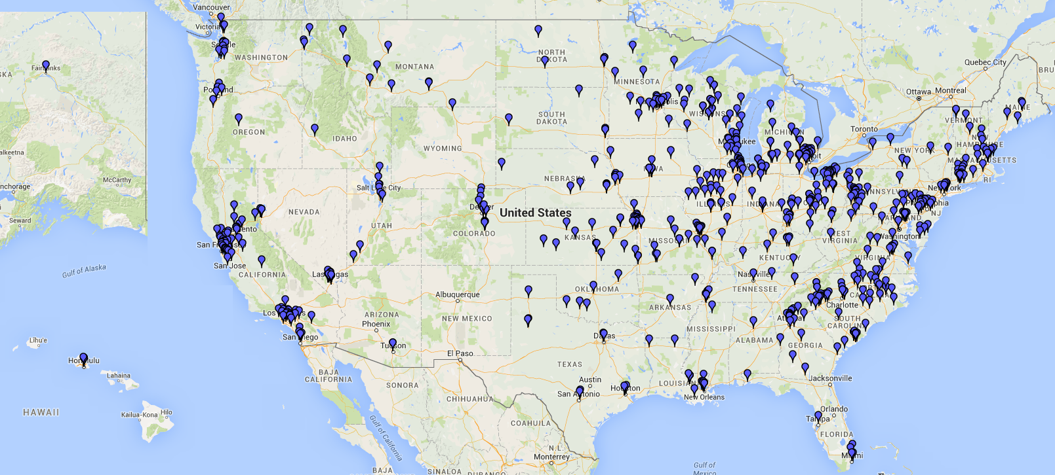
Where are we now?
IRB Approvals:
683 sites
238 sites with at least 1 patient
accrued
Accruals:
685 patients registered to S1400
333 patients from SWOG sites
486 patients notified of their sub-study assignment
252 patients registered to a sub-study
S1400B: 13
S1400C: 29
S1400D: 21
S1400I: 31 Closed Sub-studies/treatment: 160 Total: 254 SWOG STATISTICAL CENTER and CTSU AS OF 4/25/16
Notes:
Update

Slide 5
Study Design Updates
Revision #3 (November 2015):
S1400B, S1400C, S1400D to single arm (targeted therapy only)
S1400I: Immunotherapy Non-Match Study added
Restricted to Performance Status 0-1 (from 0-2)
Pre-screening during any line of treatment for Stage IV/Recurrent disease
Prior docetaxel exclusion removed
Revision #4 (March 2016):
Rapid Request for Amendment (RRA) for ipilimumab and for nivolumab
Lung-MAP is open in Canada

Slide 6
Overview of Upcoming Changes
Revision #5 (Expected Fall 2016)
S1400I: Addition of Patient Reported Outcomes
Add the option of enrolling to a new sub-study following progression
Subsequent Revision (Expected Late 2016)
Two NEW Sub-Studies:
S1400G: a biomarker-driven study including a PARP inhibitor
S1400F: a non-match study for patients who have failed prior nivolumab

Slide 7
S1400I Patient Reported Outcomes
Joseph Unger, Ph.D.
SWOG Biostatistician (S1400IPRO)

Slide 8
Rationale for Inclusion
Complex symptom profile/associated effects not fully captured by current endpoints
Validated patient-reported outcome measures needed to complement clinical outcomes
Need to evaluate how well PRO measures track with disease-/treatment-related symptoms and clinical outcomes (e.g., time to progression)

Slide 9
Rationale for Inclusion of PROs (cont’d)
In Phase III trials, the PRO measures will also capture impact and reach of treatment on broader quality of life outcomes
Interference with day-to-day function
Physical function/functional status
Emotional and social function

Slide 10
Master Protocol Design Changes Required Alteration of PRO Design
Initial Lung-MAP design involved randomized Phase II trials that, if successful, moved to Phase III
Focus on symptom status measures based on intended use in Phase II setting
S1400I retained symptom focus: still key scientific issue
Symptoms remain important in this advanced stage disease setting
Provides opportunity to examine correlation(s) between symptoms status and clinical outcomes
Minimized number of changes occurring in Lung-MAP

Slide 11
Lung-MAP Trial Schema
S1400
Centralized Biomarker Profiling
Biomarker-driven sub-studies
Non-match sub-studies
S1400B
PI3K+
S1400C
CCGA+
S1400D
FGFR+
S1400I
Checkpoint
Naive
Single Arm Phase II
GDC-0032
Palbociclib
AZD4547
Nivo/Ipilumumab vs.
Nivolumab
Randomized Phase III
GDC-0032
vs. TBD
Palbociclib
vs. TBD
AZD4547
vs. TBD
Patient Reported Outcomes ¹
¹ Upcoming Revision #5 Expected Fall 2016

Slide 12
Final S1400I PRO Selection
Validated Measures
MDASI-LC: 21 total items: 13 core symptoms, 2 lung cancer symptoms, and 6 interference items
Single item patient rating of performance status
Single item patient rating of global change in symptom status
Non Validated Measures
NSCLC-SAQ: 7 core symptom items
PROs in future Lung-MAP Phase III trials
Include other validated PRO measures in place of NSCLC-SAQ
Purpose: Better address impact/reach factor & prognostic value of symptoms/functional status for later clinical outcomes
12

Slide 13
Lung-MAP PRO Objectives
Compare symptom status by treatment arm using the MDASI, a validated PRO symptom measure
Identify PRO-based symptoms and functional status/interference items prognostic for time to progression
Develop a statistical model that identifies a PRO-based symptom score optimally prognostic for survival outcomes
Collect psychometric information data for the Non-Small Cell Lung Cancer Symptom Assessment Questionnaire

Slide 14
Feasibility
Use of PROs in the Phase III Non-Match Trial
Accrual higher in non-match studies
Limited eligibility criteria
Patients must be eligible for the clinical component of S1400I
Patients must be able to complete the PRO measures in English
Baseline PRO assessment is required

Slide 15
Limited Site and Patient Burden
Two Questionnaires for the patient to complete
39 questions to complete on a paper form
Estimated time 15 minutes
Sites are required to enter the responses into RAVE® as well as upload the original patient-completed forms into RAVE®

Slide 16
Limited Site and Patient Burden
PRO assessment schedule built on existing clinical assessments:
S1400I Clinical Assessment Schedule
B
1
2
3
4
5
6
7
8
9
10
11
12
13
Weeks
Baseline
Week 5
Week 7
Week 9
Week 13
S1400I PRO Sub-study Assessment Schedule
Especially in advanced stage cancer setting, a more limited PRO administration schedule will reduce missing data (improves interpretation)
Implemented through RAVE (current system)

Slide 17
Study Logistics
Mary Redman, PhD
Study Lead Biostatistician

Slide 18
S1400 Registration: Pre-screening Option
Evaluate eligibility, consent patient*, and confirm evaluable tissue**
* Use pre-screening consent; ** Need Pathology Form sign off
Register to S1400 in OPEN
Submit tissue to FMI within 1 day after registration
If Patient will not be registered to a sub-study for any reason
Note: Can change decision
Continue current treatment
Follow-up per protocol
Submit Notice of Intention Not to Register Form in Rave ®
Upon Progression: Submit S1400 Notice of Progression in Rave ®
Sub-study assignment
(received within 1 day from Notice of Progression if at least 16 days since tissue submission)
Follow-up for 3 years

Slide 19
S1400 Registration: Screening at Progression Option
Evaluate eligibility, consent patient*, and confirm evaluable tissue**
* Use Screen at PD consent; ** Need Pathology Form sign off
Register to S1400 in OPEN
Submit tissue to FMI within 1 day after registration
If Patient will not be registered to a sub-study for any reason
Note: Can change decision
Wait to receive sub-study assignment from SWOG
Submit Notice of Intention Not to Register Form in Rave ®
Sub-study assignment
(received within 16 days following tissue submission)
Follow-up for 3 years

Slide 20
Sub-study Registration: From Sub-study Assignment
Sub-study common and specific eligibility criteria
If patient IS eligible for and consents to assigned sub-study
If patient is assigned to sub-study and meets sub-study common eligibility criteria but does NOT meet study-specific eligibility criteria
If patient is not going to register to a sub-study for any reason
Register to S1400X sub-study in OPEN after receiving sub-study assignment email
Submit Notice of Intention not to Register Form in Rave®
Protocol treatment within 7 working days of sub-study registration
Submit Request for Sub-study Reassignment Form in Rave®
Follow-up, obtain and submit specimens and forms per
sub-study protocol
Follow-up for 3 years
Notes:
Separate out into 3 slides

Slide 21
Notice of Intention Not to Register Reasons: Within last 3 months
Reason (N=44) | %
Tissue Inadequate | 7%
Not eligible for screening at PD/prescreening reg. | 5%
Not eligible for any sub-study | 36%
Symptomatic deterioration | 14%
Patient Death | 20%
Preference to receive nivolumab | 9%
Investigator decision | 0%
Patient refusal | 7%
Other | 2%

Slide 22
New Sub-study Registration Option (In Revision #5)
With Revision #5, patients who progress on a Lung-MAP sub-study may register to another Lung-MAP sub-study, if eligible for one of the other studies
Progress on Lung-MAP sub-study
If Patient will not be registered to new sub-study for any reason
Note: Can change decision
Evaluate Common Eligibility Criteria
Submit the Request for New Sub-study Assignment
(See S1400 main Protocol Section 14)
Submit Notice of Intention Not to Register Form in Rave ®
Sub-study assignment
(received within 1 day following request submission)
Follow-up per current Sub-study
Follow-up per new Sub-study

Slide 23
Data Submission Requirements
All data is submitted electronically:
Medidata Rave® | TRIAD application | SWOG Specimen Tracking System
All case report forms & specified source documentation | Radiology images | All specimens
Protocol Section 14 for submission schedule | Protocol Section 14 for schedule Protocol Section 15 for details | Protocol Section 15 for details and schedule
Forms due on Monthly Expectation Report | Queries in Rave at each disease assessment
Timely submission of data is critical to trial success!
Many resources available to help:
Protocol abstract page on SWOG.org and CTSU.org (ex: Master Forms Set, TRIAD Fact Sheet)
SWOG CRA Workbench (ex: ORP Manual, BSA Calculator, reports)
Lung-MAP Data Coordinators: email S1400question@crab.org or call (206) 652-2267
Notes:
Protocol page example resources: Master Forms Set, TRIAD Fact Sheet)
CRA Workbench example resources: ORP Manual, BSA Calculator, expectation & ineligible patient reports
Mary: I suggest referring the attendees to the handout: S1400 Registration and Study Flow schema, the Tissue Specifications information sheet, and the Who Do I Ask Contact Sheet.

Slide 24
Tissue Requirements
Philip C. Mack, PhD Study co-Chair, Translational Medicine

Slide 25
Tissue Requirements:
S1400 requires adequate tissue for biomarker profiling.
For details, refer to the S1400 protocol Section 5 for eligibility requirements and Section 15 for a complete description of tissue requirements. Specimens must be submitted using the SWOG Specimen Tracking System, a process outlined in the S1400 protocol Section 15.
NOTE for LIVER SPECIMENS:
It is recommended that at least 40% of the specimen contain malignant cells to ensure sufficient tumor DNA.
Tumor Content > 20%
including tumor volume > 0.2 mm³
It is important that the specimen contains as much tumor content as possible to ensure that there’s enough DNA needed for sequencing.

Slide 26
For Best Results – Use These Specifications:
Specimen Type
FFPE BLOCK or 12-20 SLIDES
(+H&E SLIDES)
Tissue must be formalin-fixed and
paraffin embedded. A tissue block is preferred.
If sending slides:
A minimum of 12 unstained, charged, and unbaked 4-5 micron slides are required.
20 slides are highly recommended.
Slides should include an additional H&E or Aperio stained slide (If unavailable, submit an extra unstained slide).
For core biopsy tissue, use 3-5 cores embedded in a single block, aligned so that when cut, the blade is running parallel to the long axis of the cores.
Fine needle aspirates with good cellularity are acceptable as long as cell blocks are established.
Biopsy tissue can be from primary or metastatic sites. Bone biopsies are not allowed.

Slide 27
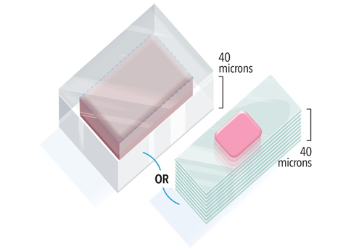
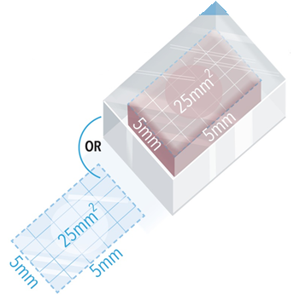
For Best Results – Use These Specifications:
Surface Area > 25 mm²
The face of the block or slide should be at least 25 mm² in area (for example, 5x5 mm or 2.5x10 mm).
Specimen Volume > 1 mm³
The total volume (surface area x depth) of the block or stacked slides should be at least 1 mm³. If the surface area is 25 mm² as recommended,
the depth should be at least 40 microns. For this reason, a
minimum of 12 slides is required.
In addition, the specimen must
contain a tumor volume > 0.2 mm³.

Slide 28
For Best Results – Use These Specifications:
Nucleated Cellularity > 80%
Specimens containing less than 80% nucleated cells require greater total volume and may not be suitable to assay. A total of 75,000 to 150,000 nucleated cells are recommended.

Slide 29
Tissue Is The Issue:
About 14% of tissue submissions are determined to be inadequate for:
58% Insufficient amount of tissue
39% Insufficient tumor cells
33% Insufficient DNA
30% Insufficient tumor size
12% Failed Sequencing
7% Other Reasons
(Note: a sample could have multiple reasons for inadequacy.)
Data as of April 22, 2016

Slide 30
Tissue Tips
“There must be local quality control at every step: acquisition, procession and submitting the tissue, to get good quality.” - Dr. Fred Hirsch, Pathology Study Chair
Meeting with the Chief of Pathology to review the tissue requirements and timeline, discuss barriers and resolutions
Identifying a pathology staff member to work with
Checking the status of available tissue as soon as a potential patient is identified
- Naomi L. Hullinger, RN, Supervisor, San Antonio Military Medical Center

Slide 31
Quality Assurance and Monitoring
Elaine Armstrong, ms
SWOG Quality Assurance Manager

Slide 32
QA/Monitoring Common Problems
Regulatory: For sites using the CIRB:
Consent forms deviate from the approved boilerplate language
Unable to determine when consent versions were implemented
Patient Case Review: Eligibility
S1400: Failure to confirm ≥ 20% tumor cells by local pathologist
S1400A & S1400C: No CT scan within 28 days
S1400C: No triplicate EKGs, taking medication that prolongs QTc interval

Slide 33
QA/Monitoring Common Problems
Patient Signing the correct consent form
Mixing up the screening consent and the prescreening consent
Patient Case Review: Treatment
Failure to dose reduce per protocol
Failure to document compliance to oral drugs
Patient Case Review: Adverse Events
Failure to report adverse events
Patient Case Review: Data Quality
Delinquent data
Failure to collect and submit specimens

Slide 34
Accrual Enhancement Committee
Roy Herbst, MD, PhD
Study co-Chair, Medical Oncology

Slide 35
How We Drive Trial Enrollment
Help Sites Already Accruing:
Phone Outreach
Tracking Data
Troubleshooting
Materials
Training
Lung-MAP.org Website
Medical Affairs Liaison
Leadership Calls/Emails to PIs
Recruit New Participants
Social Media Campaigns
Webinars
Press/Media
Promotional Video
Outreach to Lung Cancer Advocacy Groups
Outreach to Lung Cancer Physicians
The Funnel
Screening/Prescreening
Protocol Revisions/New Sub-studies
Provide Extra Support for High Accruing Sites:
Accrual Planning
Frequent Contact with Site Staff
Personalized Materials
Personalized Social Media
Personalized Outreach to Patient Advocates
Investigator Teleconferences
Our Advisors:
Trial Oversight Committee
Trial Leadership Team
Site Coordinators Committee
Public Affairs Committee

Slide 36
Site Coordinators Committee
Exciting news! We are seeking applicants for a new S1400 Lung-MAP Site Coordinators Committee. We would like the members to represent all types of sites: NCTN, NCORP, CCTG, academic, minority, etc.
SWOG has funds to support travel for members
to two SCC meetings per year, in conjunction
with the SWOG Group Meeting, and funding for
up to four conference calls per year. Apply at: https://www.surveymonkey.com/r/LMAPSCC.
Application Deadline May 15, 2016

Slide 37
CCS Associates Recognition
Caroline C. Sigman, PhD │ President, CEO
Beverly Smolich, PhD | Director, Clinical Research Projects
Accrual Enhancement Support:
Kisha Thomas, MPH, CCRA
Project Manager, Lead Clinical Research Associate
Donya Bagheri, MS, DABT
Executive Director, Research and Development
Rona Ackerman, MS
Executive Administrative Associate
Drug Selection and Protocol Support:
Lynn Parker Thomas, PhD
Senior Scientist
Amie Franklin, PhD
Senior Scientist
Meena Navidi,
PhD Director, Preclinical Projects
Danielle Zaragosa, MA
Regulatory Affairs Associate

Slide 38
Site Perspectives
Roy Herbst, MD, PhD Study co-Chair, Medical Oncology
Emily Shardelow, BS, CCRP
Clinical Research Associate II
University of Kentucky
Markey Cancer Center Clinical Research Organization (MCC CRO)
James L. Wade, III, MD, FACP, FASCO
Medical Oncology / Hematology
Cancer Care Specialists of Central Illinois

Slide 39
Mapping out the Lung-Map Study: Using a Site Schema to Facilitate Operationalization
Emily Shardelow, BS, CCRP
Clinical Research Associate II

Slide 40
Objectives
Explain how S1400 is operationalized at the University of Kentucky
Reminders and pointers to assist in successful implementation of S1400

Slide 41
Eligibility – MD screen
CRA review path for adequate tissue
CRA review for stage, progression, prior tx
(determine consent to use)
CRA consent – Prescreening
CRA consent – Screening
Re-biopsy pt (if no archival tissue available)
Notify pathology/send request for tissue (include S1400 Local Path Review Form)

Slide 42
Confirm eligibility
Register patient to S1400 Specimen Submission Step
**Must ship path within 1
day of registration!
Send pathology
Log into SWOG Specimen Manager, label block/slides, de-identify path report, & include S1400 Local Path Review Form
Receive email of specimen confirmation
Receive email that biomarker assay couldn’t be run (insufficient tissue sample)

Slide 43
Receive email that biomarker assay couldn’t be run (insufficient tissue sample sent to SWOG)
Insufficient archival tissue
Sufficient archival tissue at site
Pt declines
re-biopsy
New biopsy
Send more specimen
Notice of Intention not to Register to a Sub-Study
Notify pathology/send request for tissue (include S1400 Local Path Review Form)
Send pathology
Log into SWOG Specimen Manager, label block/slides, de-identify path report, & include S1400 Local Path Review Form

Slide 44
Receive email of specimen confirmation
Pre-screening
**WAIT**
Screening
Receive sub-study assignment with confirmation email
Patient progresses
Consent to sub-study
Submit S1400 Notice of Progression to receive sub-study
Consent to sub-study

Slide 45
Consent to sub-study
Sub-study specific & common eligibility
Meets eligibility of sub-study
Doesn’t meet eligibility of sub-study
Schedule chemo slot
Request for sub-study reassignment
Register to sub-study and immediately order chemo drug(s)
**Pt must start treatment within 7 working days!

Slide 46
Tips
General
Submit Local Pathology Form to Pathology when request is made for block/slides
Have slides/block in hand before registering to Screening
Sub-studies
If MD suspects any potential issues with eligibility, address first
i.e. Do EKG before scheduling MUGA/ECHO if suspect heart issue
Order drug immediately after registering pt to sub-study
Have a point of contact in ancillary test areas, the more “friends” you have the better!
i.e. ophthalmology, cardiology, etc.

Slide 47
Heartland NCORP S1400 Experience
James L. Wade III, MD, FACP, FASCO
Heartland NCORP PI

Slide 48
Overview
Initial participation as Central Illinois CCOP
August 2014 Heartland NCORP began accrual
Union of 3 successful CCOP’s, only one a prior SWOG member
2016 S1400 redesigned
Multiple target specific Phase II trials
Immune check point inhibitor naïve Phase III
Coming soon: Prior immune inhibitor treated 3rd line

Slide 49
Strategy
Identify advanced squamous cell patients early and enroll in master protocol for tissue analysis; provides opportunity to plan next steps with your patient.
Wait for disease progression after first line therapy, then you and your patient have a choice; immune check point treatment off study or S1400 sub-study enrollment.
If no mutation subset (marker -), can go directly to immune checkpoint inhibitor randomized phase III (S1400I) if eligibility criteria met.
If marker+ (FGFR mut+, CDK4/6 amplified, or PI3k mut+) may go first, or later, to a phase 2.

Slide 50
How to decide next step?
Nivolumab and Pembrolizumab response rates are approximately 15% and 40% respectively (pembro response based on 61 pts PDL1+ retrospective 2nd line ).
Their impact is on overall survival, which is about 9.2 months (taxotere was 6 months).
There is now no standard 3rd line option. NCCN 3rd line chemotherapy treatments are category 2B.
Nivolumab initially tested in 3rd line setting, with response rate similar to the randomized trial for the 2nd line indication.
It is not any less effective in this setting.
For patients who really need a response (disease bulk, local factors, symptoms) consider Nivo or Pembro for 2nd line with S1400 as a 3rd line option.

Slide 51
Abstract
117 patients. 17 (14·5%, 95% CI 8·7-22·2) of 117 patients had an objective response as assessed by an independent radiology review committee. Median time to response was 3·3 months (IQR 2·2-4·8), and median duration of response was not reached (95% CI 8·31-not applicable); 13 (77%) of 17 of responses were ongoing at the time of analysis. 30 (26%) of 117 patients had stable disease (median duration 6·0 months
Notes:
Year 1 from NCI is 100% for infrastructure and training.

Slide 52
S1400 strategies for Marker+
When patients progress after 1st line
Is it radiographic progression only, not clinical?
Is disease pace slow/moderate?
Are the patient’s symptoms stable?
If yes, then consider a S1400 sub-study before moving to immune based therapy.
Patients may receive immune based therapy on S1400I if mutation+ and progress.

Slide 53
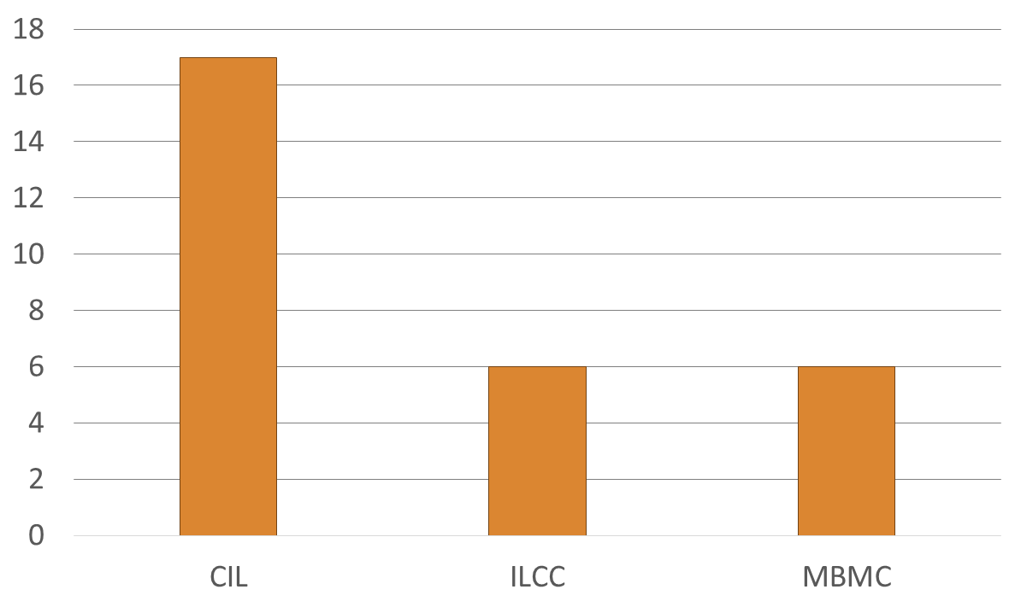
Heartland NCORP S1400 experience: 29 patients accrued thus far
# Patients

Slide 54
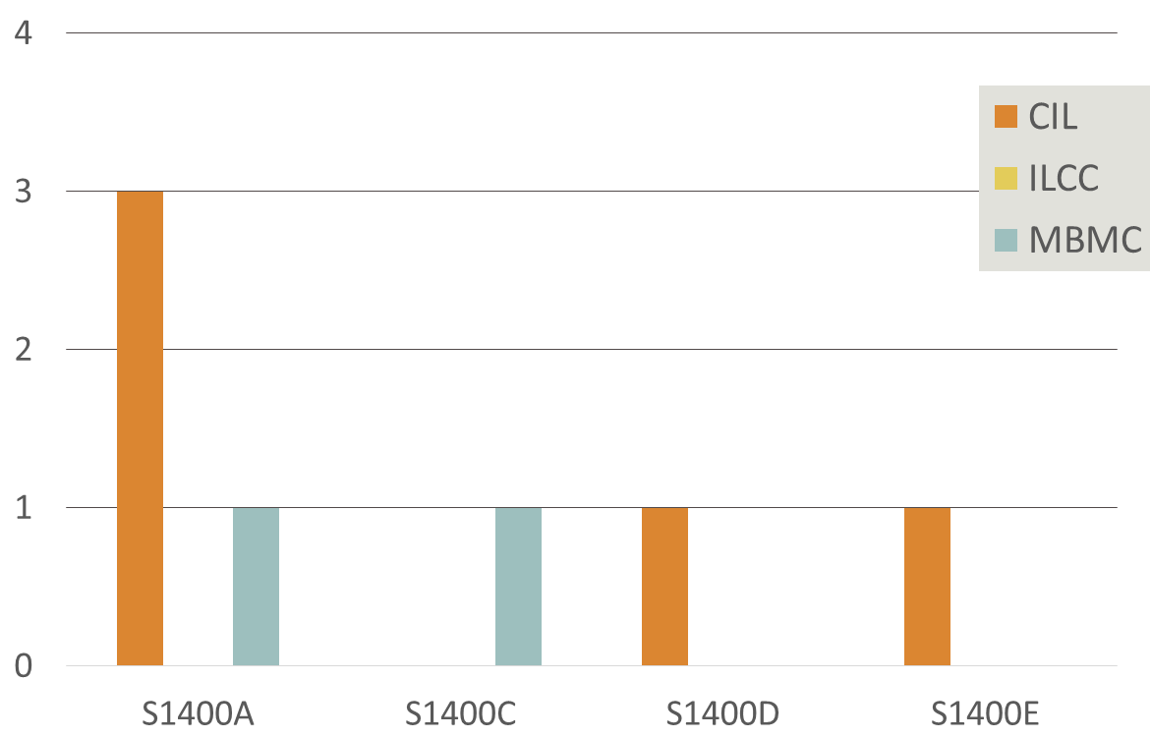
S1400 sub-study accrual: 7 patients
# Patients
0 patients on S1400B and S1400I

Slide 55
S1400 Investigator buy-in
Investigator | Site | # Participants
Dickey | MBMC | 1
Dy, I | CIL | 2
Dy, P | CIL | 1
Faller | MBMC | 3
Fishkin | ILCC | 1
Floyd | CIL | 2
Kairouz | CIL | 1
Le-Lindqwister | ILCC | 1
Liu | ILCC | 3
Lyss | MBMC | 1
MacVicar | ILCC | 1
Meadors | CIL | 1
Mosley | MBMC | 1
Saba | CIL | 1
Sobti | CIL | 2
Srokowski | CIL | 1
Velasco | CIL | 1
Wade | CIL | 5
Total |  | 29

Slide 56
S1400 Implementation
We are dependent on our excellent CRA staff
Patient tracking
Tissue quality, send off, results return
Sub-study assignment
“New” sub-study requirements i.e.
- Lab data i.e. Hgb on day of treatment
- Vital signs before, during and after immune therapy
S1400 will be with us for a long time, as an ever evolving bridge to better squamous cell lung cancer outcomes
Expect more changes to come as our treatments improve, which is the price for success!!

Slide 57
Questions?
Thank you for your time.
The slides presented today will be available on the SWOG website→ S1400 Protocol Abstract page→ Other Study Materials→ S1400 Group Meeting Materials link
Notes:
Update

Slide 58
PROs Chosen for S1400I
Primary: M.D. Anderson Symptom Inventory-Lung Cancer (MDASI-LC)
“Pros”:
Psychometric properties documented in literature for lung cancer patients plus a variety of other cancers
Interference subscale measures impact on day-to-day function
Cons:
Minimal coverage of general PRO domains
Considered Adding:
PROMIS Short Form & Profile measures
PRO-CTCAE items - more direct tracking with MD-rated CTCAEs

Slide 59
PROs Chosen for S1400I (cont’d)
Secondary: Non-Small Cell Lung Cancer Symptom Assessment Questionnaire (NSCLC-SAQ*)
In development
S1400I PROs will provide validation data for new symptom measure (also part of Phase II/III design)
Inclusion of NSCLC-SAQ limits use of other measures but adds to PRO resources
Issue: Conceptual duplication in measures
MDASI-LC & NSCLC SAQ, MDASI-LC & PRO-CTCAE, and MDASI-LC Interference items & PROMIS Profile Physical Function items
→ → Patient burden/annoyance & research staff burden
*Friends of Cancer Research & CRITICAL Path Institute
59

Slide 60
S1400I PRO Design Objectives
The design emphasized the following important considerations…
Feasibility of recruitment to PRO sub-study
Potential burden of PRO questionnaires to sites and patients
Ease of clinical interpretation

Slide 61
Ease of Clinical Interpretation
Primary endpoint is the MDASI-LC Severity Score
Randomized design enhances interpretation of PROs
The Minimally Important Difference (MID) is 1.0 points* (SD = 2.0)
Co-primary endpoint assessments (alpha=.025 for each):
Early assessment at Week 7, when clinically meaningful differences by arm may first occur
Late assessment at Week 13 to identify potentially long term differences
* Mendoza et al., 2011

Slide 62
Power and Analytic Plan
At 7 Weeks:
Assume 20% dropout (death, other reasons) and 10% non-adherence
Gives 92% power to detect treatment arm difference of 1.0 points
At 13 Weeks:
Assume 35% dropout and 15% non-adherence
Gives 81% power to detect treatment arm difference of 1.0 points
Primary analysis uses multiple linear regression (consistent with design)
Also linear mixed models to incorporate longitudinal data, with appropriate consideration of missing data patterns

Slide 63
Additional Exploratory Analyses
Examine whether individual PRO items and subscale scores predict progression and survival
Examine whether change from baseline to week 5 in symptom or interference items predicts progression (landmark analysis)
Since deterioration as measured by PRO scores may not have begun until after treatment initiation
Develop a model using PRO items that “best” predicts clinical outcomes

Slide 64
Purpose of Exploratory Analyses
By examining how PRO measures track with clinical outcomes, can help identify a model for PROs in early phase trials
Conducting these analyses within a study with uniformly staged and treated patients helps establish validity of model(s)
Goal is to consider use of PROs in future single arms trials

