Slide 1
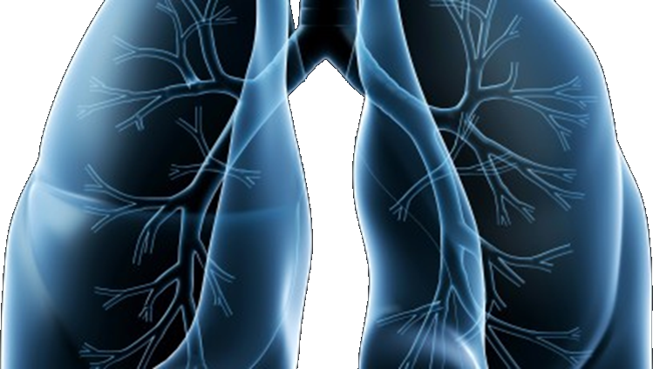
LUNG-MAP
S1400 Lung Master Protocol
SWOG Spring meeting
May 01, 2015

Slide 2
S1400 Master Protocol Unique Private-Public Partnerships with NCTN
Alliance
ECOG-ACRIN
NRG
NCI-C
SWOG
S1400 Master Protocol
David R. Gandara, M.D.
SWOG
Lung Cancer Committee Chair

Slide 3
Overview of Changes
Closure of S1400E (November 2014)
Revision # 1 (January 2015)
Eligibility clarifications
Relaxation of timing from study assignment to registration
Revision # 2 (expected May 2015)
Allow 2nd and greater lines of therapy
Add in Pre-Screening during 1st line therapy
S1400A design modification to single arm
TRIAD/ Image submissions
Vassiliki Papadimitrakopoulou, M.D.
Study Chair
Medical Oncology

Slide 4
Now allowing: more than one line of prior therapy
Screening at progression on prior treatment:
To be eligible for screening at progression, patients must have received at least one line of systemic therapy for any stage of disease (Stages I-IV).
At least one of these lines of therapy must have been a platinum-based chemotherapy regimen.
Patients must have progressed following the most recent line of therapy.
For patients who received platinum-based chemotherapy for Stage I-III disease progression must have occurred with in one year from receiving therapy.

Slide 5
Now Allowing: Pre-Screening
Pre-Screening prior to progression on first-line treatment:
To be eligible for pre-screening, patients must have received at least one cycle of a first-line platinum-based chemotherapy regimen for Stage IV disease.
Patients are eligible upon receiving Cycle 1, Day 1 infusion.
Note: Patients will not receive their sub-study assignment until they progress and the S1400 Notice of Progression on First-Line Therapy is submitted.

Slide 6
Updated Trial Schema
FMI NGS
S1400A
Non-match
S1400B
PI3K
PIK3CA mut
S1400C
CDK4/6
CCND1, CCND2, CCND3, cdk4 ampl
S1400D
FGFR
FGFR ampl,
mut, fusion
*Revision # 2
1:1
1:1
1:1
Arm¹
Arm¹
Arm²
Arm¹
Arm²
Arm¹
Arm²
¹ Medi4736
¹ GDC-0032
² Docetaxel
¹ Palbociclib
² Docetaxel
¹ AZD4547
² Docetaxel
*Patients currently on docetaxel should continue per protocol

Slide 7
Other Modifications
Current | Revision #2 (Coming May 2015)
Prior radiation within 28 days before S1400 registration not allowed | Prior radiation within 28 days before sub-study registration not allowed
No prior Docetaxel treatment | Docetaxel not allowed for Stage IV Docetaxel allowed as long as no progression <1 year after treatment for Stage I-III
Register to assigned sub-study within 42 days | Criterion removed
Notes:
Mary to input

Slide 8
Study Logistics Updates
Mary Redman Ph.D.
SWOG
Lead Biostatistician

Slide 9
S1400 Registration and Sub-study Assignment
Evaluate eligibility, consent patient and confirm evaluable tissue
Register to S1400 in OPEN
Submit tissue to FMI within 1 day after registration
Pre-Screened during 1st line treatment
Screened at progression
Progression
Patient will not be registered to a sub-study for any reason
Within 16 days after S1400 registration
Submit S1400 Notice of Progression on First-Line Therapy within 1 day.
Submit Notice of Intention Not to Register Form in Rave
Sub-study assignment
Follow-up for 3 years
Sub-study assignment

Slide 10
Post Sub-study Assignment
Sub-study common and specific eligibility criteria
If patient is assigned to sub-study B, C or D and meets sub-study common eligibility criteria but does NOT meet study-specific eligibility criteria
If patient IS eligible for assigned sub-study
If patient is not going to register to a sub-study for any reason
Register to S1400X sub-study in OPEN to receive sub-study treatment assignment
Submit Notice of Intention not to Register Form in Rave®
Protocol treatment within 7 working days of sub-study registration
Submit Request for Sub-study Reassignment Form in Rave®
Follow-up, obtain and submit specimens and forms per
sub-study protocol
Follow-up for 3 years
Notes:
Separate out into 3 slides

Slide 11
Images Submissions
TRIAD Integration expected May 2015
Rave queries will be posted for baseline scans and follow-up assessments that have already been performed
See Section 15.4 in the sub-study protocols for imaging submission procedures

Slide 12
Tissue Requirements
Tissue block (preferred) or at least 12 (4-5-microns) unstained slides (20 slides are strongly recommended).
Tissue must contain at least 20% viable tumor cells and > 0.2 mm3 tumor volume
Hematoxilyn-eosin (H&E)-stained slide or Aperio H&E-stained slide. If H&E slide is not available, submit an extra unstained slide. An H&E slide is not required with tissue block submission
Bone biopsies are not allowed
Phillip Mack Ph.D.
Study Chair
Translational Medicine
Notes:
Update

Slide 13
Tissue Form Requirements:
Local pathology report from initial diagnosis
S1400 Local Pathology Review Form:
Tumor material must be reviewed by a local pathologist to ensure sufficient tumor cells are present in the sample. The local pathologist must review and sign off on the S1400 Local Pathology Review form prior to enrolling patient noting that the tumor volume is at least 0.2 mm³ and tumor tissue contains at least 20% viable tumor cells.

Slide 14
Quality Assurance and Monitoring
First monitoring visits will begin approximately 3 months after first patient registration and will continue every six months
Any site with patients registered to a sub-study will be monitored on site
If no patients have been registered to a sub-study, monitoring may be conducted off site
Monitoring will be conducted in conjunction with routine audits whenever possible
Elaine Armstrong
SWOG
Quality Assurance Manager
Notes:
Update

Slide 15
QA/Monitoring Common Problems
Most common problems identified during monitoring:
For sites using the CIRB:
Consent forms deviate from the approved boilerplate language
Unable to determine when consent versions were implemented
Patient Case Review:
Failure to confirm ≥ 20% tumor cells in tissue submitted to Foundation Medicine
Failure to have pathologist sign off on the S1400 Local Pathology Review Form
Failure to submit baseline forms and pathology reports within 7 days of registration
Data submission errors when completing forms in Rave (guidelines for forms completion in process)

Slide 16
Funding Highlights
Sites will receive up to $5,869 ($1,079 screening/ $4,790 registration) for each patient on trial
If biopsies are needed, sites will receive $3,000/$6,000 for the biopsies performed at screening and/or progression after initial response on Arm 1
Sites will be reimbursed for additional research based procedures
Sites will be reimbursed $1,333 for on site visits outside the regular audit schedule
Nathan Eriksen
SWOG
Chief of Administration
Notes:
Update

Slide 17
Accrual Enhancement Efforts
Establish Lung-MAP Vanguard Site Coordinators’ Committee (VSCC) that will serve in an advisory capacity on strategies to improve study operations and to enhance enrollment
Catalog and schedule timely updates of study educational and promotional materials (e.g., training videos, slide decks, newsletter, protocol card) to coincide with protocol revisions and major scientific meetings
Increase site outreach activities such as study-wide webinars and contact with individual sites to address challenges in screening or enrolling patients
Establish accrual benchmarks for expected high-enrolling sites. Follow-up with these sites that are lagging in activation or accrual
Facilitate expansion of Lung-MAP to Canada
Roy Herbst, M.D., Ph.D.
Study Chair
Medical Oncology

Slide 18
Where are we now?
IRB Approvals:
337 sites
29 sites with at least 1 patient accrual (19 SWOG sites)
Accruals:
56 patients registered to S1400
40 patients notified of their sub-study assignment
18 patients registered to a sub-study
To be updated as the Group Meeting draws closer.
S1400A: 8
S1400B: 0
S1400C: 2
S1400D: 2
S1400E: 6
Notes:
Update

Slide 19
S1400 Contact List Location
Comprehensive Lists
S1400 Activation Memorandum dated 6/15/2014
Each of the Funding Memorandums
Within the Protocol
Eligibility Questions
CTSU Contact Pages
S1400 Protocol Section 5.0
Treatment/Medical
S1400 A-D Protocol Treatment Section 7.0 and 8.5
Notes:
Update

Slide 20
Questions?
Thank you for your time.
The information presented today will be available on the SWOG website under the S1400 Group Meeting Materials.
Notes:
Update

