Slide 1

Adjuvant Pembro for TNBC with RD after Neoadjuvant Chemotherapy
Kickoff Training
SWOG S1418 / NRG BR006
A Randomized, Phase III Trial to Evaluate the Efficacy and Safety of MK-3475 as Adjuvant Therapy for Triple Receptor-Negative Breast Cancer with > 1 cm Residual Invasive Cancer or Positive Lymph Nodes (ypN1mi, ypN1-3) After Neoadjuvant Chemotherapy
PIs: Lajos Pusztai MD/DPhil & Eleftherios Mamounas MD
Notes:
Hello and welcome to the kickoff for SWOG 1418. The adjuvant trial comparing Pembrolizumab to observation in TNBC with residual invasive cancer after neoadjuvant chemotherapy.
My name is Joshua Mammen and I am a study Co-PI at SWOG. First of all I would like to thank you for participating in this important trial.

Slide 2
SWOG S1418 / NRG BR006
A Randomized, Phase III Trial to Evaluate the Efficacy and Safety of MK-3475 as Adjuvant Therapy for Triple Receptor-Negative Breast Cancer with > 1 cm Residual Invasive Cancer or Positive Lymph Nodes (ypN1mi, ypN1-3) After Neoadjuvant Chemotherapy
Primary Objective:
Compare invasive disease-free survival (IDFS) between patients randomized to receive 1 year of pembrolizumab adjuvant therapy to no pembrolizumab) in both the entire study population and also in the PD-L1 positive subset.

Slide 3
S1418 Accrual as of 02/15/2019
Total of 446 registered and 372 patients randomized
Randomization rate in past 3 months 20-24 patients/months

Slide 4
Agenda
Background
Study Overview
Statistical Overview
Registration
Data and Sample submission
Patient Reported Outcomes
Imaging
Quality Control/Study Monitoring
Informed Consent
Acknowledgements
Notes:
During this talk you will hear about the study, including its background, overview and statistical deign and registration steps necessary, data and sample submission, patient reported outcomes, imaging, quality control and study monitoring.
A brief introduction to the informed consent process and finally acknowledgements for all the hard work which went into developing this.
The intended audience for this includes anyone conducting the study at a SWOG, ECOG or NCIC site. Those personnel would include CRAs, data managers, and principal investigators.

Slide 5
Background
Patients with triple negative breast cancer (TNBC) who have residual invasive cancer (RD) after neoadjuvant chemotherapy are high risk for recurrence.
  5-year recurrence rates range from 15% - >60% depending the extent of residual invasive cancer
There is no FDA approved post-operative systemic therapy for patients who have received a full anthracycline/taxane regimen preoperatively. Current treatment options include:
  Observation
  Single agent capecitabine based on results from the CREATE-X trial
  Participation in a clinical trial

Slide 6
Rationale for use of Pembrolizumab as experimental agent
Extensive lymphocytic infiltration is associated with better prognosis, with or without chemotherapy in stage I-III TNBC, suggesting a role for the immune system in controlling micro-metastatic disease.
Single agent pembrolizumab induces 18% objective response in heavily pretreated metastatic TNBC
Manageable toxicity profile with single agent pembrolizumab
  Gr3/4 adverse event rate around 12% in multiple large metastatic trials across disease types
Convenient schedule of administration
  IV every 3 weeks

Slide 7
Rationale for observation as control arm
There is no FDA approved effective treatment to improve survival in patients with residual TNBC after neoadjuvant chemotherapy.
Current clinical practice patterns vary and include no further therapy to administration of additional adjuvant chemotherapy post-operatively
To accommodate diverse practices in the community, patients who receive post-operative chemotherapy for RD remain eligible for S1418/BR006.

Slide 8
Objectives
Primary:
  Compare invasive disease-free survival (IDFS) between patients randomized to receive 1 year of pembrolizumab adjuvant therapy to no pembrolizumab) in both the entire study population and also in the PD-L1 positive subset.
Secondary:
  Toxicity
  Overall Survival (OS) and Distant Recurrence Free Survival (DRFS)
Other:
  BAHO QOL (Form QoL Questionnaire, MCL, MED, inflammatory markers)
  Tissue banking

Slide 9
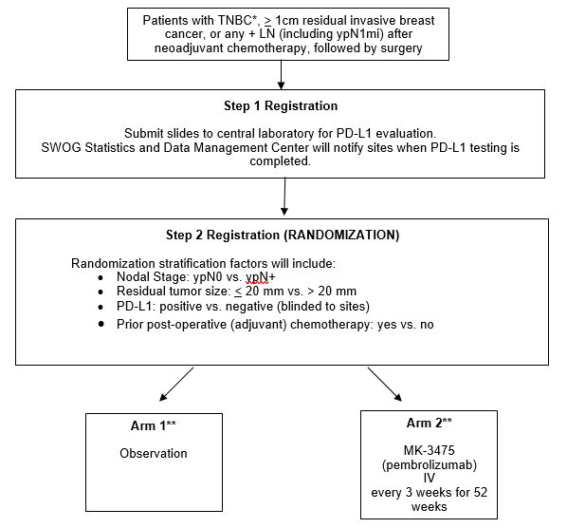

Slide 10
Key Eligibility
ER, PR and HER2 negative, as well as ER and PR <= 5% positive or HER2 equivocal, breast cancers by ASCO/CAP guidelines with > 1 cm residual invasive cancer in the breast, or any invasive tumor in the lymph nodes, including N1 mic, after completion of 16-24 weeks of neoadjuvant chemotherapy.
  Patients may receive post-operative chemotherapy for up to 24 weeks but must be registered for screening within 35 days of completion of adjuvant chemo (i.e. within 35 days of administration of last adjuvant chemotherapy)
  Screening registration within 90 days after final breast surgery if no adjuvant chemo, and within 270 days if adjuvant chemo was given.
Five unstained slides available for PDL1 staining
Patients for whom RT to the affected breast or chest wall and regional nodal areas is clinically indicated, should receive routine RT after randomization when possible, and receive MK-3475 (pembrolizumab) concurrent with RT, if randomized to the experimental arm.
  Routine RT administered, or initiated, prior to registration is also allowed. MK-3475 (pembrolizumab) may be added to ongoing radiation, or started after its completion, if randomized to the experimental arm, provided there are no > Grade 1 radiation-related skin toxicities and provided that no radiosensitizing chemotherapy is being administered.
  ANC >= 1,500 mcL, PLT >= 100,000/mCL, Hgb >= 9 g/dL, normal Creatinine, Tbili <= 1.5 IULN, AST/ALT/AlkPhos <= 2.5 IULN, HIV with good CD4 count included
No active autoimmune disease or Hep B,C, no prior immunotherapy or active immunosuppressive therapy, no live vaccines within 30 days of registration.
Co-enrollment to EA1131, A22105, A011202 or NSABP-B51 trials is allowed.

Slide 11
Statistical Design
We test the hypothesis that pembrolizumab will reduce IDFS by 33% compared to observation alone
There are two primary endpoints:
  Comparison of IDFS between arms in all randomized patients
  (1-sided α=0.01)
  Comparison of IDFS in PDL-1 positive patients (1-sided α=0.015)
1:1 randomization with stratification for PDL1 status, T size, nodal status and adjuvant chemo (yes or no).
The accrual goal is N=1000 patients with a trial duration of 8 years
  3.5-4 years of accrual time with 22 patients/months
  4 years of additional follow up after last patient enrolled

Slide 12
Interim Analysis Plan
Two interim analyses are planned for early stopping for either futility or efficacy.
Interim analyses will be performed when 50% and 75% of IDFS events have occurred.
  For the PDL1+ subset, critical values for stopping at the first and second interim analyses while preserving the overall type I error rate of 0.015 (1-sided) are 0.0006, 0.0048, and 0.0134 for 50%, 75%, and 100% of the events.

Slide 13
Amendment # 2 activated on February 1st 2018
Main Changes:
HER2 equivocal cases as per ASCO CAP guidelines, that do not receive HER2 targeted therapy are eligible.
ER or PR 1-5% positive cases are eligible if no adjuvant endocrine therapy is planned.
The requirement that adjuvant chemotherapy (i.e. Xeloda) be given prior to radiation has been removed. The study is now compatible with EA1131.
XRT initiated prior to registration is allowed. Pembrolizumab may be added to ongoing radiation or started after its completion, provided there are no > Grade 2 radiation-related skin toxicities
The timing for patients who receive adjuvant chemotherapy and radiation therapy to have completed their final breast surgery has been updated from 210 days to 270 days prior to screening registration.
Patients who undergo elective surgery while receiving pembrolizumab should have clinical evaluation for hypoadrenalism and morning serum cortisol level, if clinically indicated.
Patients receiving extended adjuvant endocrine therapy for an earlier ER positive breast cancer treated with curative intent and without recurrence for at least 5 years may continue with their endocrine therapy
Amendment # 3 and # 4 approved and activated
were administrative amendments required by CTEP

Slide 14
All sites have to use “OPEN” to enroll patients to this study.
“OPEN” can be accessed at https://open.ctsu.org or from the OPEN tab on the CTSU members’ side of the website at https://www.ctsu.org, or from the OPEN Patient Registration link on the SWOG CRA Workbench.
How to enroll and randomize a patient

Slide 15
Registration Overview
Any eligibility issues should be addressed to breastquestion@crab.org or by phone 206-652-2267 prior to registration.
Registration Step 1 is for general eligibility and PD-L1 testing
  Patients must not be registered to Step 2 until receiving confirmation from the SWOG Statistical Center that the patient's tissue specimen was adequate for PD-L1 testing.
Registration Step 2 is for treatment randomization
  Register patient for randomization within 14 calendar days of notification.

Slide 16
STEPS TO RANDOMIZATION

Slide 17
Pre-order kits for PD-L1 testing
1
Initial orders must be placed through the SWOG Specimen Tracking System:
https://crawb.crab.org/SpecTrack/Logon.aspx

Slide 18
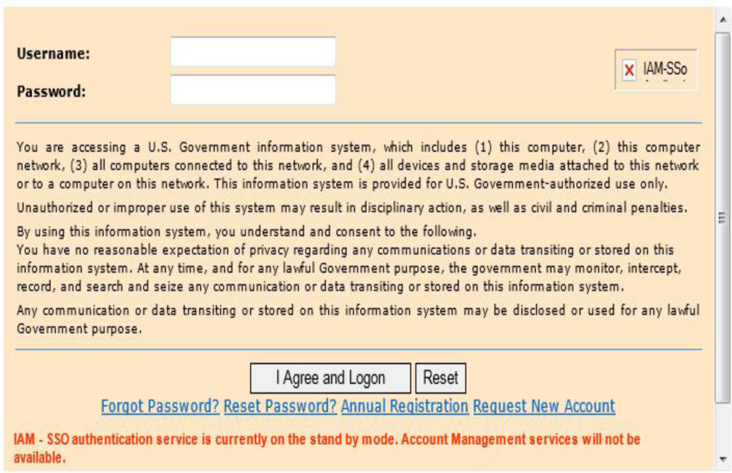
Log onto the STS using your CTSU user ID.

Slide 19
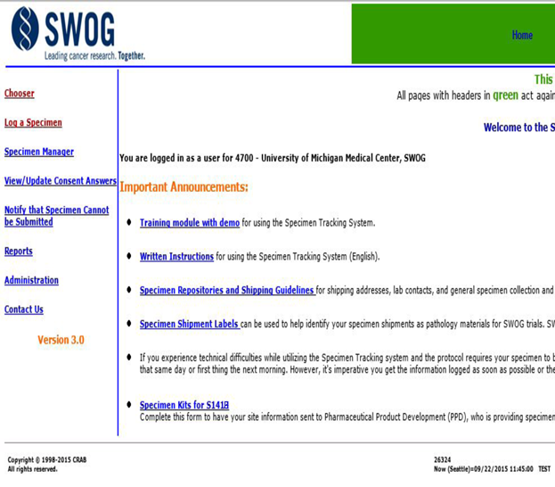
Click on the link
S1418 Specimen Kits

Slide 20
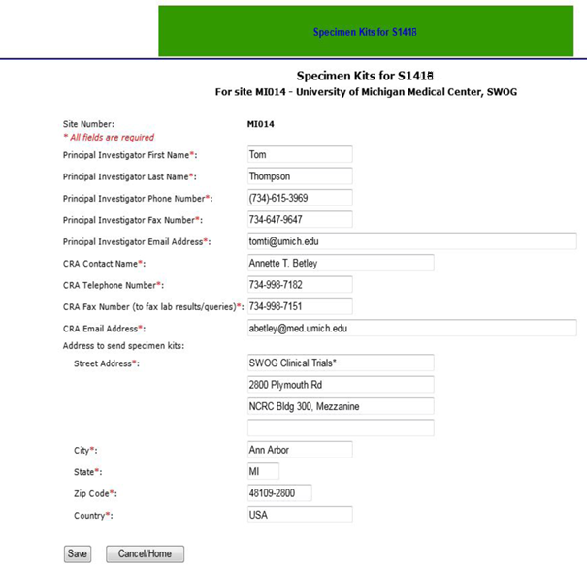
Fill in all of the required contact information, then click “Save”
For SWOG sites, the contact information will be pre-filled based on the current data in the SWOG Roster.
This information can be updated at any time through this link on the STS.
Entering information through this link will NOT make any changes to the SWOG roster.

Slide 21
1
Initial order will contain 4 PD-L1 Kits that should arrive within 10-15 business days of placing your order. Plan accordingly.
Along with your initial kit order, PPDI will assign you a username which you will need to login to their web site: http://preclaruslabdata.ppdi.com/
Subsequent kit orders must be placed through the PPDI web site (http://preclaruslabdata.ppdi.com/) using your assigned username.

Slide 22
Register Patient to Screening
2
Confirm that the patient meets all of the criteria listed in Section 5.1 of the protocol prior to registration.
Do not register more than 14 calendar days prior to the date you plan to submit the tissue specimens.
Immediately after registration submit all of the data specified in Section 14.4.

Slide 23
Submit Tissue
3
Submit 5 unstained slides for PD-L1 testing to Clarient/Neogenomics (Lab #214), Pharma Services Department, Phone: 949-445-7300 x 7103, alisoviejo.biopharmprocessing@neogenomics.com or Pinky Tripathi, Phone: 949-445-7300 x 3247, pinky.tripathi@neogenomics.com
Slides must be shipped within 7 days of cutting the slides and must be received within 7 days after Registration to Step 1
All shipments must be logged into the SWOG specimen tracking system

Slide 24
Email Notification
4
Within 16 calendar days after specimen submission, institutions will be notified via e-mail whether or not the tissue specimen was adequate for PD-L1 testing.
Sites will be blinded to the patients PD-L1 results.
If email indicates tissue was adequate for PD-L1 testing, the patient may be registered to Step 2, Randomization.

Slide 25
Register the patient
5
Register the patient to Step 2, Randomization, to receive treatment assignment.
Confirm that the patient meets all of the criterial listed in Section 5.2 of the protocol prior to registering the patient to Step 2.

Slide 26
Registration and Data/Sample Submission
Section 13 of the protocol contains instructions for registration
Section 14 of the protocol contains instructions for data submission
Section 15 of the protocol contains instructions for sample submission for PD-L1 testing, optional tissue and blood banking for TM, and BAHO blood sample collection and questionnaire administration
  NOTE: The BAHO baseline blood specimen must be collected after the Step 1 Registration and before Registration-Step 2 (Randomization).

Slide 27
Behavioral and Health Outcomes (BAHO) sub-study
BAHO is required for the first 510 English-Speaking patients.
Blood for BAHO* (7.5 mL lavender top) is collected at 4 time points: baseline (after Step 1 Registration and prior to Step 2 Registration (Randomization), weeks 13 and 55, and 18 months after randomization
  Quality of life and patient reported outcome questionnaires (Forms QOL, MSL-B/F, MED) are administered at the same 4 time points as blood collection
IMPORTANT: Separate blood specimens are collected for TM and the BAHO substudy. These samples will need to be mailed to different locations.
All specimens must be logged at SWOG Specimen Tracking (STS).

Slide 28
Optional Tissue Banking for Translational Medicine (TM)
The optional tissue banking for TM is separate from the mandatory tissue submission for PDL1 testing. All patients must be offered optional tissue banking for future TM studies.
With patient consent to Tissue Banking for TM, the following must be submitted:
  FFPE tissues are collected at: baseline (one block or 20 unstained slides) and at the time of recurrence (two core biopsies)
  Blood for TM* (5 ml red-top and 5ml green top) is collected at 4 time points: baseline, weeks 13 and 55, and also at the time of recurrence
IMPORTANT: Separate blood specimens are collected for TM and the BAHO substudy. These samples will need to be mailed to different locations.
All specimens must be logged at SWOG Specimen Tracking (STS).

Slide 29
Quality Assurance
Mandatory training of key site personnel prior to first patient registration
Additionally mandatory centralized training to be provided if major changes to the protocol occur, or common problem areas are identified during monitoring and audits
Oversight through routine auditing and monitoring using a risk-based approach to monitoring.

Slide 30
Quality Assurance
Full time SWOG monitor dedicated 100% to S1418
Routine monthly communication between monitor and site staff to assess potential problem areas, provide feedback, identify staff turnover, etc.
Centralized electronic monitoring
On site monitoring

Slide 31
Centralized Monitoring
Routine review of submitted data
Verification of critical source documents remotely via collection and review of pathology, radiology and applicable lab reports
Analysis of site characteristics and performance metrics to identify trial sites with poor performance or non-compliance through the SWOG IPR and other available reports

Slide 32
Centralized Monitoring (cont)
Timeliness of SAE reporting
Timeliness of data submission
Verification of specimen submission
Off site review of investigational drug accountability, recordkeeping on a bi-annual basis
Notes:
Finally, sites will be evaluates for their timeliness of SAE reporting, timeliness of data submission, verification of specimen submission and offsite review of investigational drug accountability, record keeping on a bi-annual basis.

Slide 33
Informed Consent
Patients are required to complete informed consent discussion and sign consent for
  Study procedures which include PD-L1 staining
Patients may opt-in to have their tissues banked for future research
Notes:
The informed consent process is straight forward with all patients required to complete informed consent discussion and sign consent with study procedures which include PD-L1 staining.
Patients may opt-in to have their tissues banked for future research. We are hopeful most patients will agree to this.

Slide 34
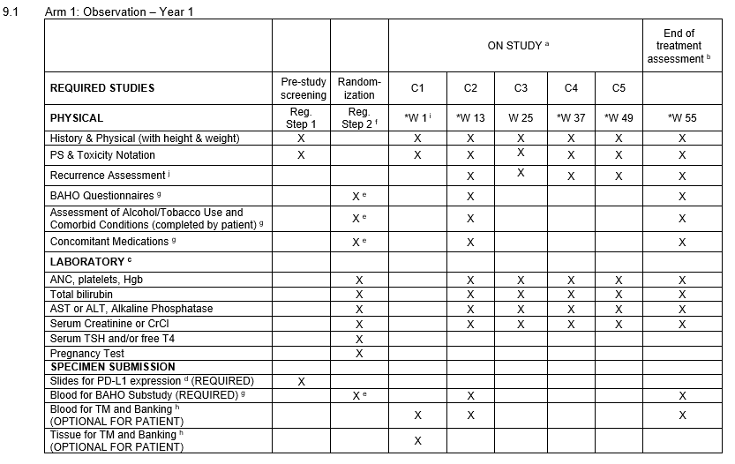
STUDY CALENDAR FOR OBSERVATION ARM

Slide 35
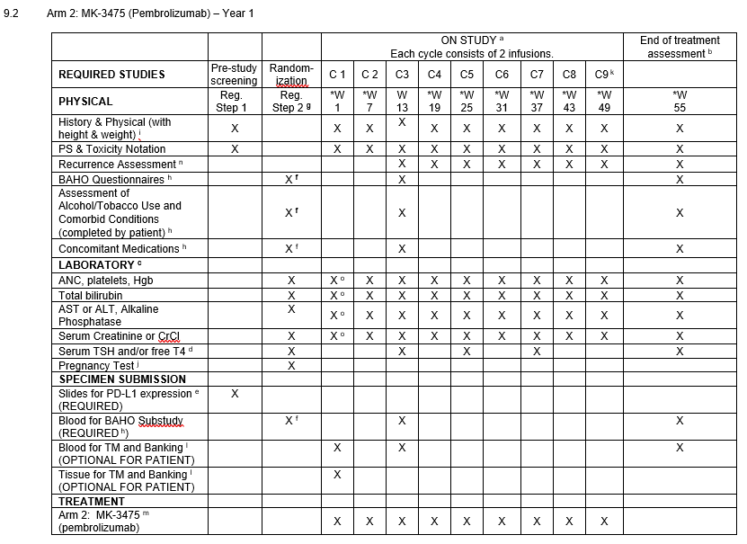
STUDY CALENDAR FOR PEMBROLIZUMAB ARM

Slide 36
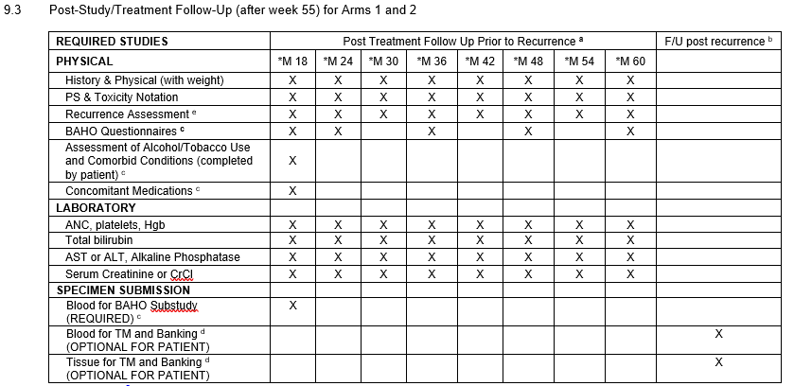
STUDY CALENDAR FOR FOLLOW-UP PERIOD

