Slide 1
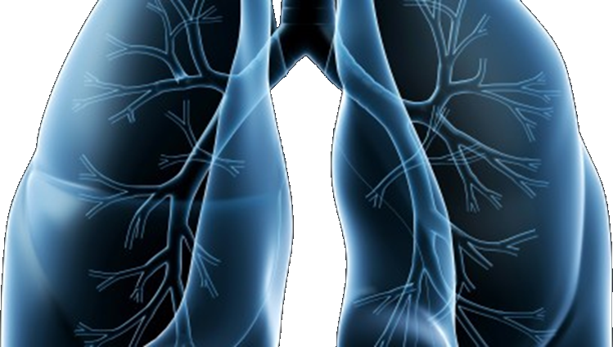
LUNG-MAP
Lung Master Protocol
(LUNGMAP)

Slide 2
Using FoundationOne CDx testing for LUNGMAP
Joel Neal MD PhD
LUNGMAP Study Co-Chair + FMI Liaison
LUNGMAP meeting, April 21, 2021

Slide 3
Using FoundationOne CDx testing for LUNGMAP
Protocol version 3/1/21 (anticipated release to sites Q2 2021) update to eligibility criteria:
Patients may either submit tissue for biomarker profiling (current state) OR submit previous commercial FoundationOne CDx test results.
If submitting commercial results:
Patients must have a FoundationOne CDx report available with the following information:
Results done on solid tumor tissue (liquid test not allowed)
Original report date on or after September 1,2019
FMI Test Order # (e.g. ORD-1234567)
Patients must consent to have their commercial FoundationOne CDx test results disclosed to SWOG
Note: PD-L1 testing will no longer be performed centrally
Commercial test results will be reanalyzed to use on LUNGMAP – turnaround still 16 days but probably less

Slide 4
Using FoundationOne CDx testing for LUNGMAP
For patients submitting commercial FoundationOne CDx results:
The request to reanalyze commercial FoundationOne CDx results must be submitted through STS (including generating a Packing List, which will be used as the request form by FMI) and source documentation must be uploaded in RAVE
When submitting the request through STS, be prepared to provide answers to the following questions.
Original collection date of the tissue used for commercial testing
Patient’s date of birth (mm/dd/yyyy)
Patient’s sex (Male, Female)
Has the patient had any type of transplant? (Yes, No)
Patient’s diagnosis (NSCLC)
Primary tumor site (Lung)
Specimen tumor site
ORD number from commercial FoundationOne CDx report (e.g. ORD-1234567)

Slide 5
Known Foundation CDx testing for LUNGMAP
Summary: Upcoming protocol amendment will allow prior Foundation CDx tumor (not liquid) results from Sept 1, 2019 or after to satisfy tissue requirement
The study chairs will continue to seek opportunities to expand to other testing platforms in the future.
Questions?

Slide 6
Consent Form Changes and Implementation
Jessica O’Donovan
Chair, LungMAP Site Coordinators Committee
VA Connecticut Healthcare System

Slide 7
Best Practices for Implementation/ Training
Review protocol changes
Specific Consent changes
Team Meetings
Might have to go over a couple of times
Prior to consenting reminders that there are changes
Flag everything that needs to be signed, especially areas that have been added
Remind the person if there have been items removed

Slide 8
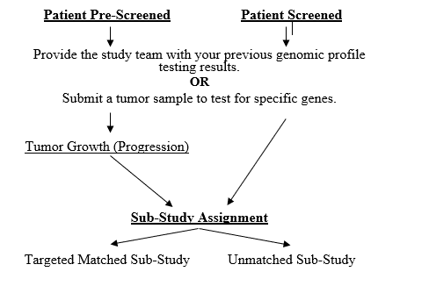
Major Changes
Previous commercial FoundationOne CDx results for sub-study assignment
Patient will have to consent to:
Release tissue for testing through the study
OR
Release previous results from FoundationOne CDx testing
When consenting make it clear which group the patient fits into:
Pre-Screening VS. Screening
Previous Results VS. Tissue Release

Slide 9
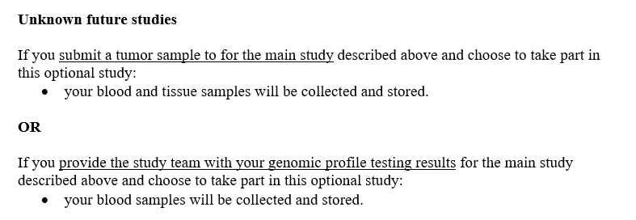
“OR” Statements

Slide 10
New Section under “What Exams, tests, and procedures are involved in this study?”
If you provide the study team with your previous genomic profile testing results, the information below applies to you.
Provide the study team with your genomic profile testing results from the FoundationOne CDx next generation sequencing test obtained commercially through your doctor.
If you had genomic profile testing, which was done as part of your cancer care, you will need to provide the results to SWOG Cancer Research Network. This is a test that you had done prior to consenting to this study. The genomic profile test results are required in order for you to take part in this study. The results of that test will determine which sub-study you will be offered.
If you submit a tumor sample to the study team, the information below applies to you.
Tumor Sample
Before you begin the study, a small piece of tumor sample, which was already removed by surgery or biopsy, will be sent to special laboratories for the study. This tumor sample is required in order for you to take part in this study because the research on the sample is an important part of the study. The result of this testing will determine which sub-study you will be offered.

Slide 11
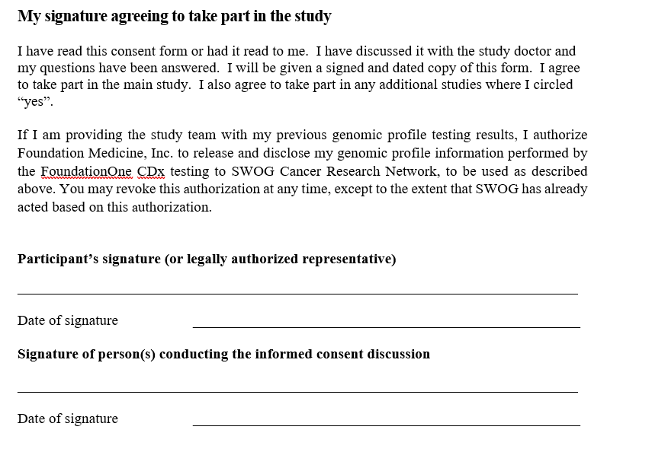
Major Change to Signature Page

Slide 12
Take Home
Know which group your patient falls into prior to consent
Prescreening VS Screening
Previous testing VS Tissue Sample being sent
Make sure you read the statements that correspond with the situation
MAKE SURE the patient knows that they are agreeing to either sending previous results OR the tissue NOT both
Review the new consent with all members of the team
Make sure all members are aware that we can send out previous results as of this update

Slide 13
How To: Request Re-analysis of Commercial FoundationOne CDx Results for Lung-MAP biomarker analysis and sub-study assignment
LUNGMAP Screening Protocol Revision #4
LOUISE HIGHLEYMAN, Lung-MAP Data Coordinator
SWOG Statistics and Data Management Center

Slide 14
Overview
Site follows steps in SWOG Specimen Tracking (STS) to request re-analysis of commercial FoundationOne CDx results
Site consents patient, confirms eligibility, and registers patient to LUNGMAP Step 1
SWOG SDMC receives file and alerts site of sub-study assignment (at progression)
FMI re-analyzes commercial data and sends data file to SWOG SDMC
SWOG SDMC alerts FMI to request
Site completes Rave form, uploading commercial report as documentation

Slide 15
OPEN Registration
Site consents patient, confirms eligibility, and registers patient to LUNGMAP Step 1
As part of eligibility, confirm commercial FoundationOne CDx report meets requirements
During LUNGMAP Step 1 Registration:
Answer auxiliary registration question regarding which approach will be used for biomarker profiling

Slide 16
SWOG Specimen Tracking System
Site follows steps in SWOG Specimen Tracking (STS) to request re-analysis of commercial FoundationOne CDx results
Complete STS steps exactly like you would for a specimen (log and “ship”), selecting “Request” for the specimen type

Slide 17
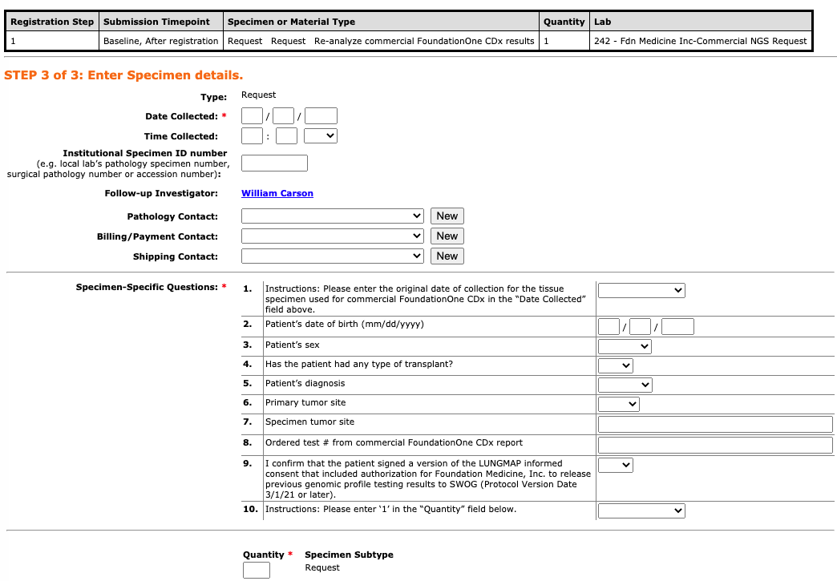
SWOG Specimen Tracking System
Site follows steps in SWOG Specimen Tracking (STS) to request re-analysis of commercial FoundationOne CDx results
Answer important questions that FMI will use to link the request to existing commercial results

Slide 18
SWOG Specimen Tracking System
Site follows steps in SWOG Specimen Tracking (STS) to request re-analysis of commercial FoundationOne CDx results
Once “Ship this Shipment and Generate Packing List” is selected, the request has been completed and sent to FMI
No need to physically mail or email anything

Slide 19
Commercial NGS Testing Form (Rave)
Site completes Rave form, uploading commercial report as documentation
Commercial NGS Testing folder will rollout in Rave based on registration question
Upload commercial FoundationOne CDx report to form
Source documentation only; upload does NOT request use of results for re-analysis and sub-study assignment

Slide 20
Receipt of Sub-study Assignment
SWOG SDMC receives file and alerts site of sub-study assignment (at progression)
Same process as tissue submissions
Email to site contacts
Added to Sub-study Assignment form in Rave
No PDF reports will be attached as these are shared via commercial process
Including any updates if they occur during re-analysis
Same timing as tissue submissions
Patients screened at progression: Sub-study assignment expected within 16 days after submission of request
Patients pre-screened prior to progression:
Confirmation email sent when results successfully transferred to SWOG
Sub-study assignment sent the next day after submission of Notice of Progression in Rave

Slide 21
Contact us!
Your friendly Lung-MAP Data Coordinators (Louise, Leah, and Amy) are here to help!
We would be happy to be on the phone with you while you go through this process for the first time
Better to ask questions ahead of time, rather than have to fix things after the fact (although we can usually help with that too)
Email: LungMAPquestion@crab.org
Phone: 206-652-2267

